Slide 1
Going beyond the algorithm: learning and libraries in a post digital age
David White – Head of Digital Learning
Teaching and Learning Exchange
@daveowhite

Slide 2
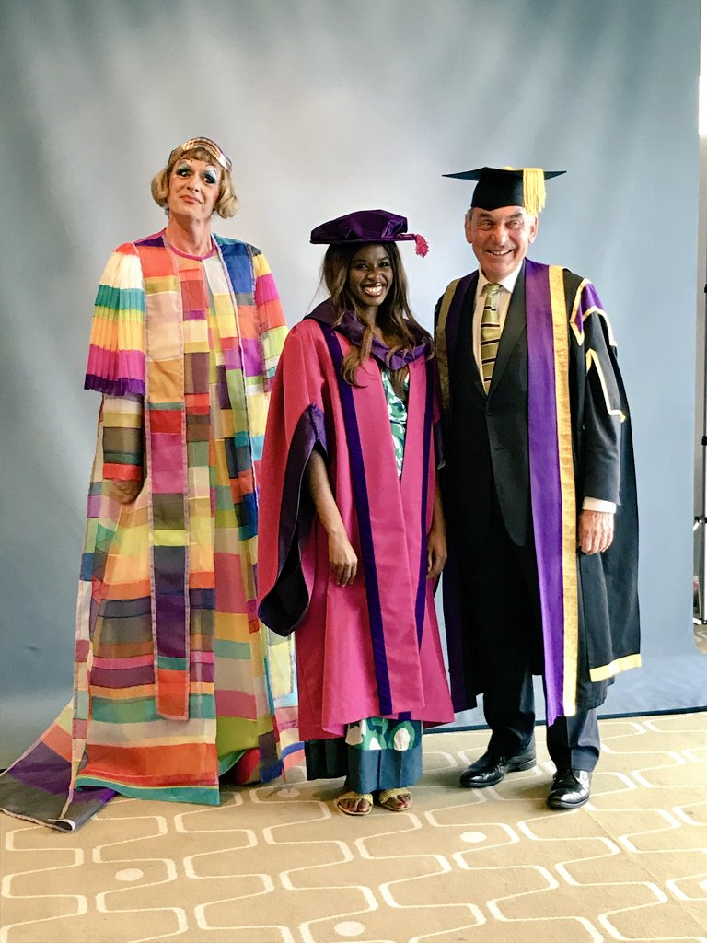
Notes:
June Sarpong

Slide 3
“I knew the Internet wouldn’t give me a wrong answer”
Visitors & Residents project – Oxford, OCLC, Jisc.

Slide 4
Notes:
Basically ok because you are asking the question in Web search. – all sorts of info – Google Search does not contain content – if we really care about ‘quality’ then we should be pushing open access.

Slide 5
“think less – find more”
Notes:
Perhaps is works so well you don’t need to think? Cognitive surplus…?
That’s what digital tech tends to do.

Slide 7
“think less – get told more”

Slide 8
Post-Digital
http://daveowhite.com/post-digital-revisited/

Slide 9
Richard Hall
Dave Cormier
Lawrie Phipps
Mark Childs
Ian Truelove
http://daveowhite.com/post-digital-revisited/

Slide 10
The speed of the change, however, has left us with the mistaken belief that social change was somehow 'created' by the digital rather than simply played out on a the canvas of the digital; that the digital itself is the main driver of change. We would argue the opposite. This ontological error has had us move towards placing technology at the forefront (think e-learning as distance learning) and moving our focus away from the people involved in these processes; the needs that they have and the skills that they bring.
Preparing for the postdigital era - June 17th, 2009

Slide 11
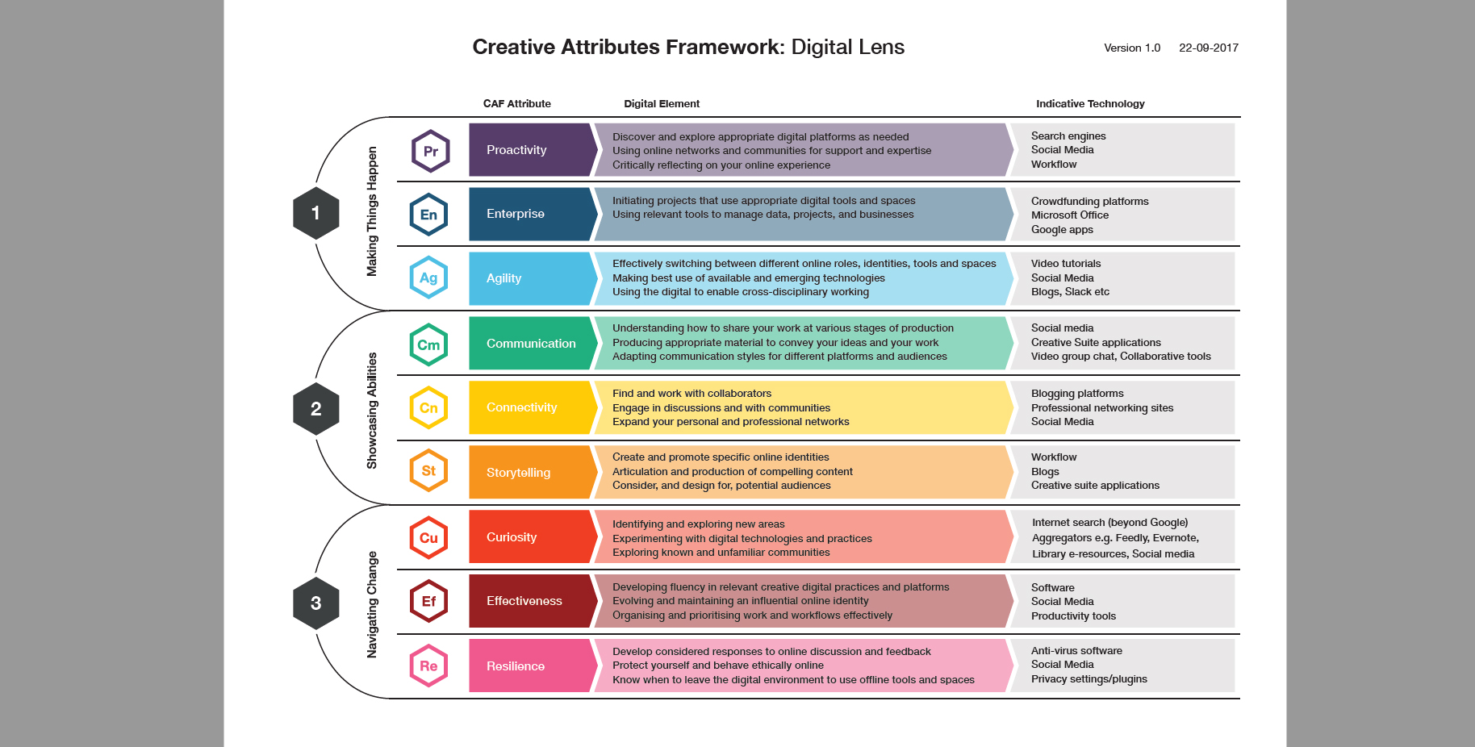

Slide 12
Curiosity
Identifying and exploring new areas of enquiry
Experimenting and critically engaging with digital tools, spaces and practices
Exploring known and new communities
Connectivity
Using digital tools and spaces to connect to and work with collaborators
Engaging in discussions with and contributing to communities
Growing your personal and professional networks

Slide 13
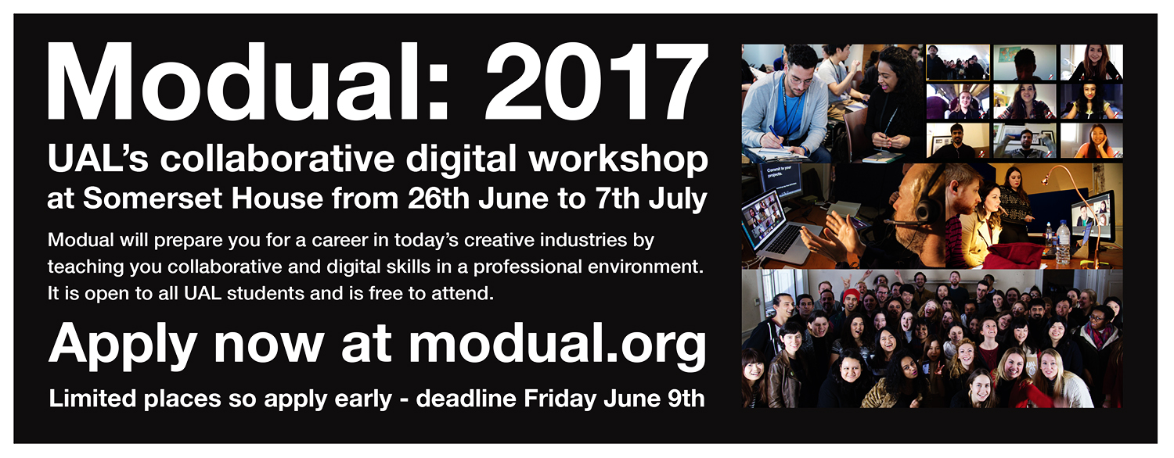
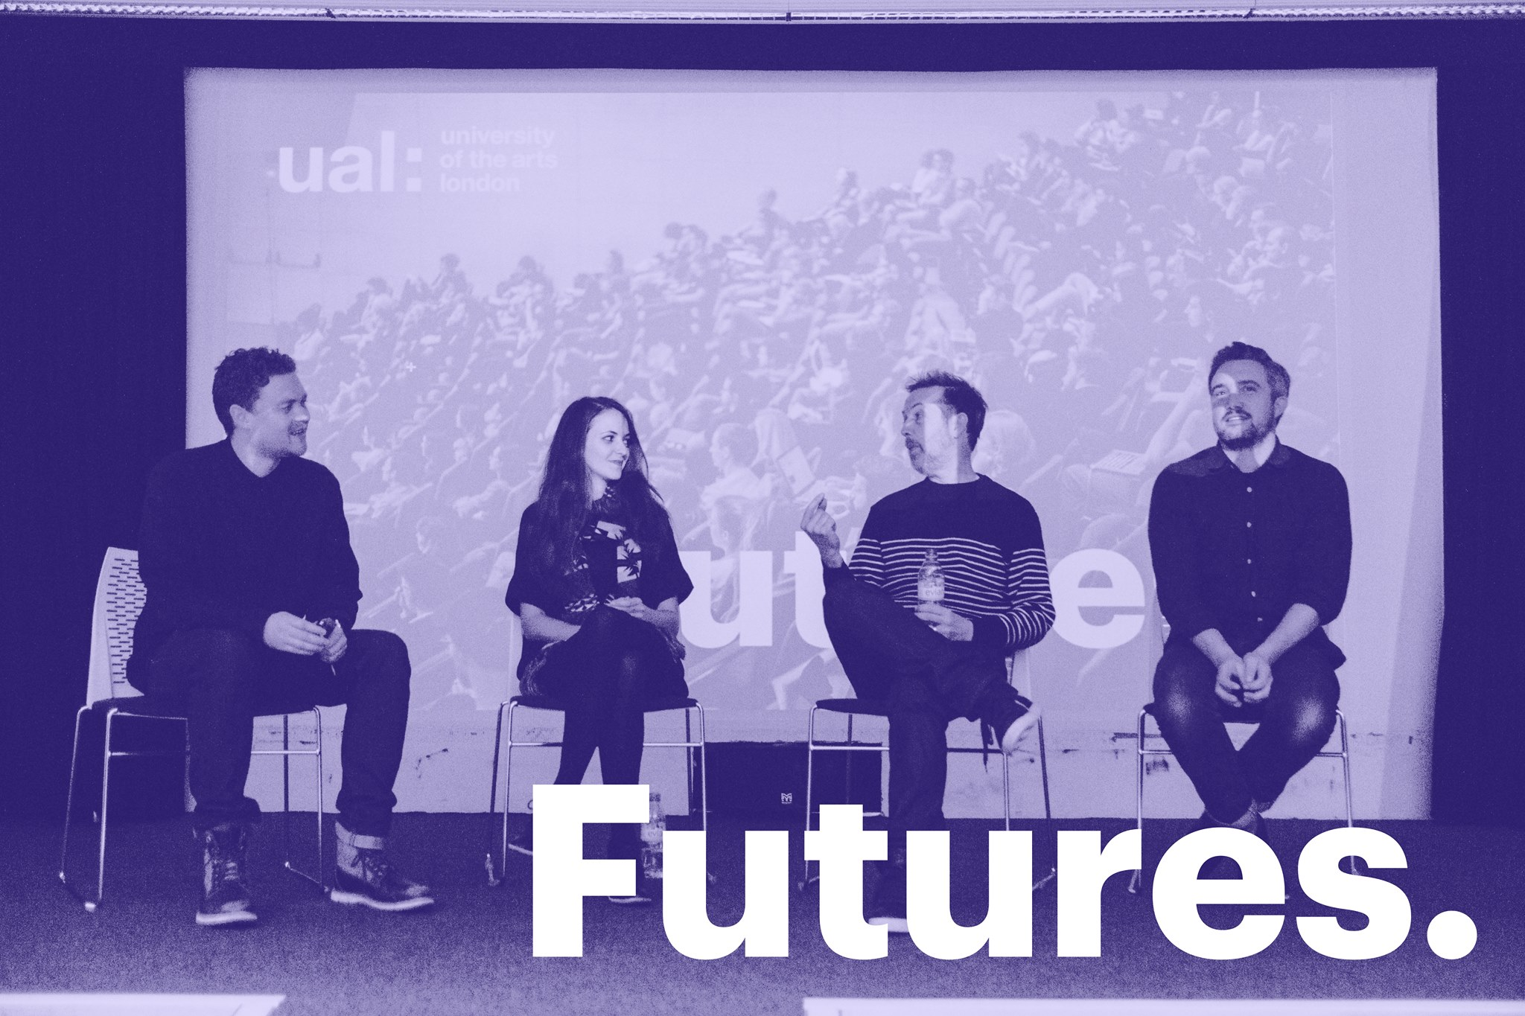

Slide 14
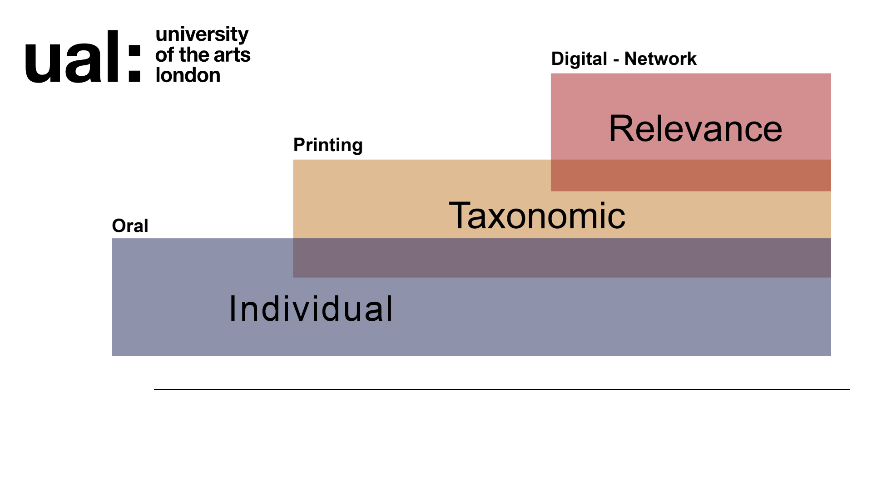
Notes:
Truthiness fuels by the way relevance works in digital networks or SM.
Search + SM = based on relevance. Where is the balance between you deciding on what’s relevant and the platform deciding?
Physical as in being in the same location as the ‘teller’ – information embodied in the teller
Taxonomical as in once content becomes physically embodied you need to order it – it becomes spatial
Relevance – one information ceases to be physical you need to be able to either recreate the taxonomy ‘site map’ or have a decent search
Need expertise in understanding the shape of a discipline to find an answer…
Algorithm skips taxonomy – algorithm is doing the research.

Slide 15
Disintermediation of
institutions
Notes:
Disintermediated because of relevance but also because
connects people and negates geography
Strange combination of oral and literary modes
ANYONE CAN PUBLISH.
Wikipedia dintermediates traditional publishers and ‘in content terms’ libraries.

Slide 16
The library
as
institution

Slide 17
The library is a cultural signifier of truth
Notes:
Not truthiness – although you can use the library to support that approach
The problem is what ‘library’ represents.

Slide 18
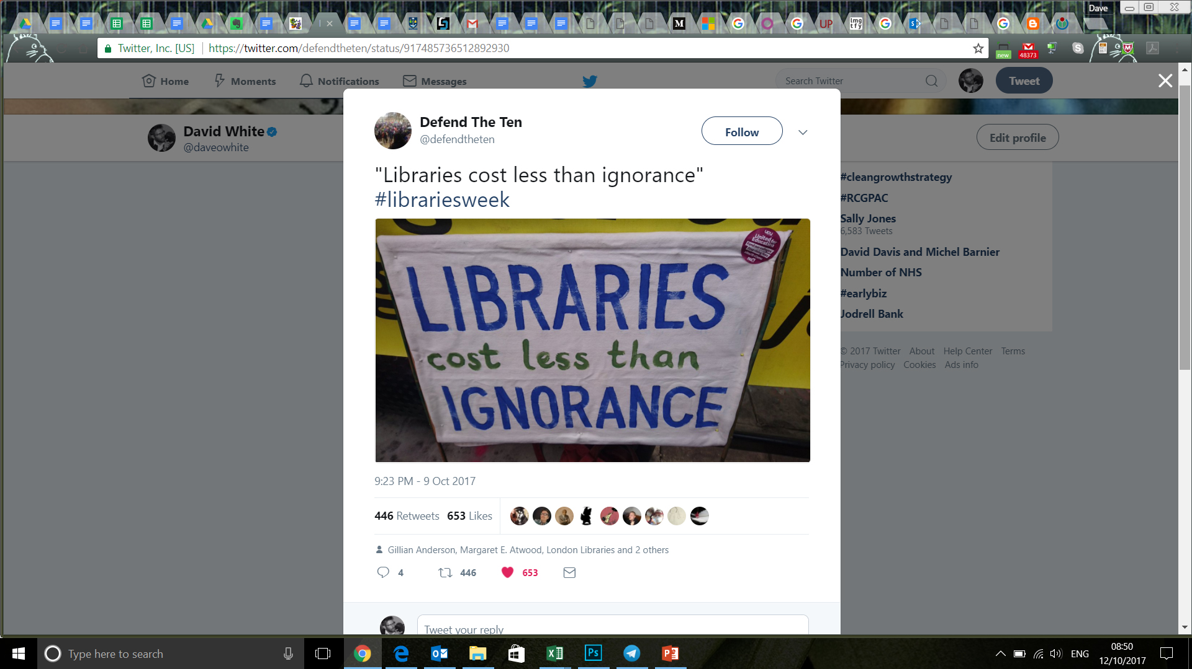
Notes:
‘The Library’ is still a building or a room.

Slide 19
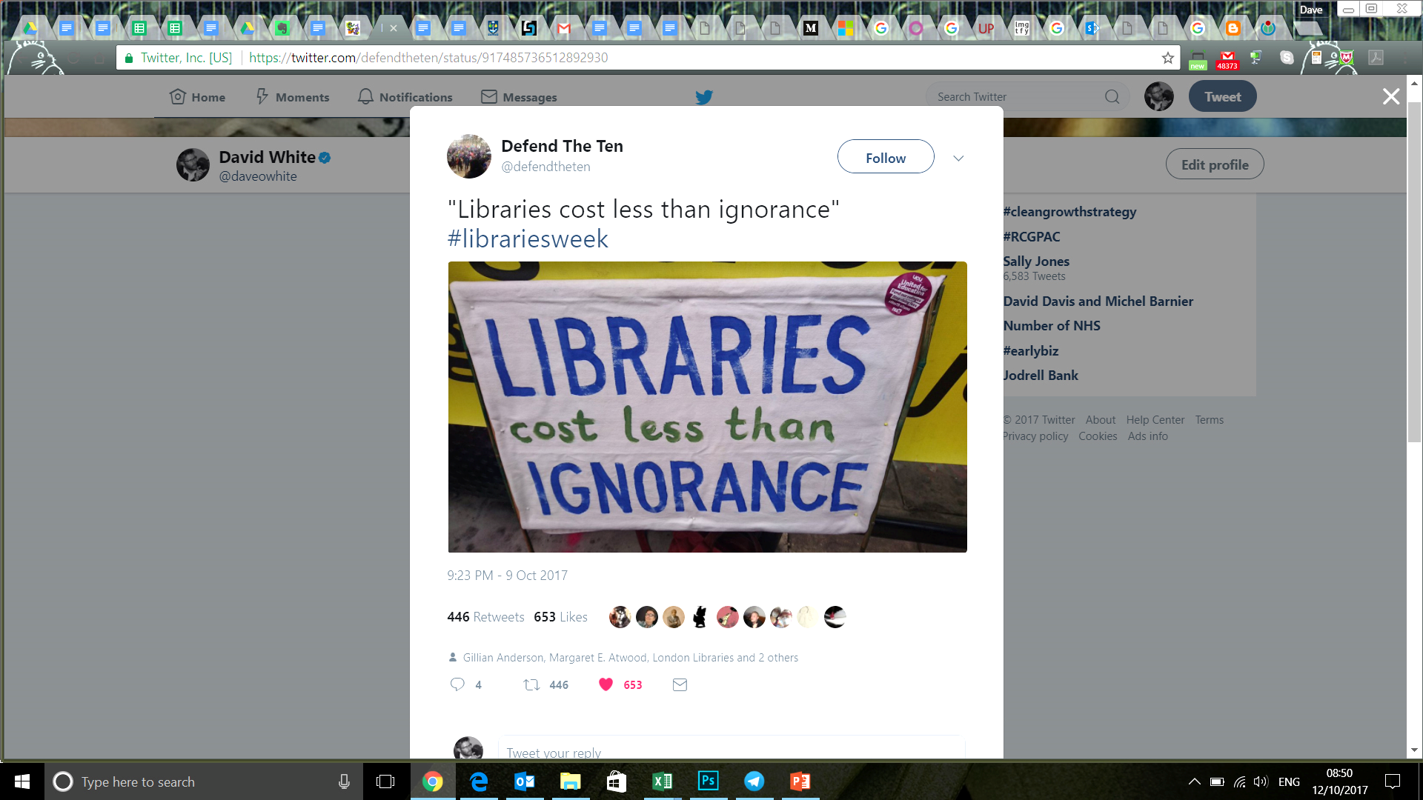
LIBRARIANS

Slide 20
The library as a cultural signifier of expertise in seeking truth
Notes:
Beyond the content that the library ‘owns’.

Slide 21
“Truth and Method”
Hans-Georg Gadamer - 1960
Notes:
Scientific method applied to social sciences vs discovering the original intended meaning from the author.
Scale and numbers vs interviews.
Gadamer argued that people have a 'historically effected consciousness' (wirkungsgeschichtliches Bewußtsein) and that they are embedded in the particular history and culture that shaped them.

Slide 22
Data
Notes:
Talk about the provocation.

Slide 23
Data as a priori knowledge
Notes:
A priori knowledge or justification is independent of experience, as with mathematics (3 + 2 = 5), tautologies ("All bachelors are unmarried"), and deduction from pure reason (e.g., ontological proofs).^{[3]}
As opposed to: A posteriori knowledge or justification depends on experience or empirical evidence, as with most aspects of science and personal knowledge.

Slide 24
Algorithm (code) as a posteriori knowledge
Notes:
A priori knowledge or justification is independent of experience, as with mathematics (3 + 2 = 5), tautologies ("All bachelors are unmarried"), and deduction from pure reason (e.g., ontological proofs).[3]
As opposed to: A posteriori knowledge or justification depends on experience or empirical evidence, as with most aspects of science and personal knowledge.

Slide 25
Data and code as ideology
Notes:
A priori knowledge or justification is independent of experience, as with mathematics (3 + 2 = 5), tautologies ("All bachelors are unmarried"), and deduction from pure reason (e.g., ontological proofs).^{[3]}
As opposed to: A posteriori knowledge or justification depends on experience or empirical evidence, as with most aspects of science and personal knowledge.

Slide 26
“The need for the discovery of expertise as well as content”
Library and Academic Support ‘provocation’
Notes:
Talk about the provocation.

Slide 27
Making expertise visible?
Notes:
Usually about connecting with a person – although when you search you are engaging with the expertise embodied in that code – it’s all people.

Slide 28
Forms of presence
Notes:
This is our problem, not the student’s. This was a school level student.

Slide 29
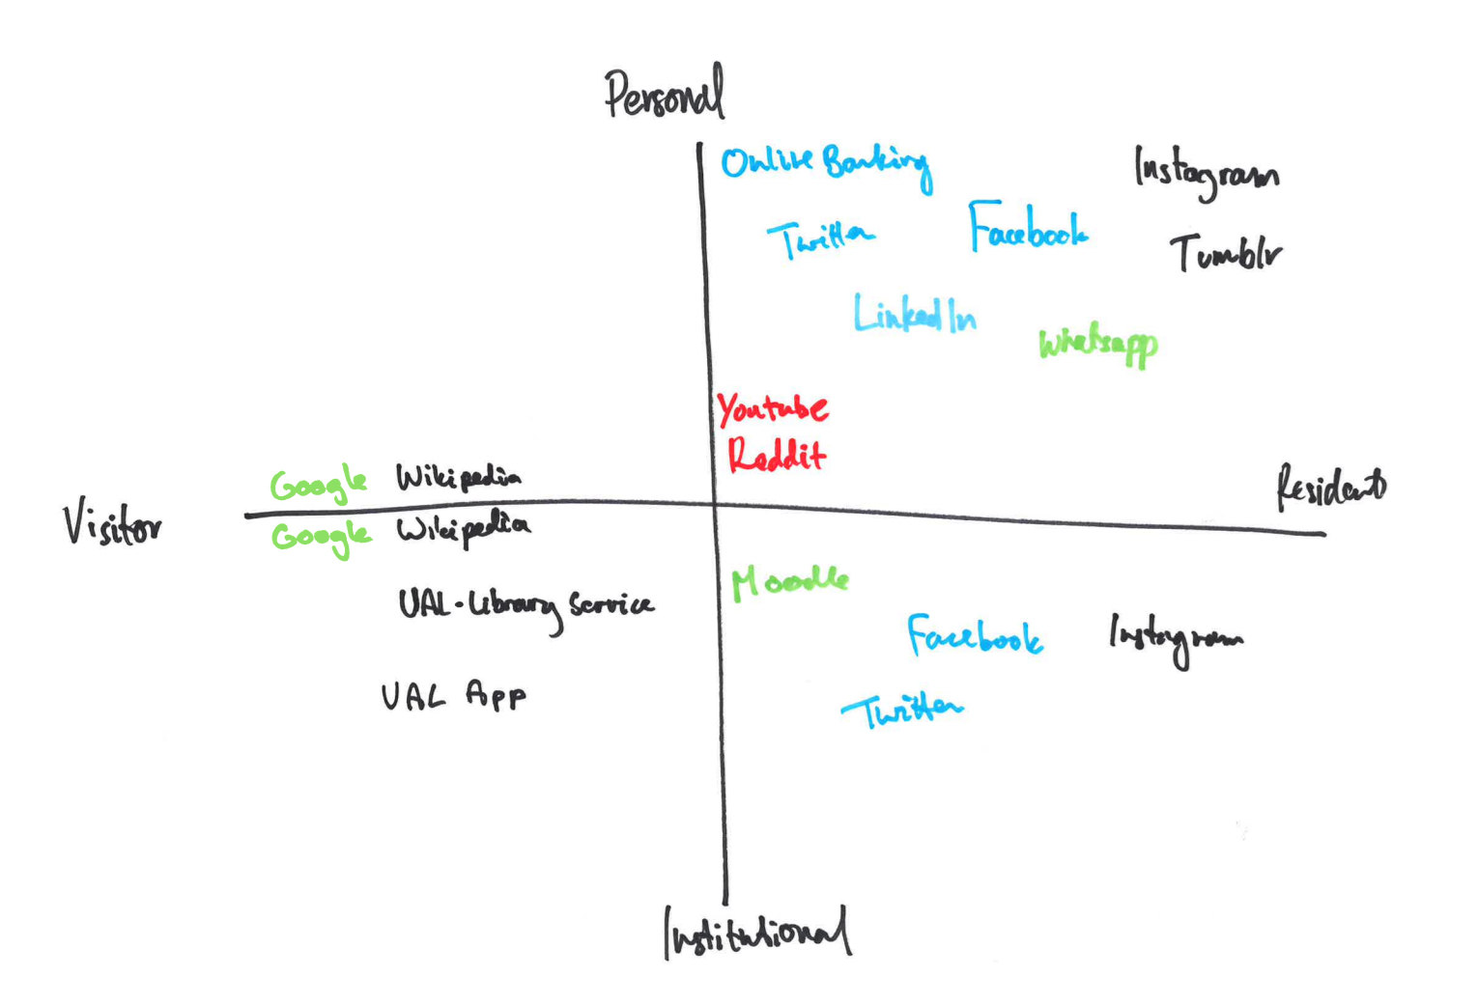

Slide 30
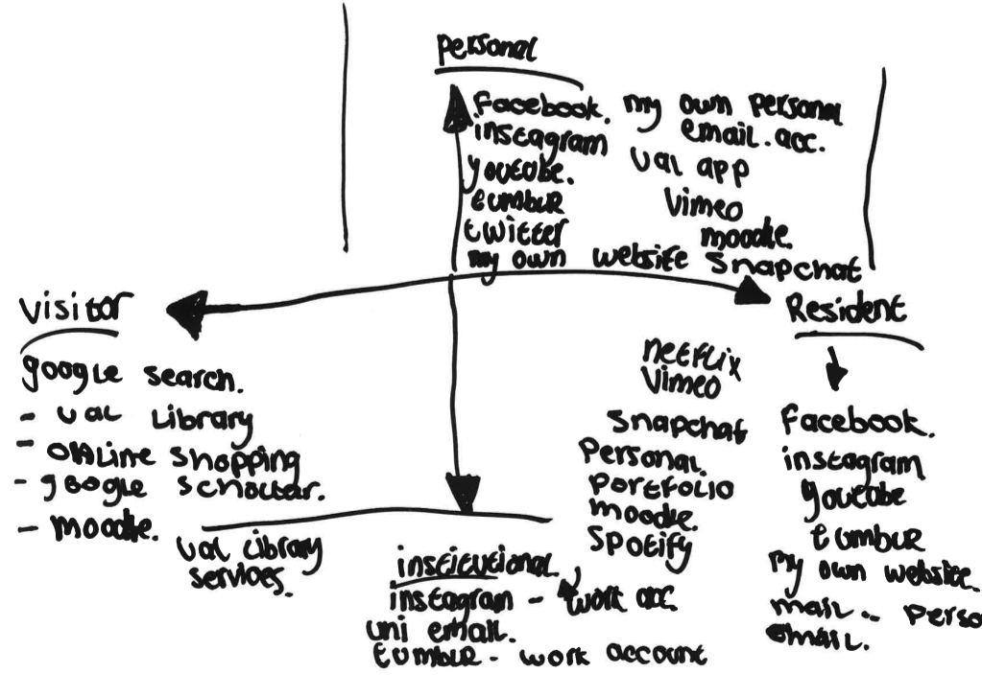

Slide 31
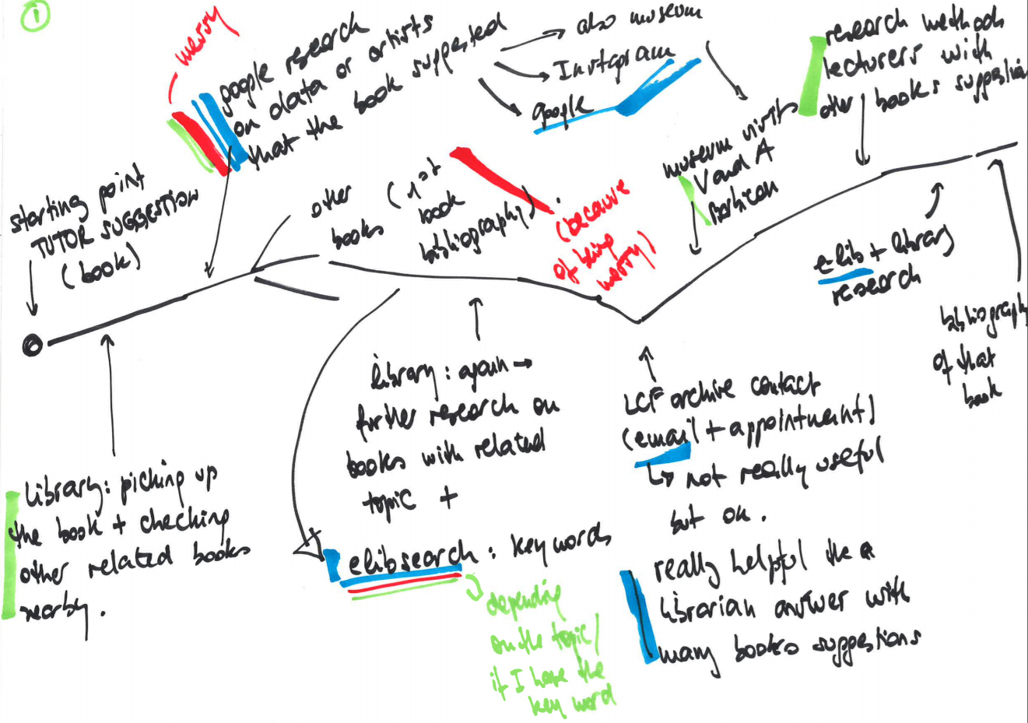
Notes:
Jess Crilly

Slide 32
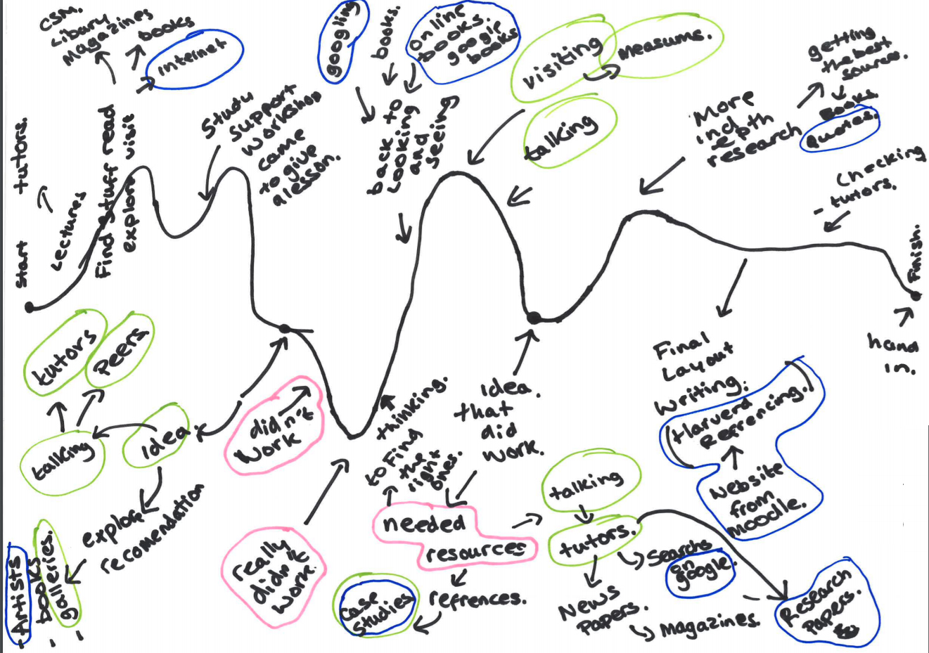

Slide 33
Inspiration and ‘stuckness’

Slide 34
“..discussion revealed that students were sometimes not clear on what librarians did or didn’t know – so what was appropriate to ask?”
Notes:
This is our problem, not the student’s. This was a school level student.

Slide 35
Experts in evaluation, navigation and curation
Notes:
This is our problem, not the student’s. This was a school level student.

Slide 36
Thanks
@daveowhite
daveowhite.com
Teaching and Learning Exchange, UAL

