Slide 1
Evolving technologies in online information literacy provision: the experience of developing LIST Online at MU
LIR Annual Seminar 2017: Cultivating Libraries in a Post Digital Learning Ecosystem
24 November 2017
Áine Carey, Teaching & Learning Librarian, MU Library

Slide 2
February 2016: LIST Online project begins
September 2016: 9 tutorials completed
September 2017: launch of new LIST f2f programme
Notes:
Good afternoon everyone.
In February 2016, our LIST Online project at Maynooth University Library began with the aim of creating 4 online tutorials by the start of the 2016/2017 academic year
By September 2016, we had completed and launched 11 tutorials
During the following academic year, we revised our long-established LIST face-to-face sessions, and launched a new programme in September 2017.

Slide 3
Linking LIST and LIST Online
Why we need see face-to-face and online learning as both part of the same process and complementary to each other
Our experiences of the changes – wins, challenges and where we are now
Lessons learnt and where to next?
Notes:
About this time last year, I spoke about LIST Online and how the project had gone, at CONUL; and last week, my colleague Carole Connolly was here in this room at this year’s CONUL seminar explaining about our changed LIST programme and what we’ve learnt so far.
Today I want to consider the 2 projects together;

Slide 4
Rationale for LIST Online
How do we maximise our resources? How do we reach students at their point-of-need?
Changing undergraduate curriculum: ‘Maynooth Education’ focused on critical skills
Rapid expansion in student numbers: more than 11,000 students and 800 staff from more than 20 countries
A national leader in university participation – 22% of student base are access students
Other aspects of student demographic: mature students, distance learners, out-of-hours teaching
Notes:
Rapid expansion in student numbers – this has been a sustained and rapid expansion – between 05/06 and 11/12, the student population grew by 36% but from 11/12 to date, it has grown by nearly 30%
In this context how do we both maximise our resources and do everything we can to meet students at their point of need?
In the last 2 academic years, the undergraduate curriculum has changed, particularly looking at the provision of critical skills, enabling higher-level skills, ensure that the information literate graduate can transfer these skills into further study, the work place or their personal and social world.
Maynooth University is the national leader in university participation with highest proportions among universities in Ireland of Access students (22%), referring to under-represented groups at 3rd level. These students require additional or different supports
And finally, more changes to the student demographic with additional numbers of mature students, distance learners and those attending classes and courses outside mainstream hours – all of whom need to be catered for in the provision of IL skills.

Slide 5
What did we decide to do?
Create online tutorials that were easy-to-use and widely accessible
Defined time frame: Feb – August 2016
Small team, specified software, teaching fellowship
Notes:
The plan was to create online tutorials that were easy to use and widely accessible.
We had defined – and short! – timeframe of 6 months until they went live.
A small team worked on the project – myself, working half-time on the project and a library assistant allocating a proportion of her time, as was possible. The software had been chosen before I started – Articulate Storyline – and there were particular outcomes required from the project, as it was funded to an extent by a University teaching fellowship.
And let me show you – fingers crossed this works! – the end result. 11 tutorials, though not all were created with Storyline – very visual site, easily accessible, further descriptions by scrolling over it. Let’s look …

Slide 6
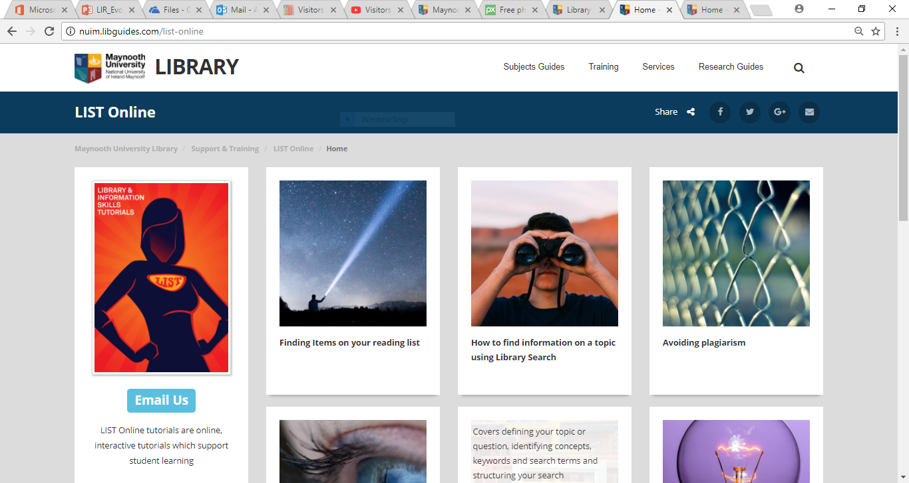

Slide 7
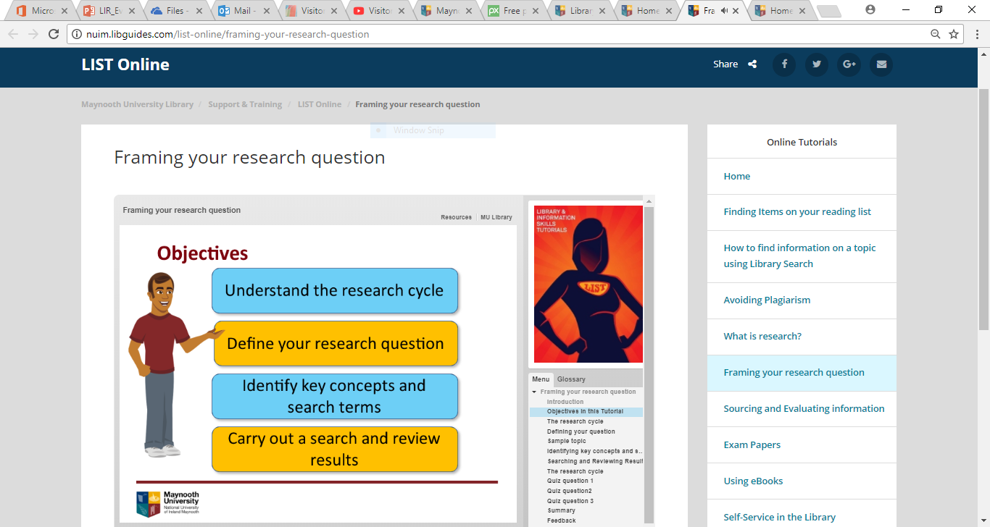

Slide 8
LIST Face-to-Face
Established in 2004
Includes library & information topics and other support services
30 minute drop-in sessions held in the Library
1300 approx. attended 2016/17

Slide 9
Behind LIST face-to-face changes
Change from a Subject Librarian model to a Functional model
Significant staff changes – retirements, new staff, new roles: an opportunity to look at LIST
Mapping our Information Literacy Framework to our teaching programme
Creation of LIST Online: change in face-to-face content

Slide 10
New approach
LIST Welcome
LIST Learning
Introductory
Focus on new students
Core skills for first weeks
Putting the library in context
Welcoming – where do they fit in?
Finding items on your reading list
New students – all you need to know about uni
Successful searching – is it not all on Google?
Greater depth
Practical, workshop approach
Point-of-need: link with assignments
Engaging with IL skills
45 minute sessions
Fake news: how not to get fooled?
Skills for better assignments
Referencing & avoiding plagiarism
Using Endnote and other referencing tools

Slide 11
NEW!
LIST
LIST Online
A great success!

Slide 12
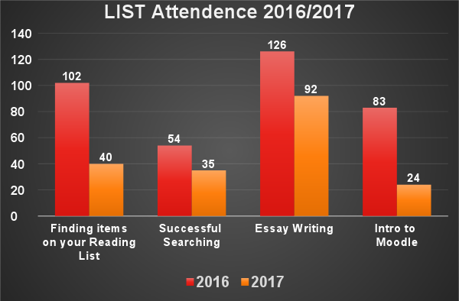
What’s actually happened …
LIST attendance down across all sessions
Why?
‘Overwhelmed’ students
Coming to the library for help – but not always the classes
Survey of students indicates students feel ‘too busy’ to come and aren’t aware of the classes

Slide 13
On the other hand …
Feedback from those who attended the sessions very positive – 97% rated the classes as ‘very good’ or ‘good’
Additional comments also very positive
Strong follow up by attendees with other library services, classes and resources
High level of endorsement by the academic departments – the classes make a difference to the students’ ability to address and complete assignments

Slide 14
Are they all using LIST Online?

Slide 15
On the other hand (again)…
Overwhelmingly positive response to LIST Online – staff and students
Mature students, access students, worried students – a lot of relief when shown LIST Online
Lecturers including on their Moodle page and recommending to students
Some lecturers incorporating completion of LIST Online tutorials as part of assignments

Slide 16
Where does this leave us?
Positive reception to both online and class material
Mapped to IL Framework and Critical Skills / Graduate attributes
LIST Online a source of support to exactly the cohort of students we need to reach
Doing this work has brought our own thinking and planning further along – sometimes you have to do it first
Notes:
Where does this leave us now? At a point where we are looking for the key to unlock greater experiential learning, support graduate attributes, critical thinking, lifelong learning? Where we seek to move away from merely instructional activities in our libraries, and seek to create engaged learning?
We are in a process of growing and developing our online and class activities, and we don’t have definitive answers but we have some ideas and opportunities for reflection
Firstly, we have got a positive reception across the board to our online material and our class development. Students react really well and feel supported by both. Lecturers are really enthusiastic and affirm that ‘these are exactly the type of skills that students need for their assignments’.
What we are doing is important because it maps our teaching supports to our Information Literacy Framework and to the University’s graduate attributes and Critical Skilsl programme. This is really important if libraries are to be effective at a strategic level – we need to align with the university’s direction.
Consistently, students who need additional support or support outside core hours respond really well to knowing LIST Online exists, what is covers, that it is available easily to them 24/7. While offering reassurance is not the only purpose, building trust with our users does matter – we are there for them.
When I spoke a year ago, shortly after the completion of LIST Online, I talked about not having lots of time at the start to plan – because of the tight deadline. Sometimes, I concluded that is the right thing – because you can actually only plan what to do when you are doing it – and you have to accept change as part of the design process. I think that remains true now – in order to get further along the path of understanding how to develop online content, and revised face-to-face content, you have to do it, reflect and evaluate and then evolve.
Staying as we were wasn’t an option – as we knew we weren’t meeting the needs of our students.

Slide 17
Suggestions for the way ahead
Online is often presented as an alternative to face-to-face
Need to be complementary and context-focused
Online content – Articulate is effective but hard to change quickly. Responsive, easy- to-use and -change solutions needed (Screencast-o-matic working well)
http://bit.ly/2mXjl9L
Face-to-face – retain approach and content but look at different options: delaying start date, promoting differently, offering other options like clinics, lunchtime sessions and roving staff to trouble-shoot
Being aware what we can control / effect – assessment, orientation, student schedules

Slide 18
See our work: http://nuim.libguides.com/list http://nuim.libguides.com/list-online Contact: aine.carey@mu.ie

