Slide 1
Thinking the unthinkable:
a library without a catalogue
Dorinne Raaimakers
LIR Annual Seminar
30 March 2015

Slide 2
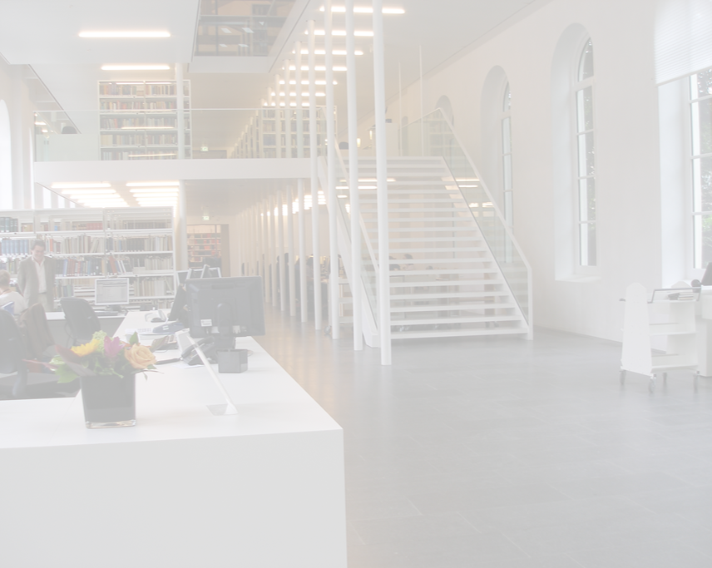
University libraries have lost their role in the discovery of scientific information
They better focus on delivery
University libraries have lost their role in the discovery of scientific information.
They better focus on delivery.

Slide 3
Why do we focus on delivery?
Which steps did we take?
How did our users respond?
What’s next?

Slide 4
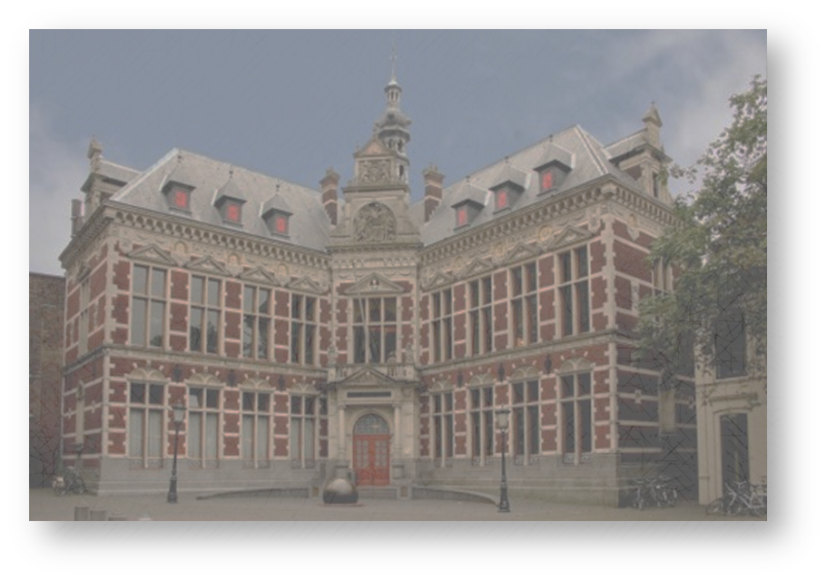
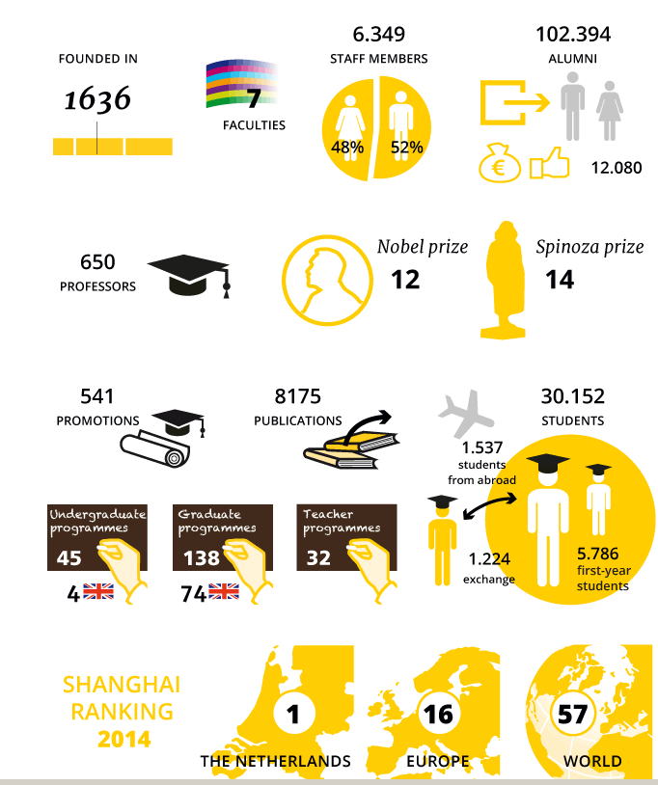

Slide 5
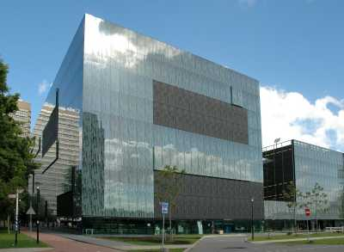
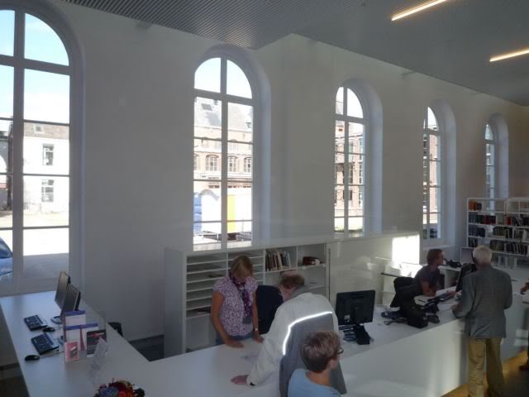
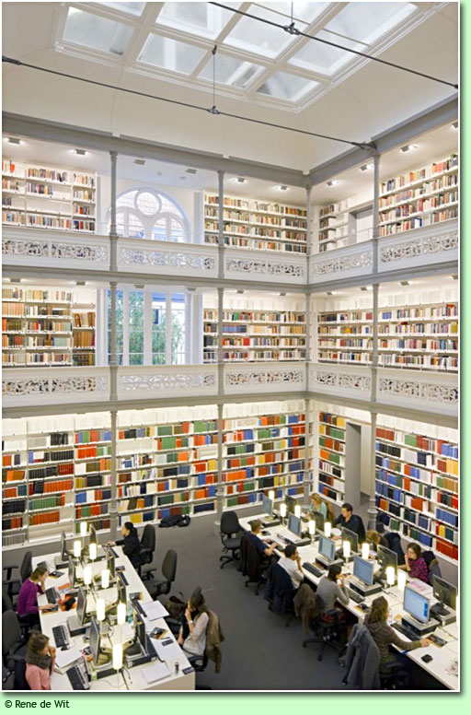
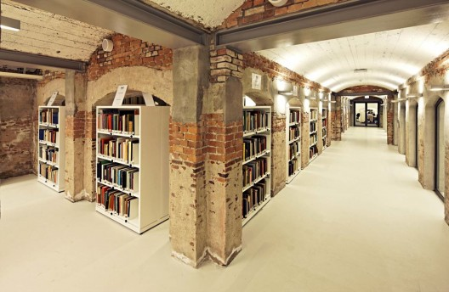
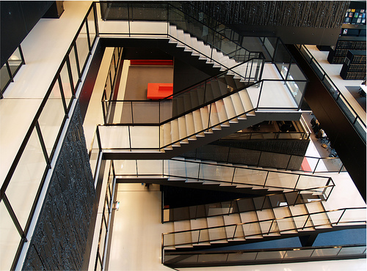
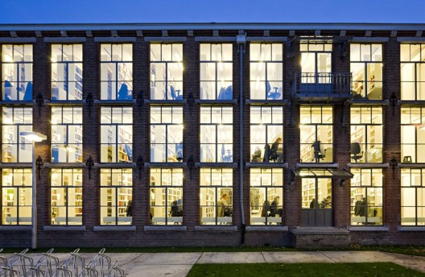
Two main locations
City Centre
Uithof

Slide 6
Homepage website Utrecht University Library, 2012

Slide 7
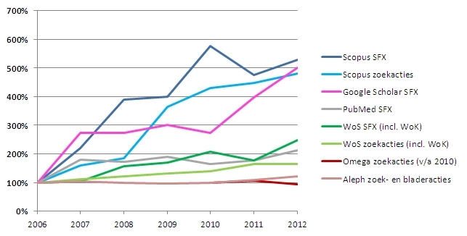
Trends search behaviour Utrecht University
relative increase / decrease in use

Slide 8
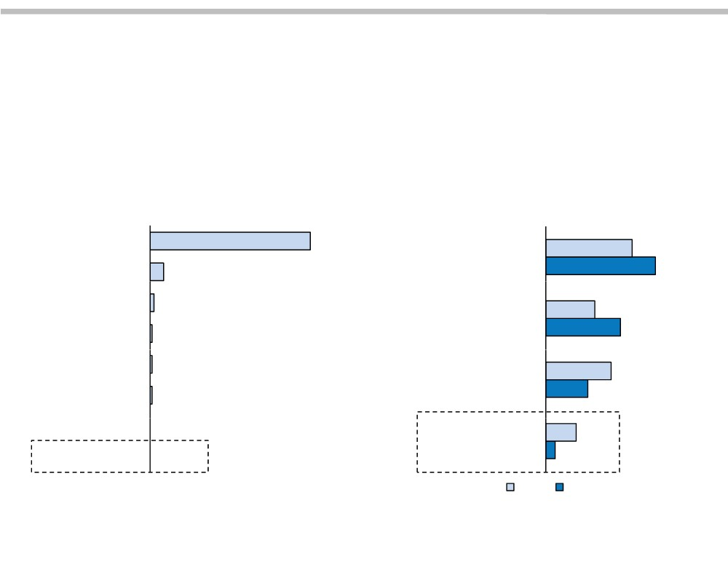
Patrons Switching Faster Than Libraries
Faculty and Students Already Looking Elsewhere for Search Help
Where Do Students Start a Search? Where Do Faculty Start Their Research?
n = 2,229 n = 3,025
Search Engine 83%
A specific electronic research resource
37%
Wikipedia
7%
47%
Social Networking Site E‐mail
2%
A general purpose search engine
21%
1%
32%
E‐mail Subscription Online Database
1%
Your online library catalog
28%
1%
18%
Ask an Expert Site Library Website
0%
13%
The library building
4%
0%
2003
2009
© 2011 The Advisory Board Company • www.educationadvisoryboard.com • 22852D
Source: “Faculty Study 2009: Key Strategic Insights for Libraries, Publishers,
and Societies” Ithaka S+R; “Perceptions of Libraries, 2010,” OCLC.

Slide 9
?
?

Slide 10
Conclusions in 2012
No need for a new library discovery tool
Phase out Omega on Sept. 1st 2013
Hold on to WebOPAC for the time being
Rethink the role of the library in providing access to scientific information

Slide 11
User survey
group interviews with students & scholars
What do they search for?
full-text articles (known item search)
subject-specific information
books
Where do they search?
Google Scholar
paid search engines
library catalogue

Slide 12
User survey
group interviews with students & scholars
One search engine to
find everything...
For me, that’s Google Scholar!

Slide 13
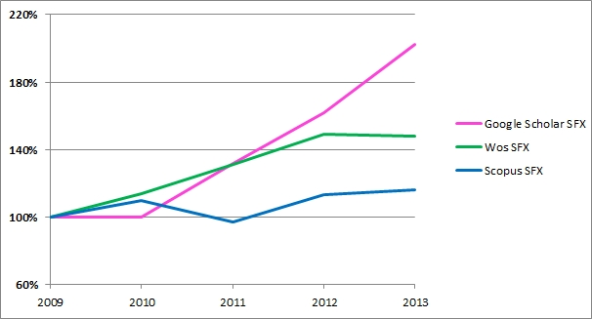
Trends search behaviour Utrecht University
relative increase / decrease in use

Slide 14
Library website

Slide 15
- Communication
- Changes in library website
- Changes in instructions & support

Slide 16
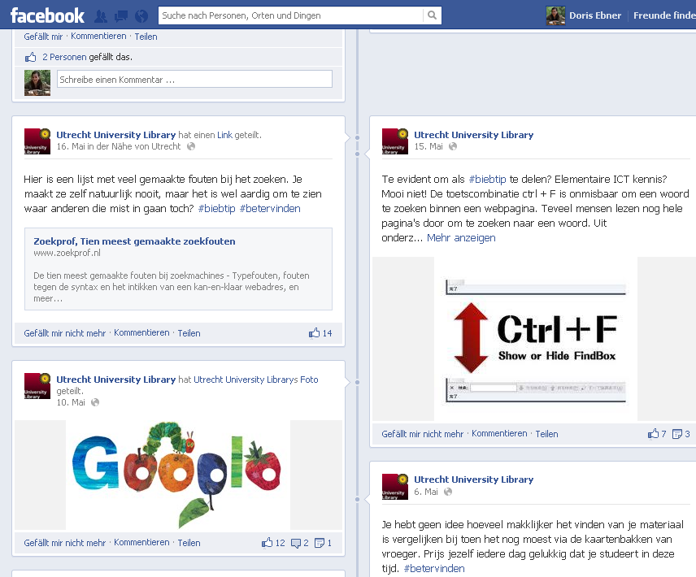
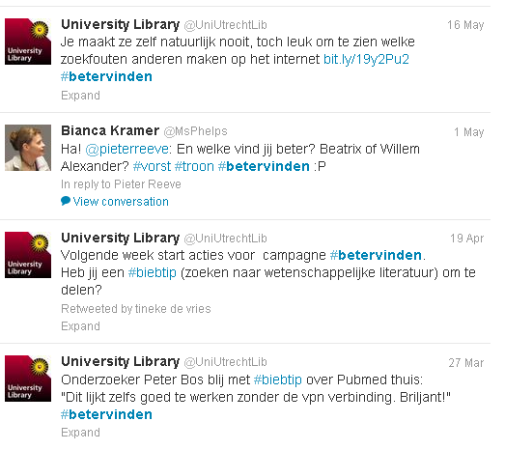
#biebtip #betervinden

Slide 17
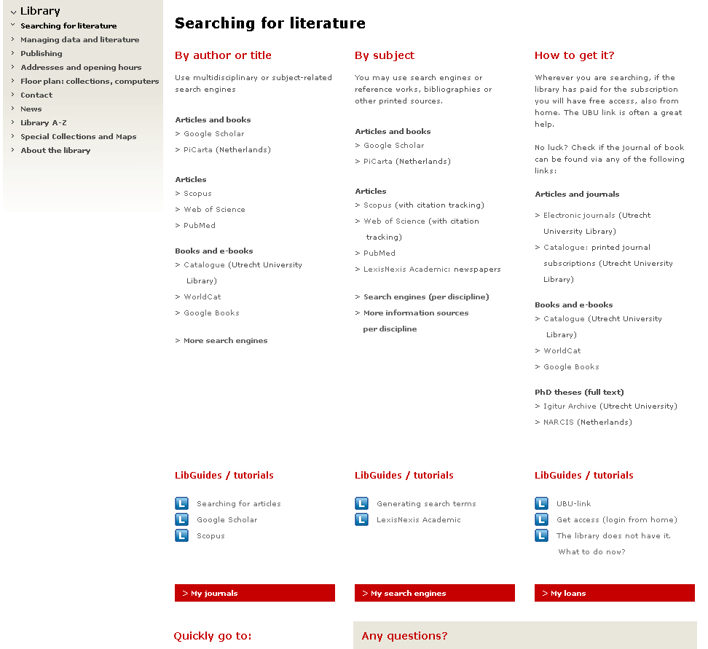

Slide 18
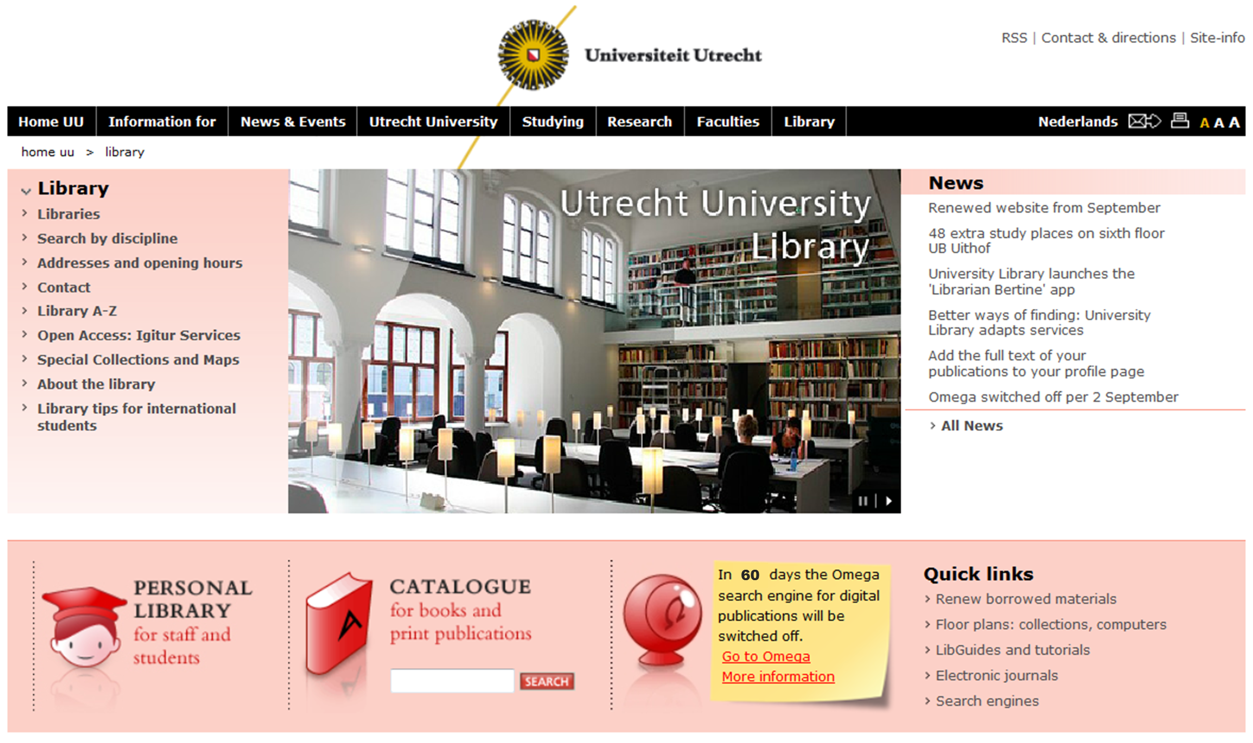

Slide 19
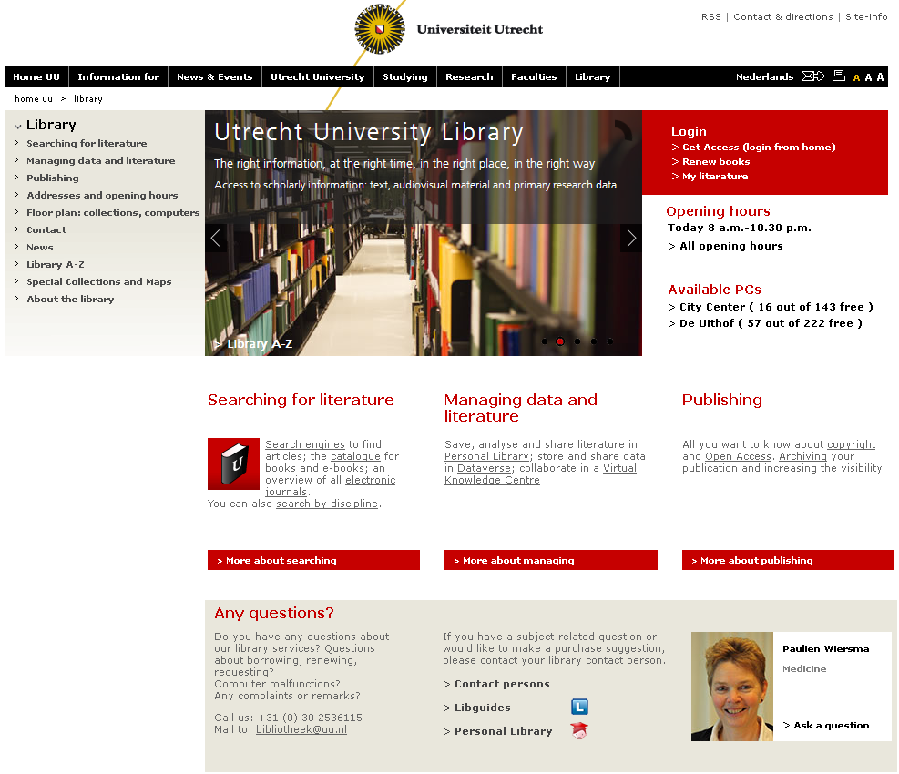

Slide 20
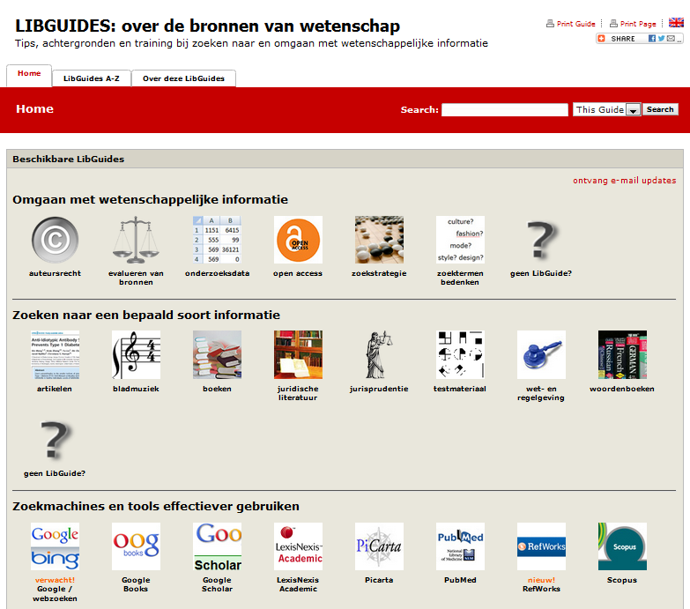

Slide 21
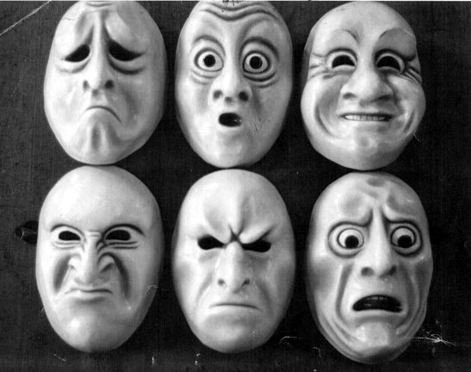

Slide 22
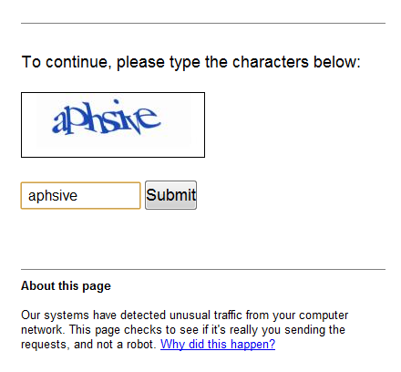
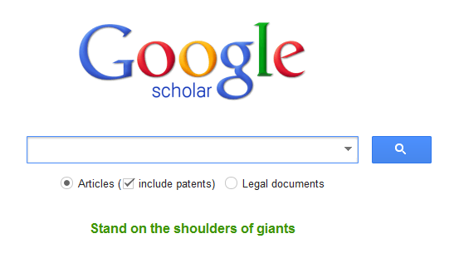

Slide 23
Wherever you’re searching,
we’ll make sure you get it!

Slide 24
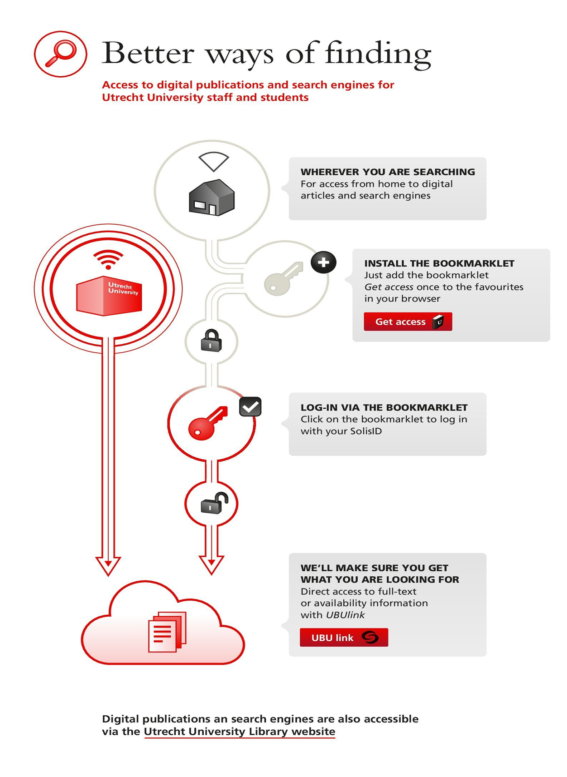
Add holding information to discovery tools
Offer our SFX knowledge base to Google Scholar and Scopus
Open up our repository for harvesting
Supply easy authentication for off campus users

Slide 26
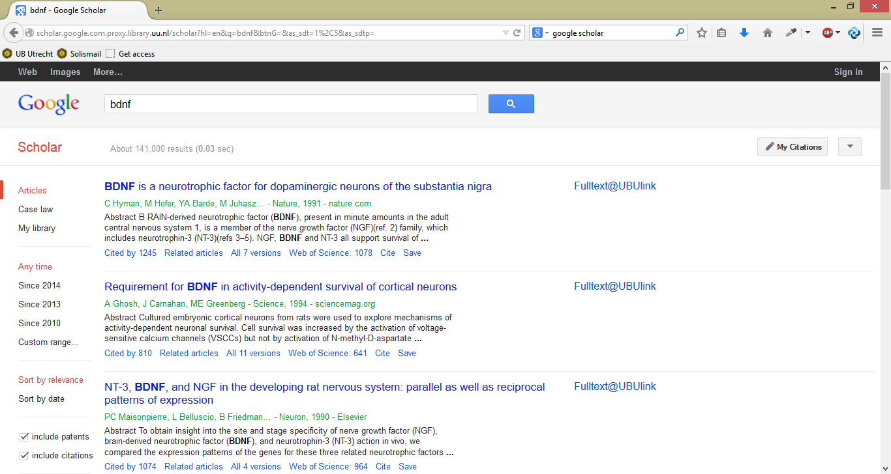

Slide 27
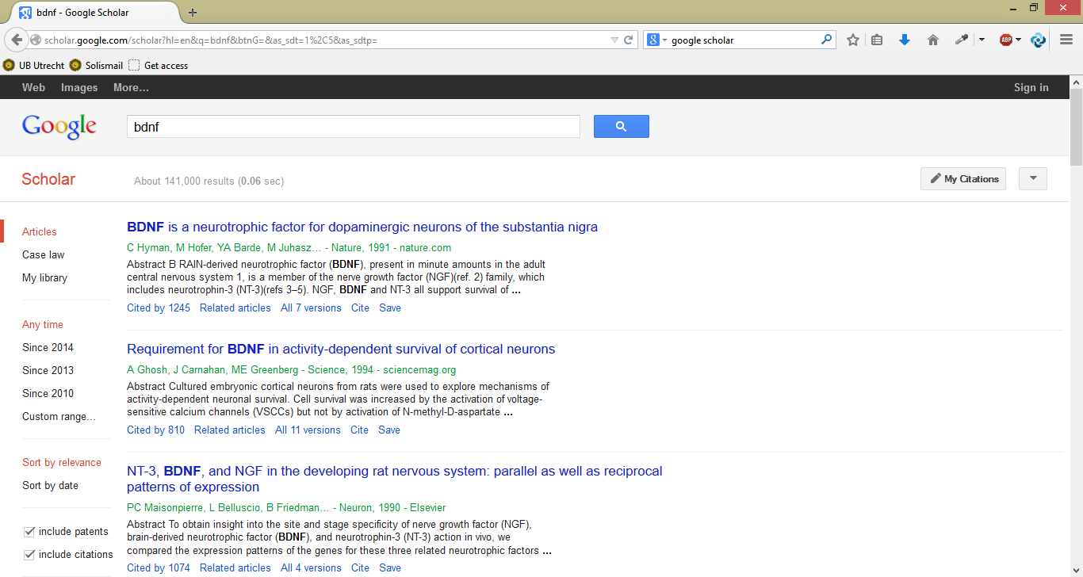
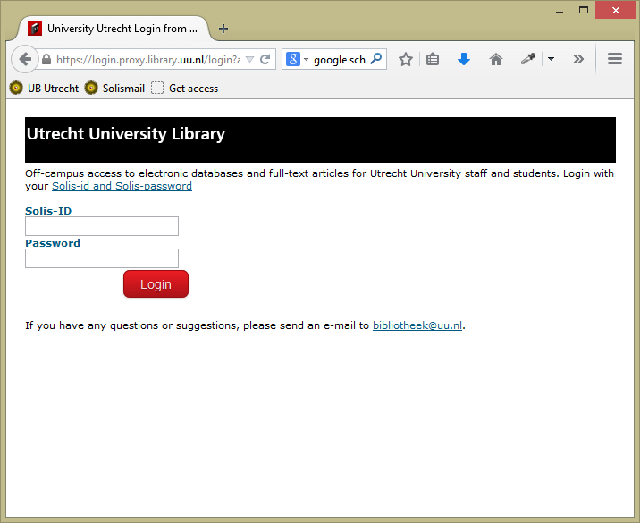

Slide 28
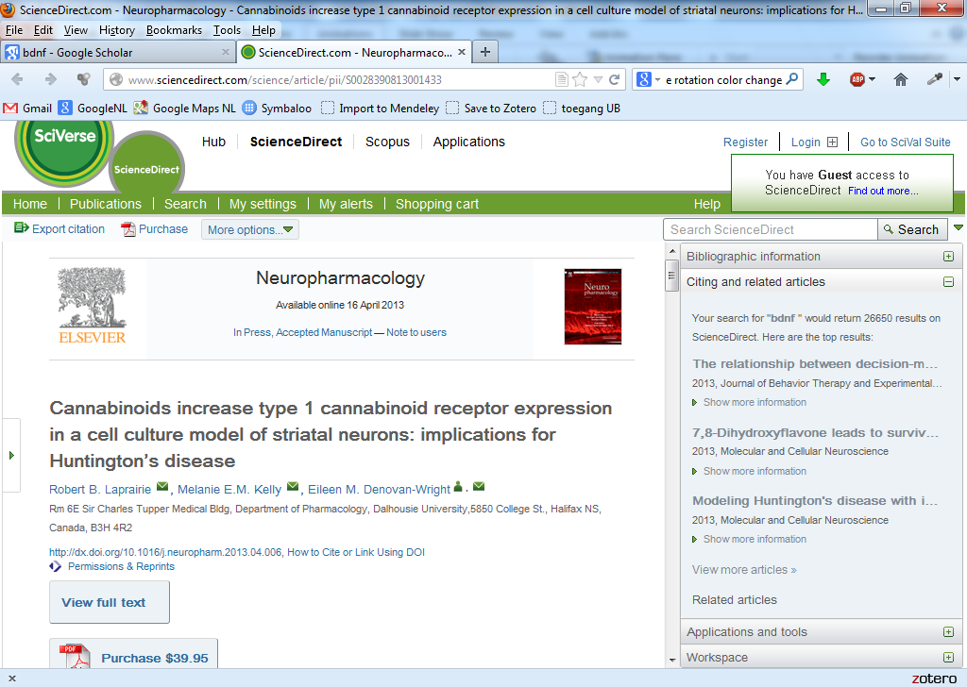
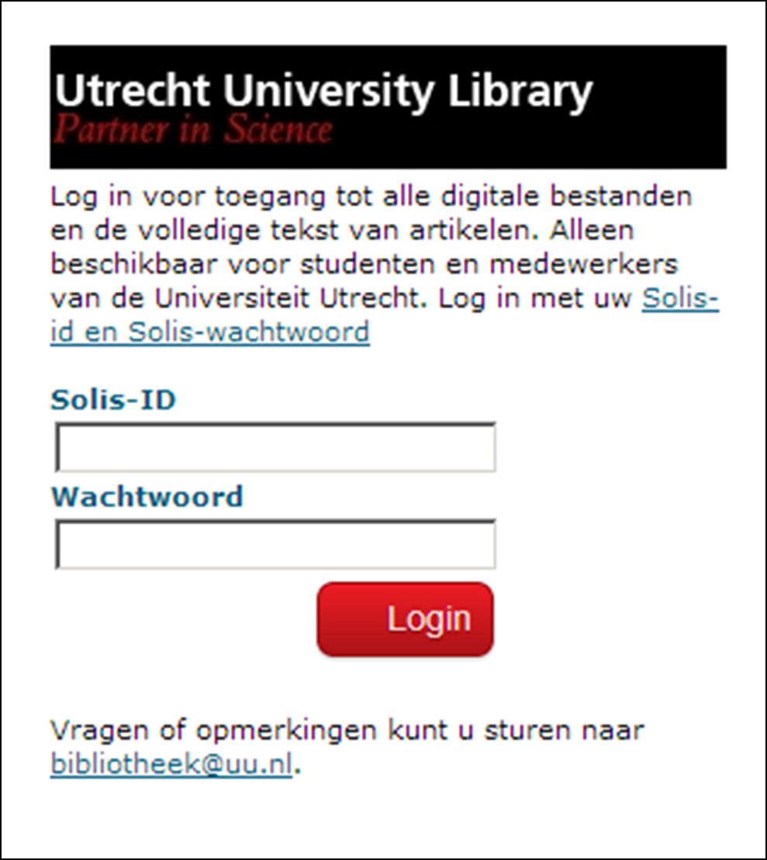
Bookmarklet (access from home):

Slide 29
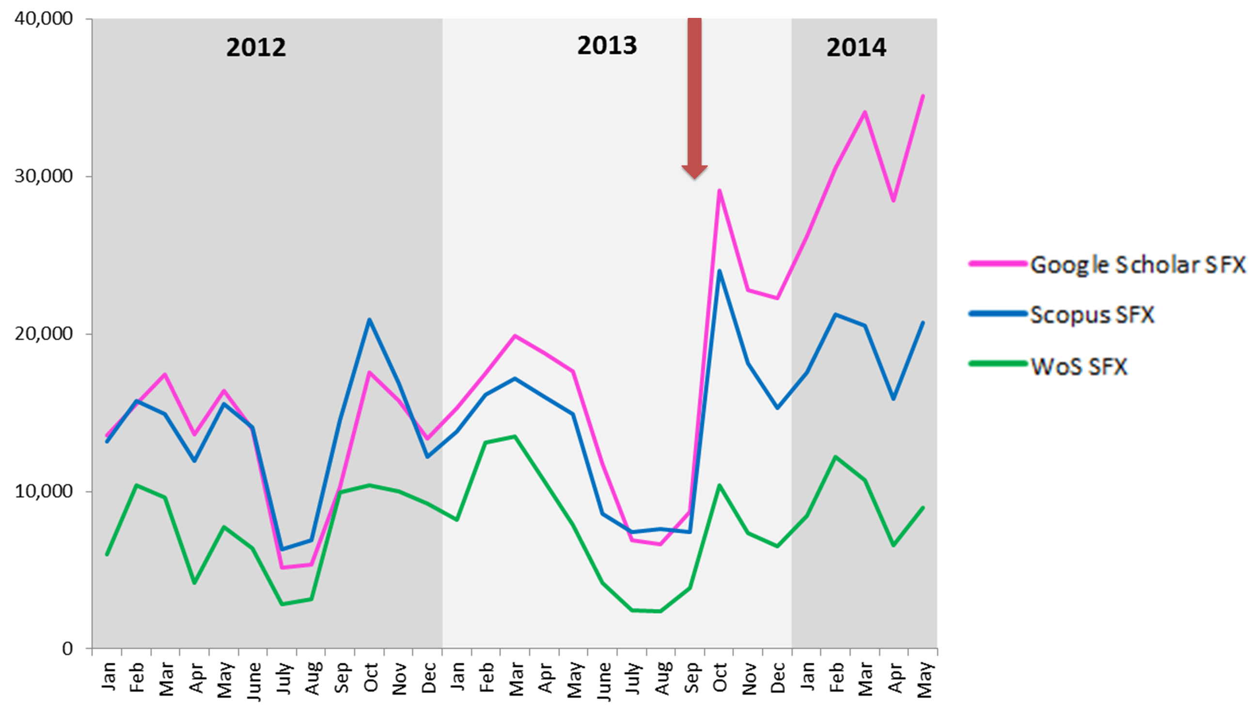
Search behaviour Utrecht University
SFX-clicks per month

Slide 30
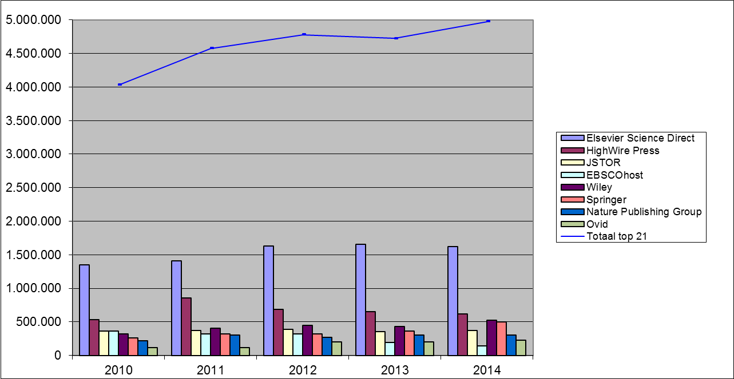
Full text requests top 21 providers

Slide 31
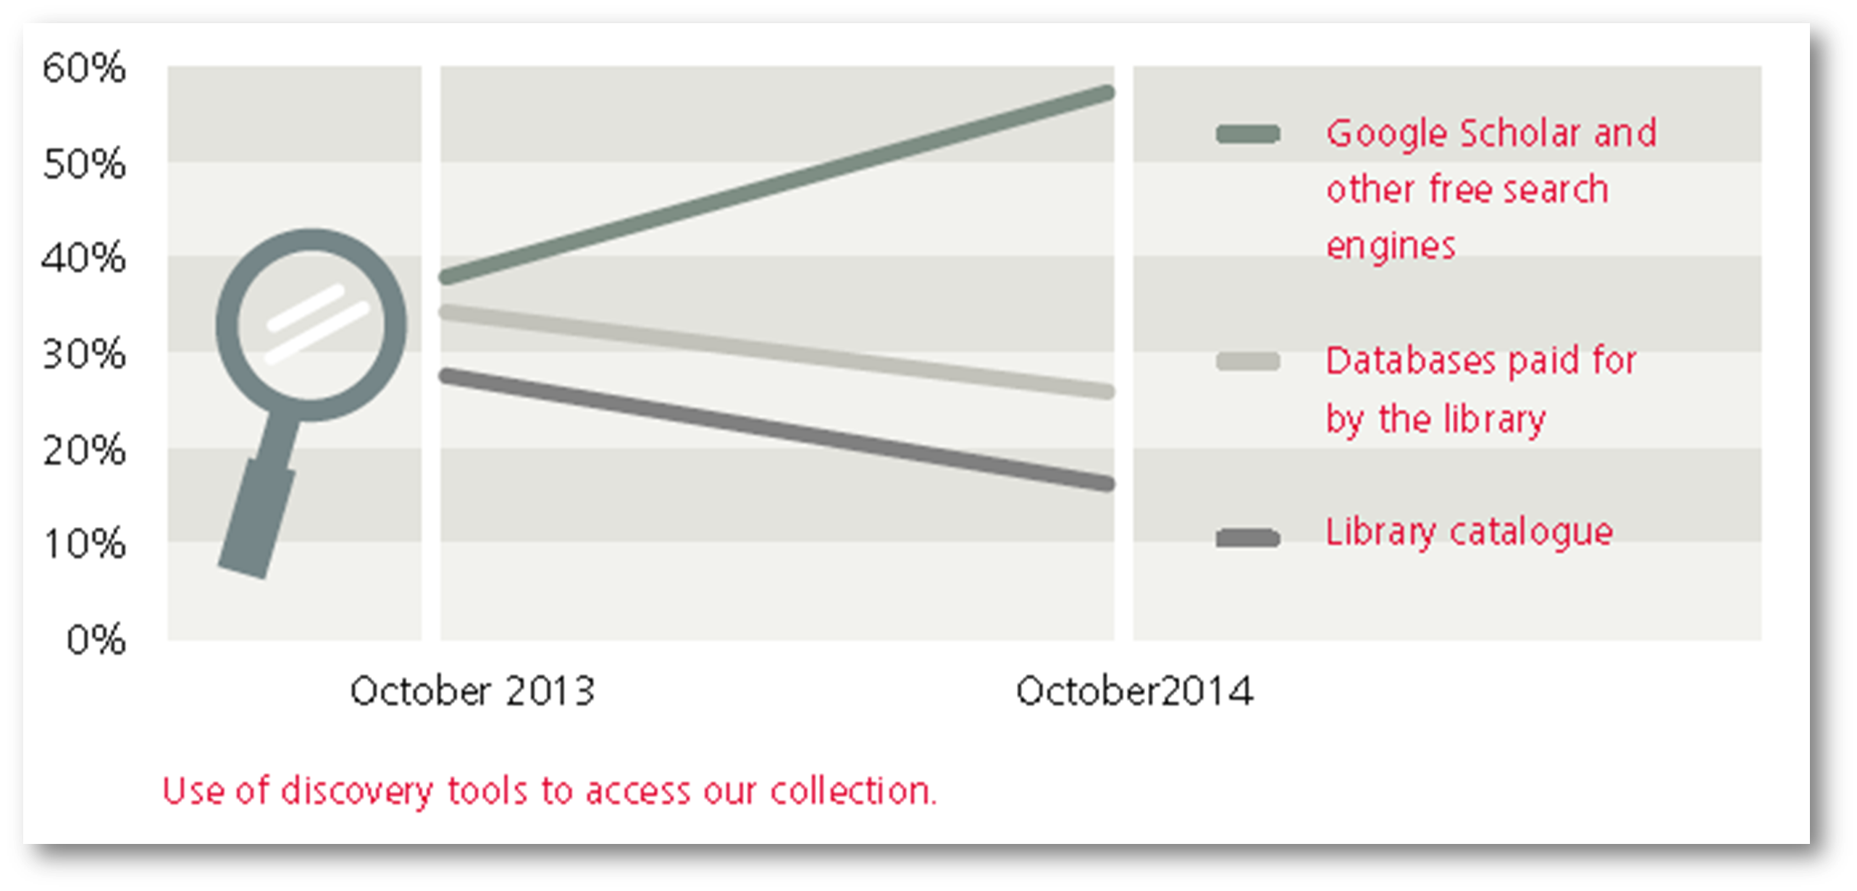
Strategic Plan
Utrecht University Library 2015-2017
Researchers, lecturers and students have a reliable partner in the library in the area of scholarly information.
Librarians use their expertise to contribute to the constant improvement of the scholarly communication cycle.
The library inspires bright minds to meet and exchange knowledge and ideas.
Library services are organised in an interdisciplinary way
in close cooperation with other parties both internal and external to Utrecht University.

Slide 32
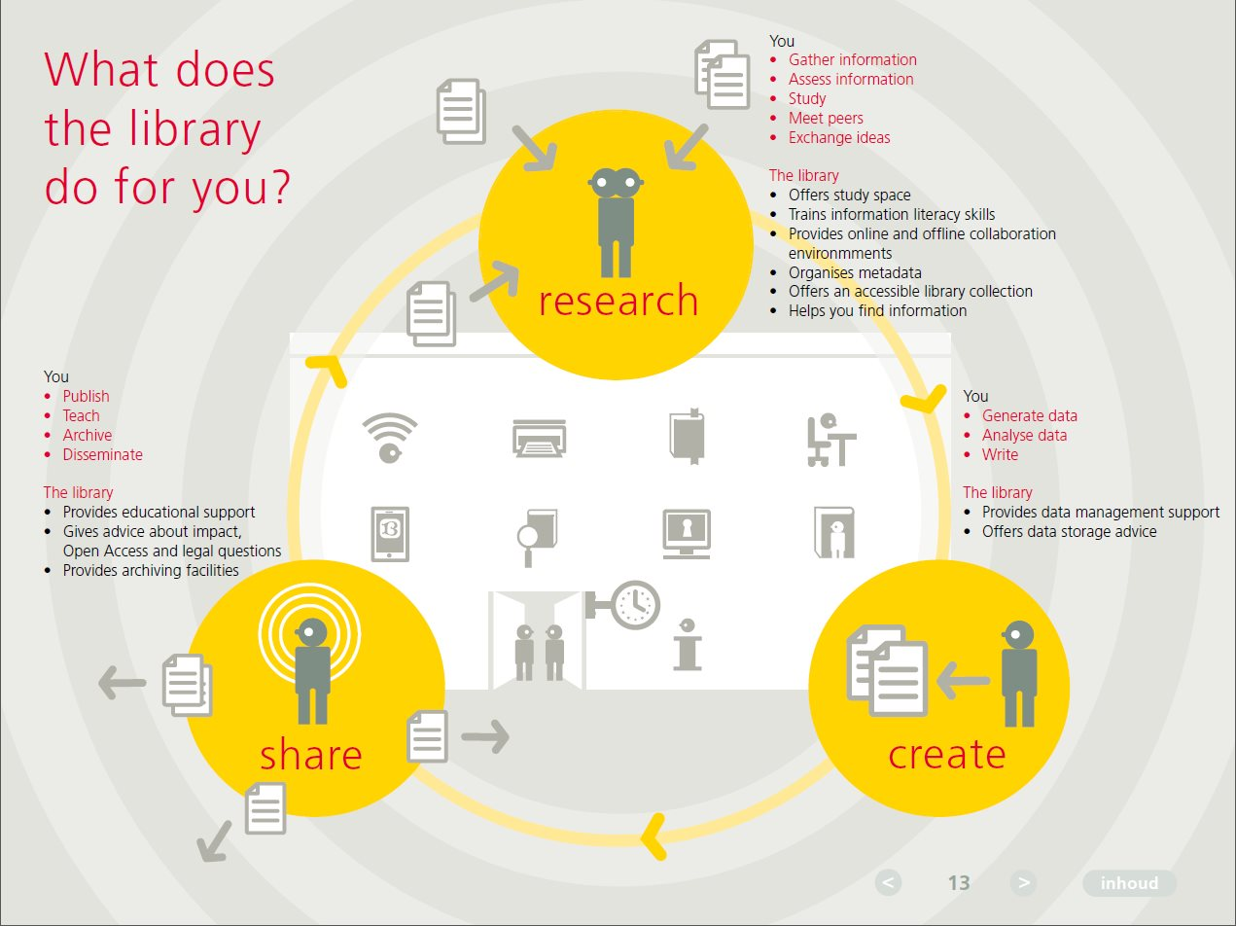
What does the library do for you?

Slide 33
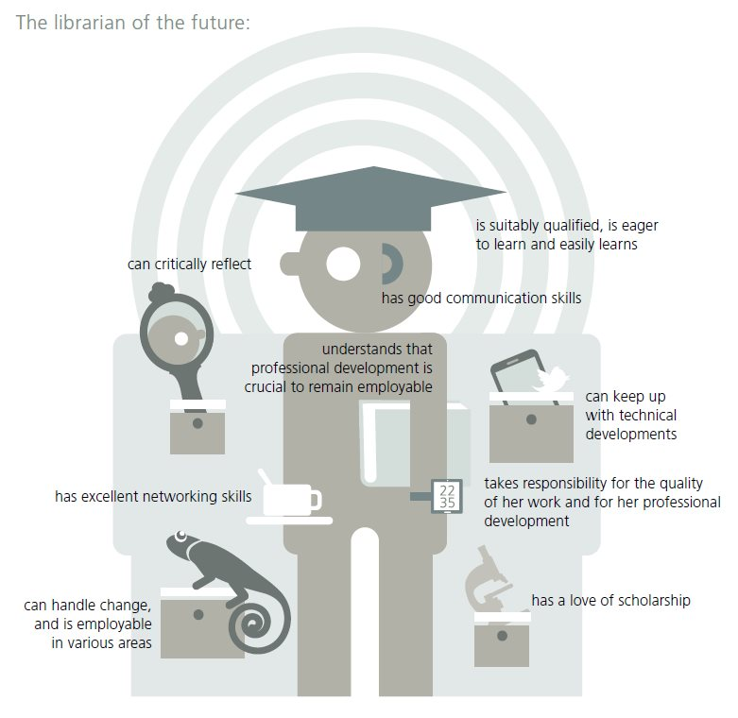
The librarian of the future

Slide 34
What’s next?
Keep improving delivery
Keep track of our users
Cooperate with other libraries
Phase out our WebOPAC

Slide 36
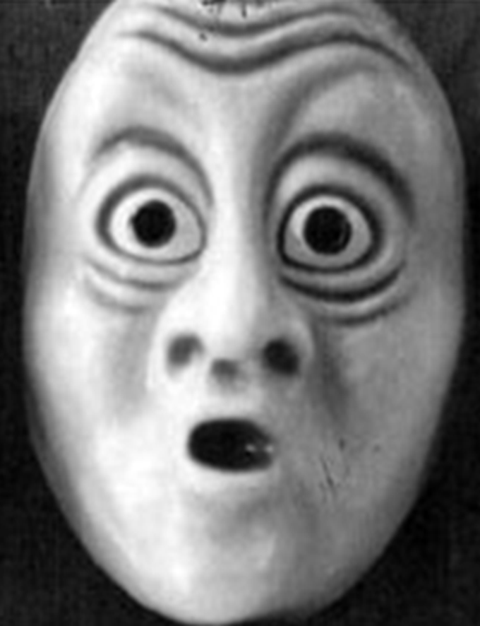
Thank you very much
for your attention
This presentation was made possible because of the help I got from my Utrecht colleagues, especially Simone Kortekaas, Bianca Kramer and Coen Wilders

