Slide 1
One Size Fits Small? A Few Thoughts on Web Discovery
Simon Perry, Systems Librarian, IT Carlow

Slide 2
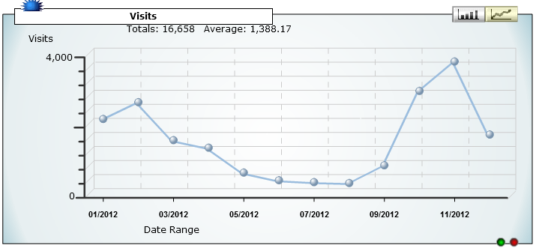
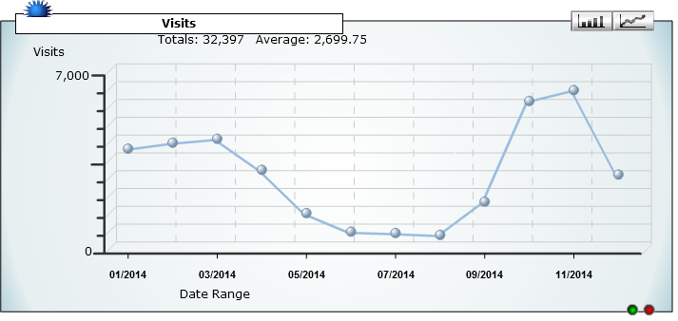
IT Carlow user of Summon web discovery tool since 2011
Generally well received by library users

Slide 3
The Buts….
Full-text linking
Width/Depth of Coverage
Indexing
System Stability

Slide 4
COST Action MP1302 – Nanospectroscopy
http://www.cost-nanospectroscopy.eu/
Nanospectroscopy small emerging technology/discipline
Requirement for textbook
Need to ‘map’ extant available material to inform textbook content
Identify review articles, books, tutorials
Notes:
Spectroscopy – star gases
Nanospectroscopy at molecule level

Slide 5
Information Sources Used
Web of Science/Science Direct – review articles
British Library - books
Library of Congress - books
Google Scholar/Google - tutorials
Summon - books
Notes:
28000 hits on Google
696 hits in Summon (including Beyond Library collections)

Slide 6
"Some specialized bibliographic sources related to deaf studies, which are important to a significant portion of our campus population, are not covered by our discovery service. But, title by title analysis shows over 95% coverage for traditional library resources. There are limitations in the coverage of nontraditional sources, such as multimedia.
"Currently, our digital archives are not included.“
“Areas that are still hard to discover include: Institutional resources like repository, or special collections, reference materials, foreign language, and Multimedia, music or other non-book materials. The other issue with some discovery tools is to maintain a good balance between types of materials, either articles or books. It's not always apparent what the format of the material is”
Breeding, M., Library Resource Discovery Products : Context, Library Perspectives and Vendor Positions, Library Technology Reports, 01/2014, Vol.50, Iss.1, p. 16-19

Slide 7
Open Access –
50%+ of Scientific papers published 2007 – 2012 available for free download
Lower in Arts and Humanities (c. 32%)
Archambault , E. et al., (2014), Proportion of Open Access Papers Published in Peer-Reviewed Journals at the European and World Levels—1996–2013, RTD-B6-PP-2011-2, Science-Metrix.
Notes:
Summon c.90 open access databases listed – do they provide f/t access though?
34 databases with ‘Institutional Repository’ in title (Dundalk IT only Irish one) no metadata harvested?

Slide 8
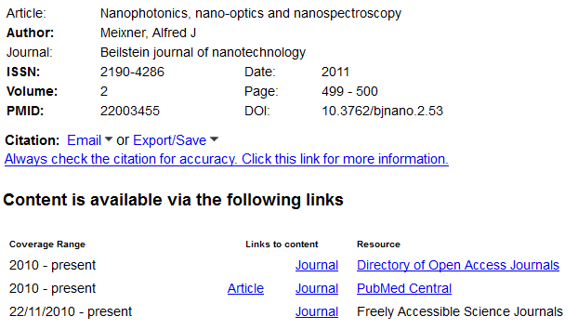
Notes:
Summon c.90 open access databases listed – do they provide f/t access though?
34 databases with ‘Institutional Repository’ in title (Dundalk IT only Irish one) no metadata harvested?

Slide 9
BUT…
Do we have to accept that discovery tools may satisfy most of our users most of the time, but not all users all the time?
And that we are permanently stuck in digital limbo between discovery and ‘what else is out there’ ?
Therefore literature searching/information literacy programmes will always have to reflect this.
Management of our discovery tools must necessarily emphasise our ‘value-added’ (known full-text availability) resources.
Notes:
Limit to value added vs everything but the kitchen sink

Slide 10
Wishlist
Personalisation – ‘My [Discovery Tool]’ saved results, saved searches, personalisation of interface, (facets, resources).
Improved discovery of OA and Institutional resources within discovery tools, better indexing/full-text access.
Improved information on availability resources from discovery tool vendors about their available resources, (are OA databases full-text?)
Improvement in quality of metadata supplied by discovery vendors.
Notes:
Problem of hosted service – not possible for library staff to customise with resources – reliant on what vendor supplies.

Slide 11
“What … we are witnessing … is the gradual demise of the discovery layer as a solution to the problem of ensuring discovery of, and access to, library resources. The ecosystem is simply too complex and too fluid for a discovery layer to keep up.”
“Many proponents of discovery layers as a solution to making vast amounts of library resources discoverable and accessible avoid discussion of metadata, preferring to focus instead on issues like usability, configurability of the interface, etc. While these issues are important, the fact remains that in the absence of an ecosystem that supports and sustains the creation and management of high-quality descriptive, administrative, and technical metadata, discovery layers remain deeply flawed. Any discovery system will only ever be as good as the metadata underlying it.”
?
Thank You

