Slide 1


Discovery Tools
- Walking the tightrope between complexity and simplicity
Ronán Kennedy
NUI Galway
LIR 2015

Slide 2
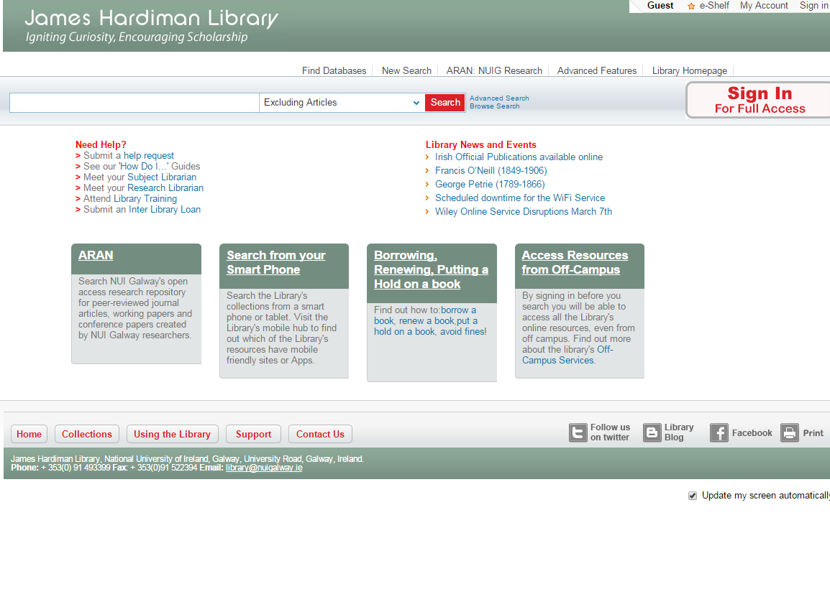

Slide 3
Logic behind why we did what we did
Highlight some things we did, we shouldn’t have
Highlight some things we didn’t do, we should have
How we found what we should have done originally but didn’t, and what made us realise what it was we shouldn’t have done and why we did it anyway, and what we did to make sure the things that weren’t originally done did get done
Notes:
Not going into too much detail about process of implementation
Concentrate on user interface decisions

Slide 4
Discovery Tools are a big deal for libraries
- And a bigger deal for library users
Primo Implementation Group
Primo Implementation Group
Interface Group
  subject librarians; research librarians; e-resource librarian, etc.
Notes:
Large Committee
Interface Group : - figure out an ideal world scenario & mould it into workable solution
Group membership : - provide a holistic set of perspectives to make sure all needs accounted for
“all needs accounted for”

Slide 5
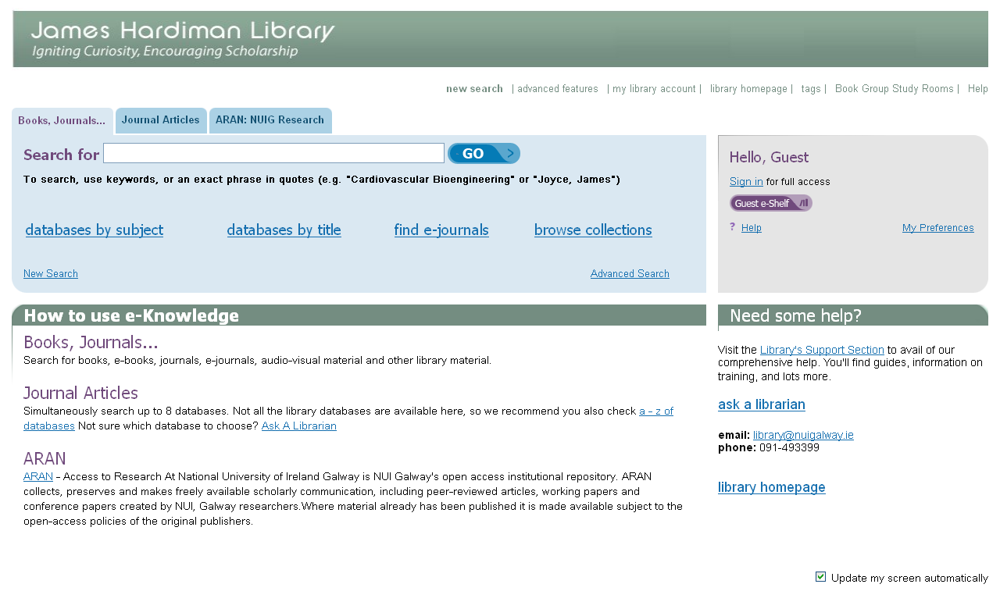

Slide 6
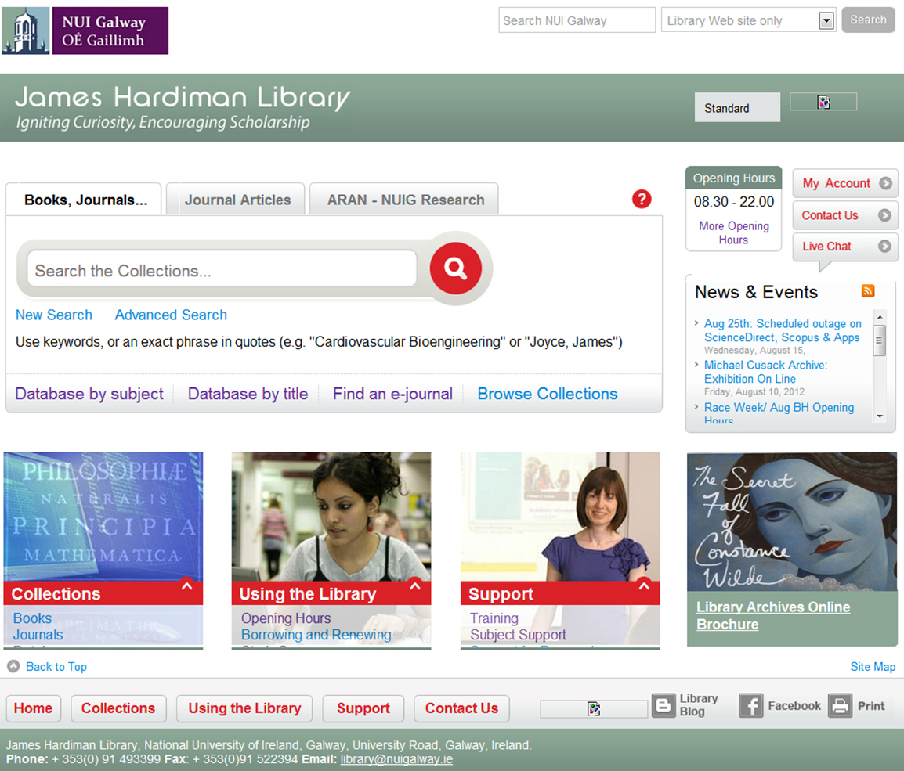

Slide 7
Initial Interface Work
Demos of out-of-the-box version
Examples of global sites – NYU, Princeton, etc
Interface Group members liaison role

Slide 8
Initial Concerns – Radical Departure
New interface could be radically different
Big departure from Aleph (function & cosmetics)
Academic opposition
Possible training problems
Notes:
Academics lazy but loud
Training – Info Libs felt a big change would need training – time & space restrictions

Slide 9
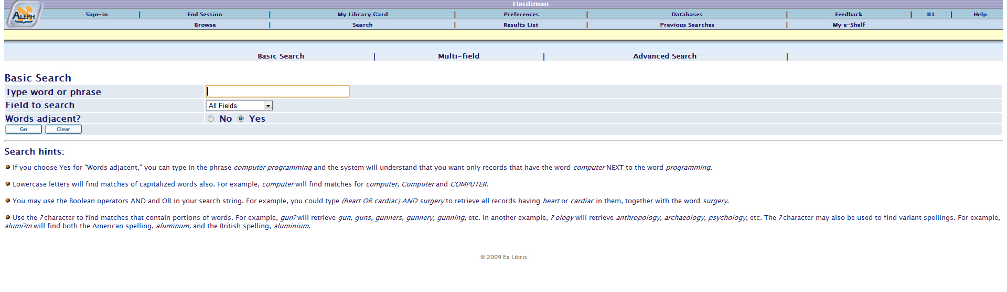

Slide 10
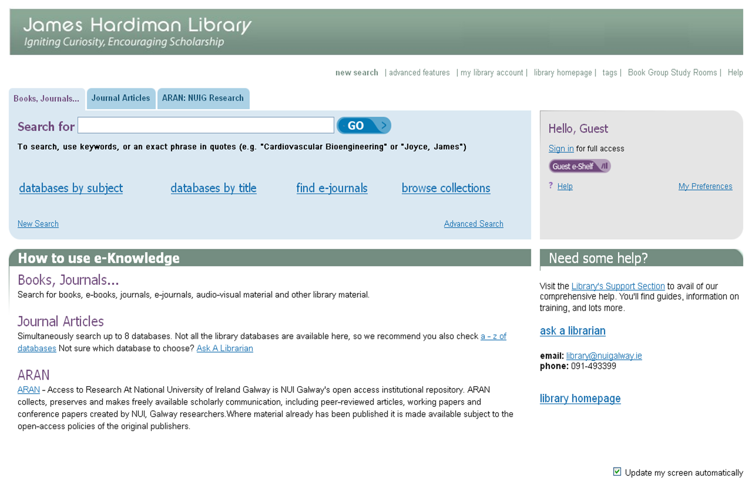

Slide 11
Conclusion #1 – too conservative
Concerns heavily shaped our vision
- tried hard to integrate the past
- fear of academics
We tried to mould Primo into something it wasn’t
Notes:
Browse collections
theses

Slide 12
Something To Consider
Move to Primo 4 and Primo Central removed any ties to the past.
Which is better: iterative change or radical change?
Evolution or revolution?
Notes:
Browse collections
theses

Slide 13
Concerns – Dumbing Down
One interface = bad information literacy
“Primo should be a flagship model of good pedagogical practise”
Multiple tabs made sense to us
Notes:
Hypocritical to preach Info Literacy & have a simple interface
Flagship model – Info Libs put a lot of training hours into Info Lit and how to search correctly and organise information – Primo should feed into this
Roy Tennant
Multiple tabs – many options to well-defined, complete sets on information

Slide 14
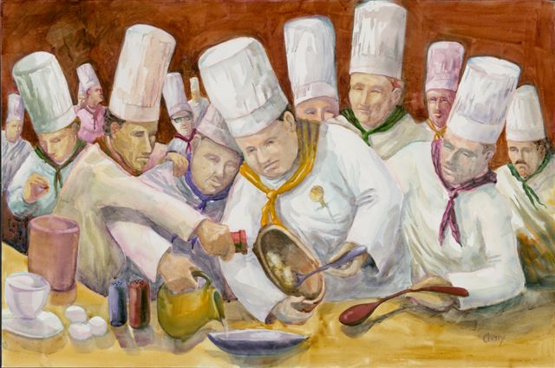
Lots of group members = lots of opinion
Subjective opinions are always difficult
“Is it exposing our resources appropriately?”
Font sizes!
Conclusion #2: people skills are vital for software implementation
http://vivavisibilityblog.com/too-many-cooks-in-the-kitchen
Notes:
Huge amount of complexity and choice built into Primo to accomadate all needs

Slide 15
Marching Through Treacle
Interface group assembled the jigsaw pieces
Model followed closely with NYU, Iowa, British Library, UEA
Time to caress the divine details….

Slide 16
Error Checking
Librarians love detail!
A lot of librarians means lots of errors being found
  Sub-conscious opinions being formed?
Notes:
Local errors & Ex Libris ones

Slide 17
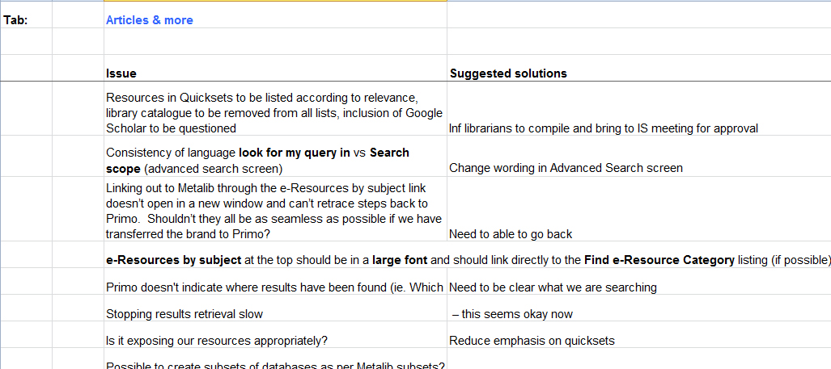

Slide 18
Perfection at all costs?
Did we get bogged down in making sure it was perfect?
Special Collections
Special Collections
Special Collections Reference
Strong Room
Conclusion #3: Librarians want perfection – users want good enough
Notes:
Mobile phone manual

Slide 19
Customisation – Tread Carefully
All Discovery Systems are *very* flexible – lots of options

Slide 20
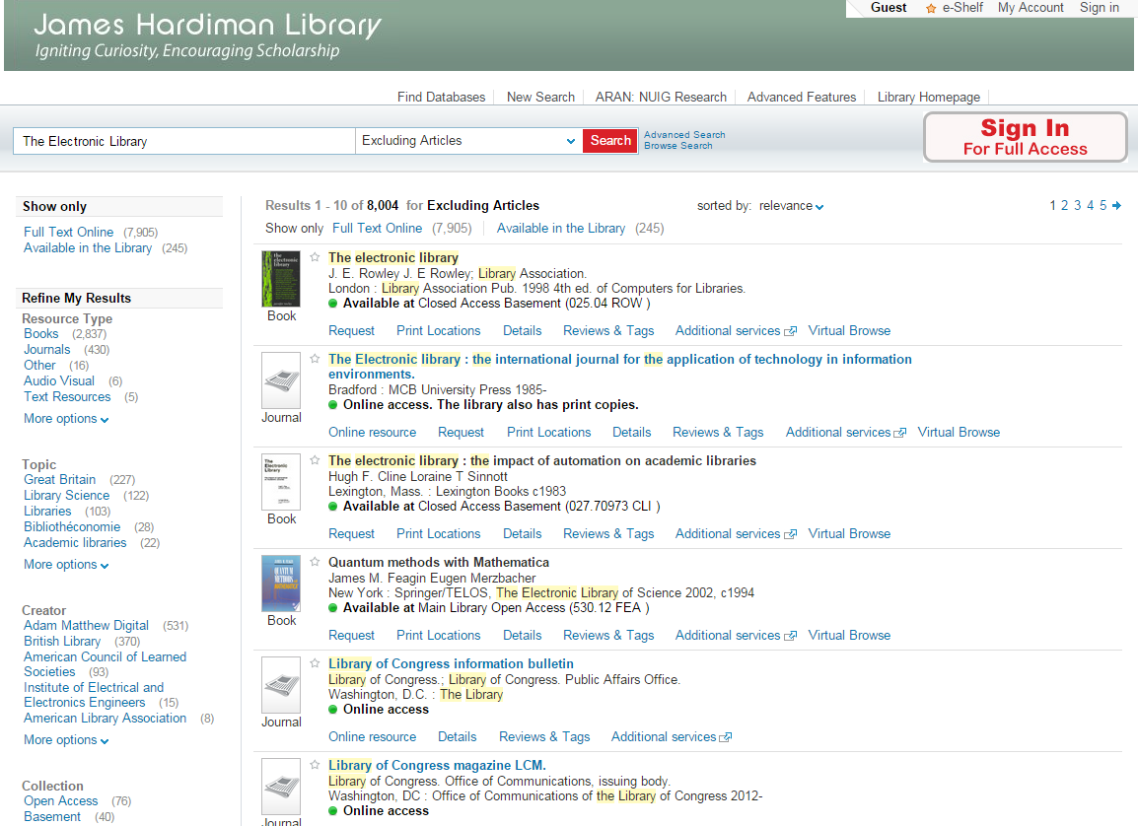

Slide 21
Customisation – Tread Carefully
Tempting to generate completely local feel
- Can be timely
    It probably won’t be noticed!
    Beware the ripple effect of tweaking
Just because you can push a button, it doesn’t mean you have to

Slide 23
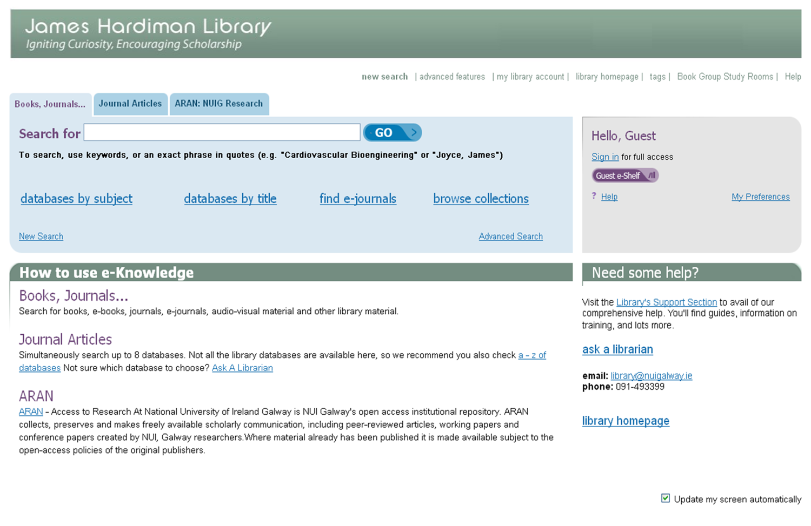

Slide 24
How was it used?
80/20 Theory
For every 1.5 million Basic Searches, there were:
    50,000 Advanced Searches (3%)
    14 reviews written
    Several hundred items tagged
Value-added features don’t get used
Notes:
Upgrade to Primo 3 wiped all these

Slide 25

LibQual Survey
LibQUAL+® is a suite of services that libraries use to solicit, track, understand, and act upon users' opinions of service quality.
Global; great for benchmarking between years and between institutions

Slide 26
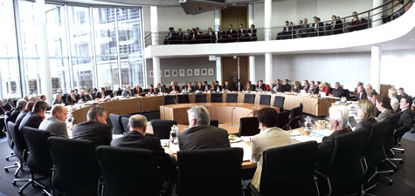
LibQual - Information Control Remit
 |  | minimum | desired | perceived | adequacy | superiority
IC-1 Making electronic resources accessible from my home or office | Overall | 6.42 | 7.84 | 6.49 | 0.07 | -1.35
IC-2 A library website enabling me to locate information on my own | Overall | 6.53 | 8.00 | 6.49 | -0.03 | -1.51
Let’s form a committee!!!
https://www.bundestag.de/htdocs_e/bundestag/committees

Slide 27
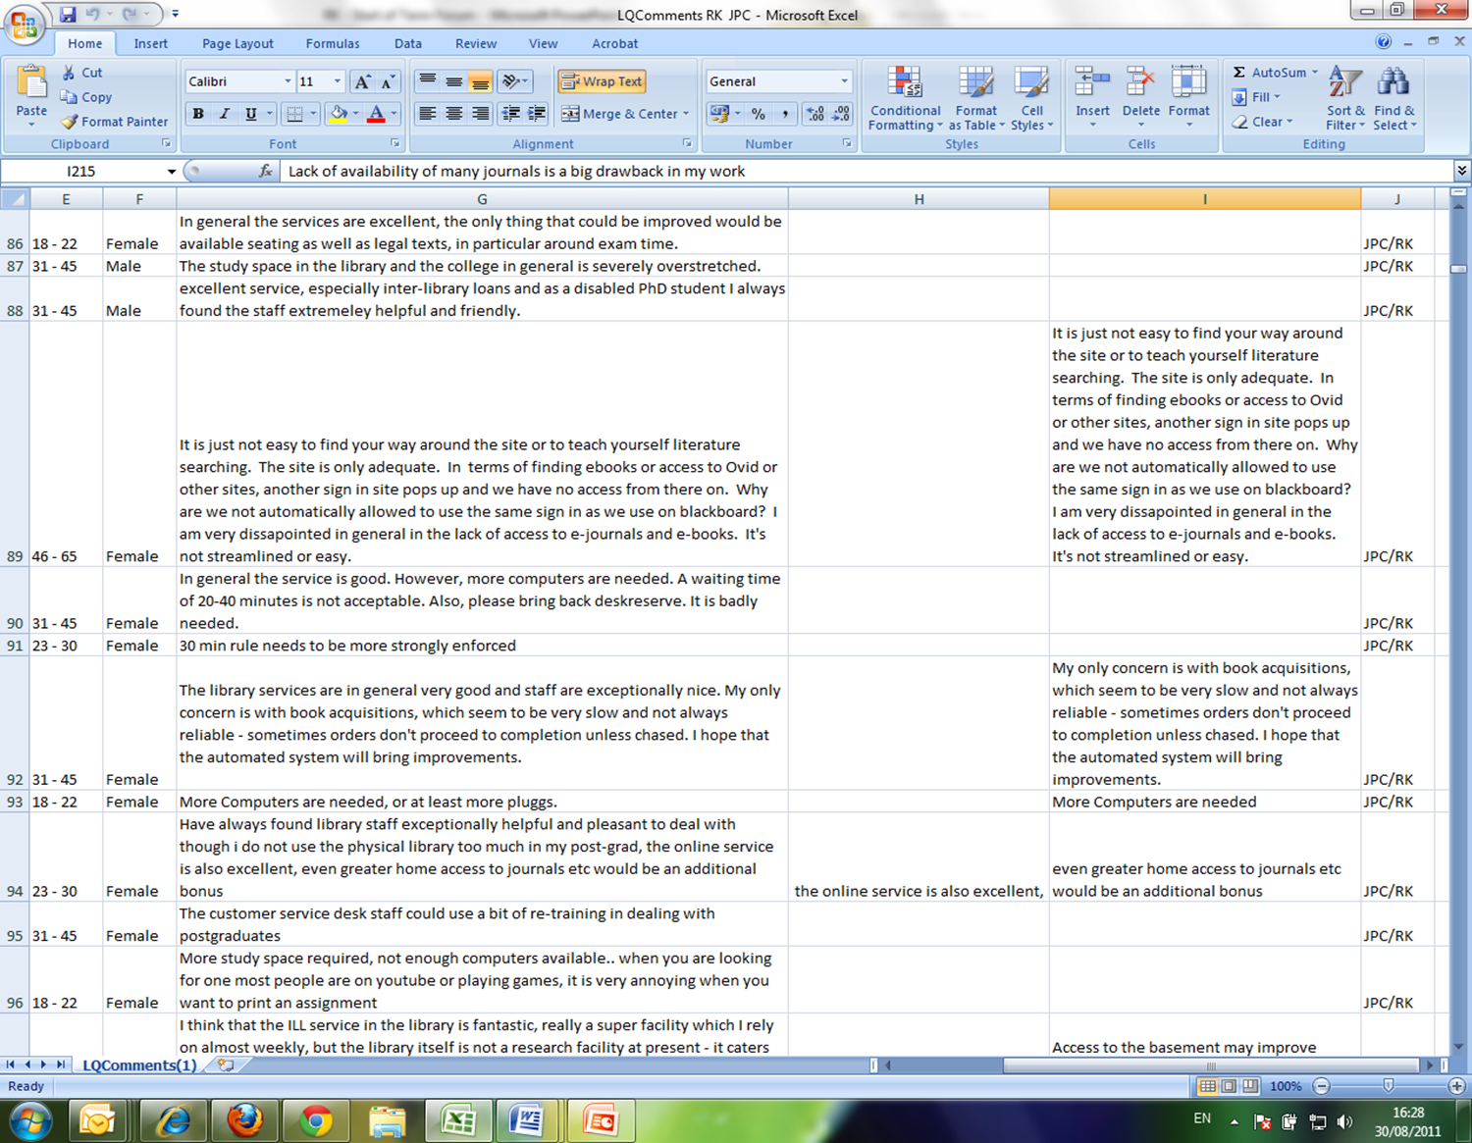

Slide 28
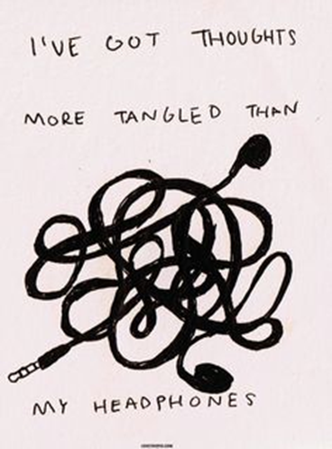
The website is difficult to use
The website is easy to use since the redesign
Navigation of the website is confusing
Online services are great!
Access to e-resources needs to be more user-friendly
Off-campus access works very well
http://s-media-cache-ak0.pinimg.com/236x/63/02/b7/6302b7a9d6b26da7b04bc10fe4930ef3.jpg

Slide 29
Assemble The Lab Rats!
User Observation Study
  Real Users
  Real Tasks
  1:1 User – Observer
Notes:
Thanks to MC

Slide 30
Find Out:
Where were users becoming confused
What interface features users didn’t notice
Did users login for a better search experience?
Additional features/on-screen guidance that might have benefitted users’ search experience
Any issues affecting the success of the users’ search

Slide 31
Structure of Observation
Pre-observation interview
Set list of tasks
Think aloud:
  Explain choices
  Highlight anything that’s confusing
  Express pleasure or frustration
  Explain how you would carry out a similar task in real life

Slide 32
Key Findings
Most of the problems came from our links to our discovery tools and once they navigated into them – comments about ‘website’ meant our discovery tools
Some users went to our webpage about books to find the book they wanted rather than using the search box!
Journal article searching caused great confusion
Notes:
There was very little distinction between our website and our discovery service. Users viewed them as a blended hybrid.

Slide 33



Slide 35
Other Findings
Reliance on Google by all participants
Prior attendance at library training hugely improved the users’ success in completing the set tasks
Several undergraduates were confused about references – they were unsure what was a journal and what was a book

Slide 36
Primo-related Findings
Terminology is hard to understand e.g. ‘currently unavailable’ ‘online access’
A simpler catalogue would be better
  “Make it simple – more like Google”
One user with experience of other libraries was emphatic that our online services were significantly easier to use than elsewhere

Slide 37
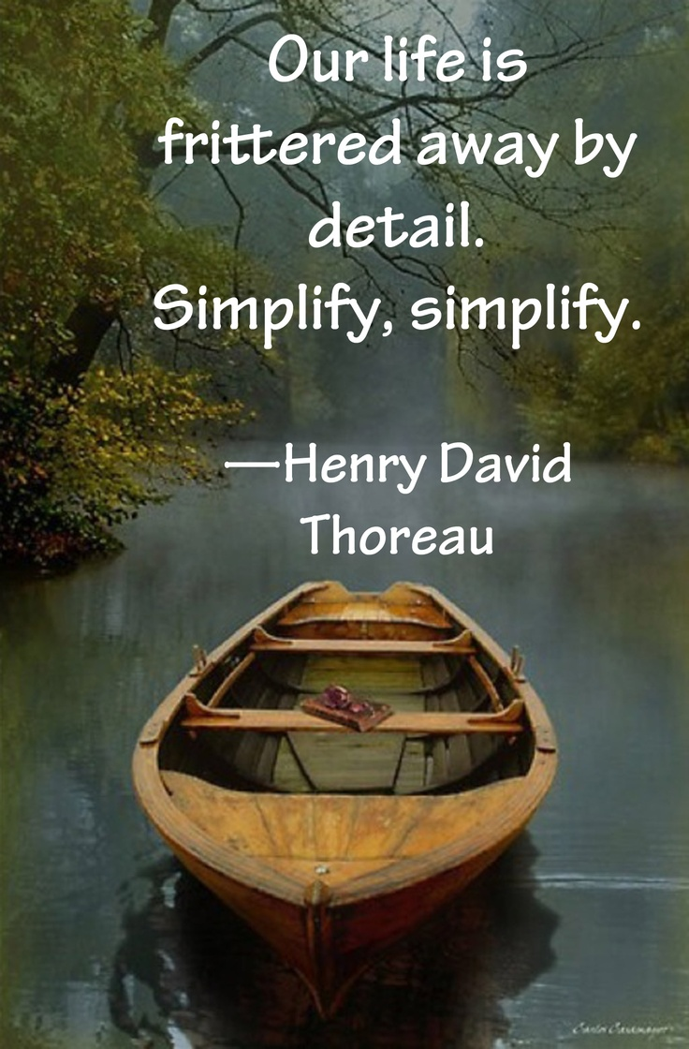
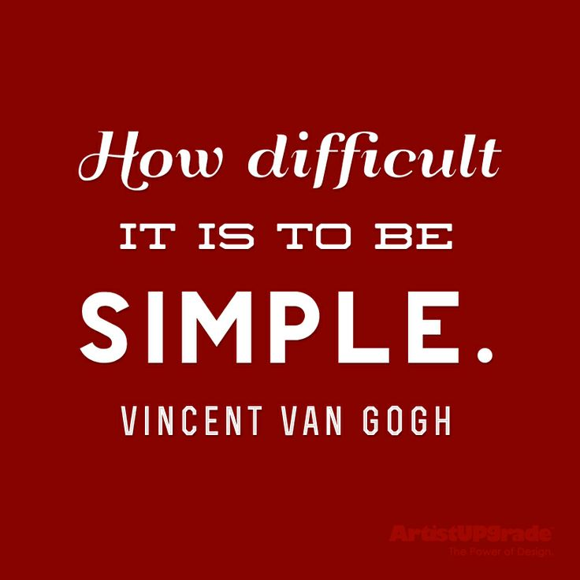
The Solution?
https://s-media-cache-ak0.pinimg.com/736x/fd/a4/46/fda4463bfc161c52e2309497563bb461.jpg
https://s-media-cache-ak0.pinimg.com/736x/fd/a4/46/fda4463bfc161c52e2309497563bb461.jpg

Slide 38
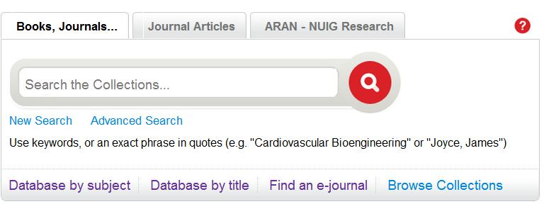
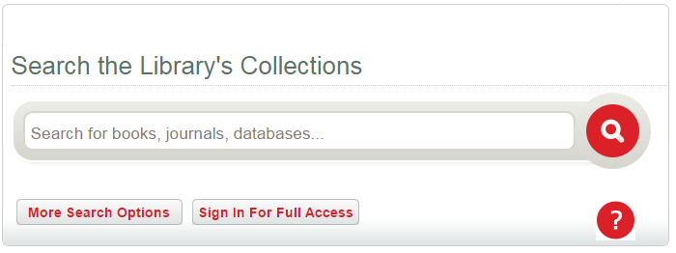
Single Search Box

Slide 39
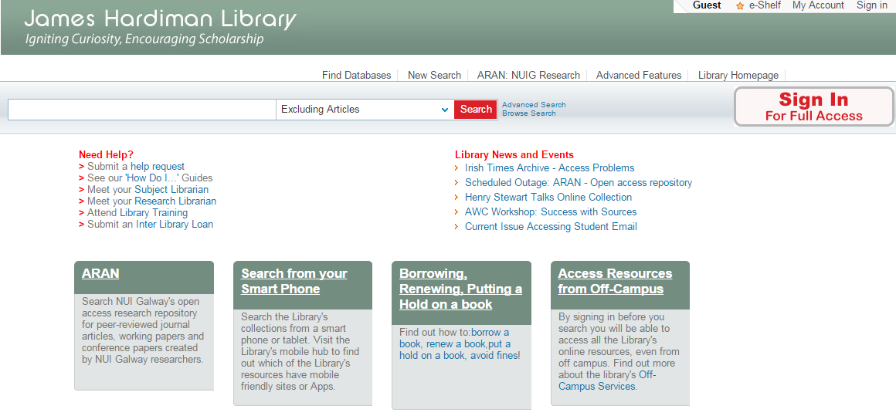
Improve Login Visibility

Slide 40
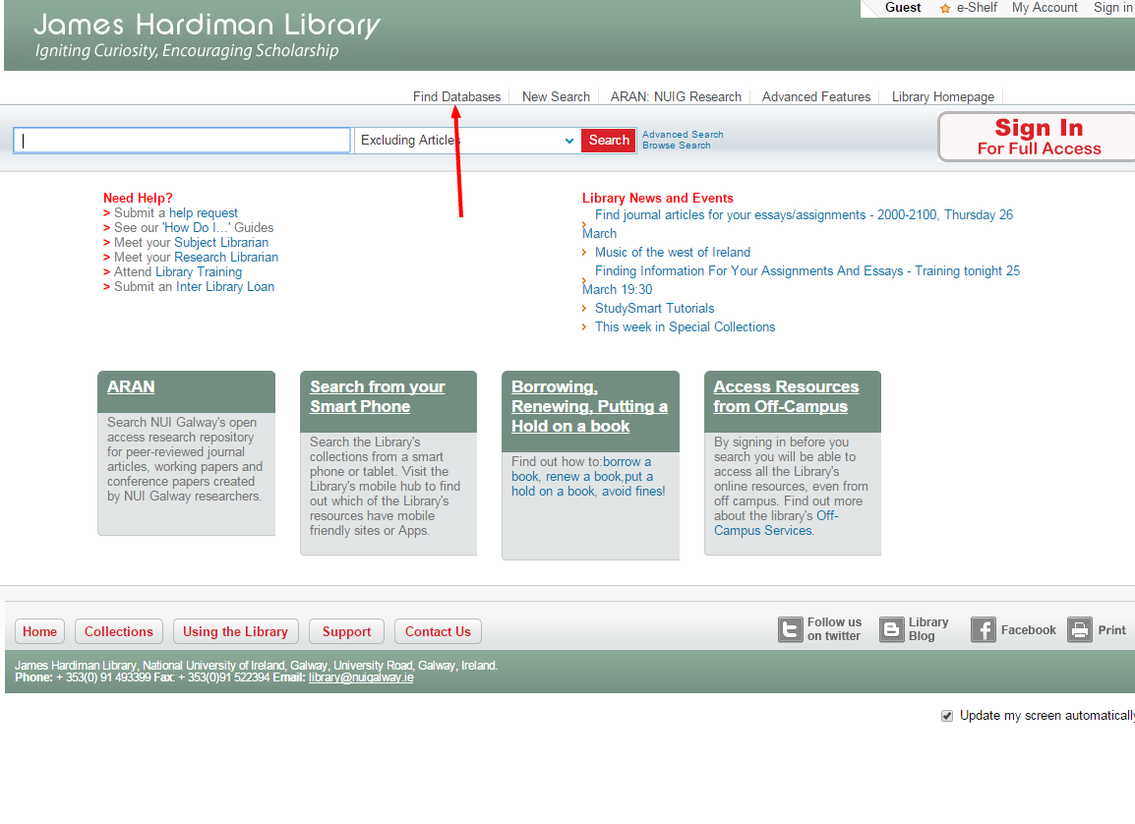
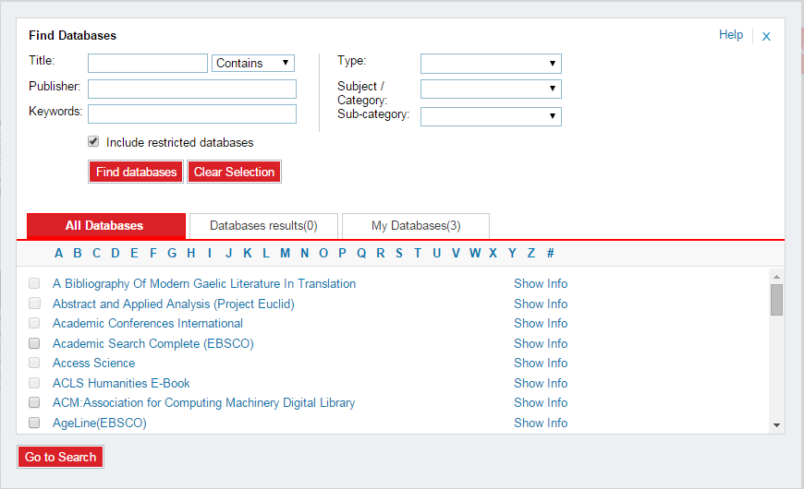
System Upgrades Helped

Slide 41
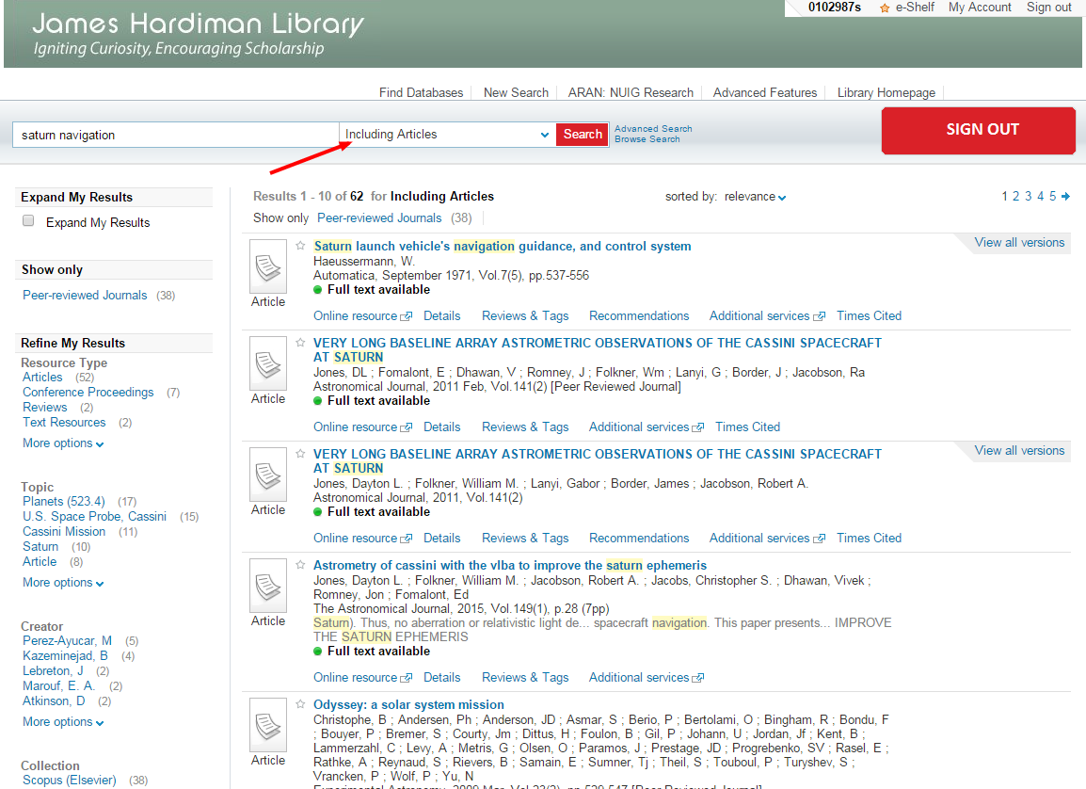
System Upgrades Helped

Slide 42
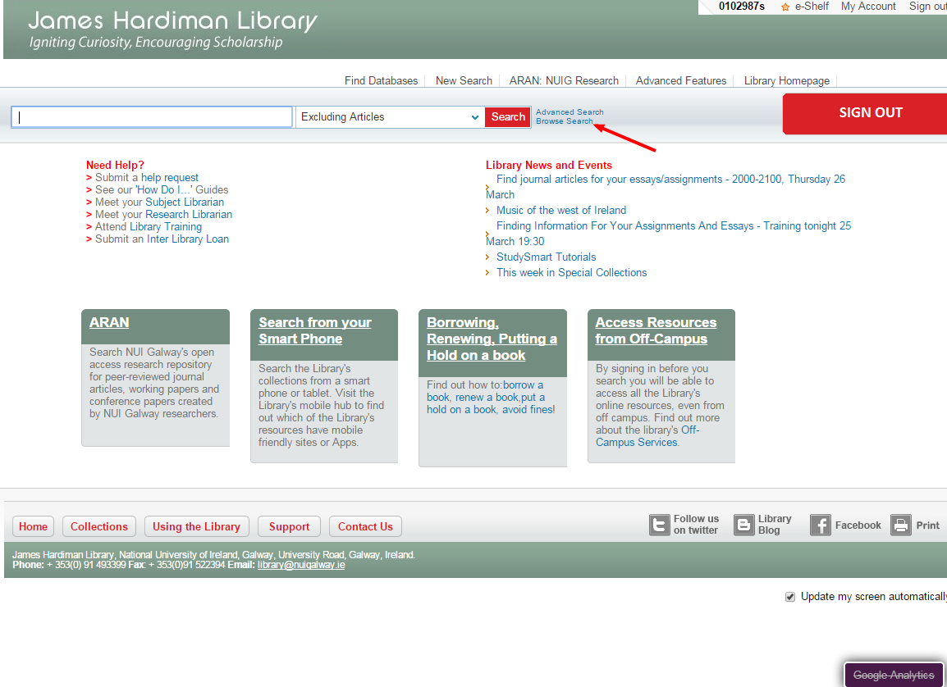
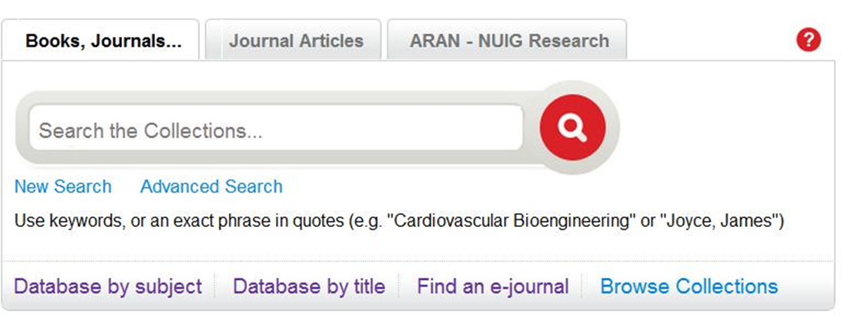
System Upgrades Helped

Slide 43
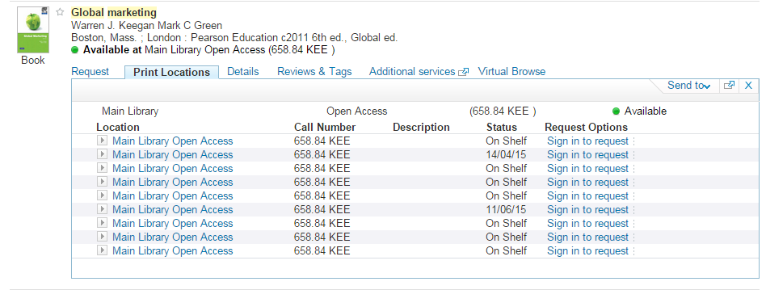
System Upgrades Helped
OPAC via Primo
  Clearer holdings information

Slide 44
Feedback
Over-whelmingly positive:
  “the new catalogue is amazing!”
  “I like the new look - design and layout - it mirrors the layout in many of our databases e.g., Ebsco, Proquest, Scopus.”
  “it looks very good – easy to search and smooth integration with SFX and OPAC”
  “an enjoyable and fruitful search experience”
  “intuitive and intelligent layout and design”

Slide 45
Feedback
Notes:
Jump from 2012 largely linked to Primo Central acquisition

Slide 46
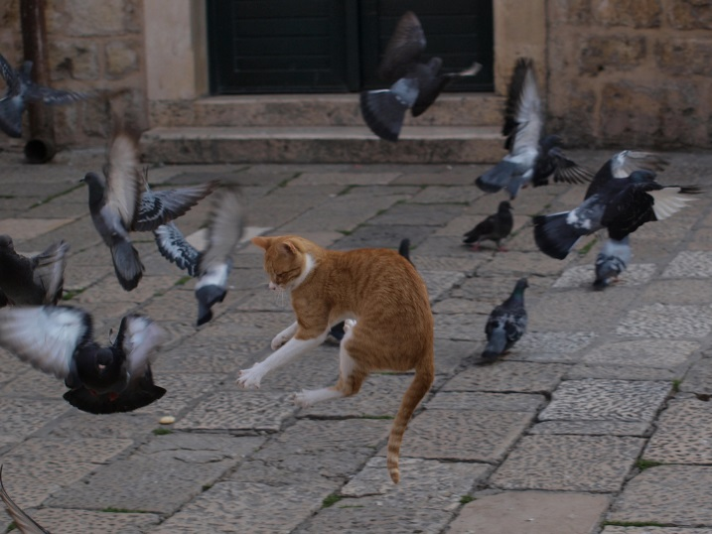
But…
https://c2.staticflickr.com/8/7172/6802655619_94bfb76881_b.jpg

Slide 47
But…
“Meeting users’ needs” = meeting what users think they need?
They don’t know what it is they don’t know
De facto trust relationship for users of libraries; they trust that what they get is accurate, complete and valuable.
Notes:
The constant feedback from library training is “wow! I didn’t know you could do that”
User still look at the Library as an infallible institution of information provision

Slide 48
But…
Easy to improve aesthetics and organisation of interactive features
What about functionality?
  Intelligence of record organisation
  What data is being searched and how that data is ranked
  What is being left out?
How do we as Librarians assess data organisation?
Notes:
Interface control is standard practise for all systems these days
Public spats between providers
‘google-based’ algorithms – is google the correct ranking model to follow?
‘advanced apis’

Slide 49
“There are strong and positive correlations, irrespective of institutional size, between per capita expenditure and use of e-journals, and numbers of papers published, citation impact, numbers of PhD awards, and research grant and contract income.”
E-Journals: Their Use, Value And Impact, RIN, 2009
Notes:
The more resources and institution has, and the better the quality of those resources, the more frequent and more highly cited the research output.
But having the resources is not enough – they have to be discoverable.

Slide 50
Final Thoughts
Improve the User Experience by asking the user
Observation is very informative
The evolutionary nature of Discovery Systems is beneficial to us
We have a duty of care to ensure users are presented with the best quality information

Slide 51
ronan.kennedy@nuigalway.ie
skype: ronan.the.librarian

