Slide 1
Portals: Pride not Prejudice!
Yvonne Desmond
LIR Annual Seminar
21 March, 2014

Slide 2
Open Access Promise
Shiny new digital landscape
Knowledge freely shared
Freely available to all
Potential to change the research landscape
Movement slow to grow

Slide 3
Achievements
Repositories
Open access Publishing
Open licensing
Institutional support
Funder mandates
Impact as metric

Slide 4
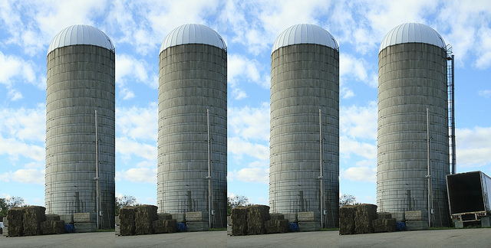
The Problem of the Silo
Pockets of Research

Slide 6
Hindawi Publishing Corporation
Social Science Research Network
Open Access | Harvard Library Portal
RePEc (Research Papers in Economics)
T-Stór
OpenAIRE
OAIster®
OpenAIRE Orphan Record Repository

Slide 7
What if you took the content of over 300 universities and made it browsable in a meaningful way to scholars, enabling them to search by discipline and always obtain full text at the end of the search?
The Digital Commons Discipline Wheel

Slide 8
Open Access, Powered by Scholars, Published by Universities
Not another cross search
Aggregates around subjects
Graphical browsing
Full text articles/No barriers
Totally free/curated
http://digitalcommons.bepress.com/subscriber_gallery/ participating universities

Slide 9
Open Access Promise
True Open Access/Trusted resource
Potential to change the research landscape
Restores serendipity
Contribution to the local repository connects to the network
Exploration by authors/ potential authors
Exposure for Organisation
Bridge …local repository to discipline wheel, wheel to local repository

Slide 10
Taxonomy
Architecture,
Arts/Humanities
Business
Education
Engineering
Life Sciences
Medicine/Health Sciences
Physical Sciences and Mathematics
Social & Behavioural Sciences
Law
http://arrow.dit.ie/ : http://epubs.rcsi.ie/

Slide 11
Demonstration of the wheel

