Slide 1

Open Library

Slide 2
Open Library is an eLibrary?
Soooooooo?
Another round of budget cuts ?
The Open Library…..It's hell to pay when the fiddler stops: it's CLOSING TIME Leonard Norman Cohen
Another technological solution ?
A Staffless Library?
A locked up Library with no friendly face
Security stuff and vandalism and BYOD?
T3……………..has finally arrived………….

Slide 3
Typically, Open Library has both staffed and unstaffed hours during the week
Open Library is defined as a library where a proportion of the opening hours are unstaffed
Accessibility with confidence and consultation
Extended service concept. Moving closer to the user
The doors are always locked during staffless hours.
Open Library provides the user with access to all the library services that are available during staffed hours. Self service loans, returns, Wifi, reading, meetings,
The only physical difference compared to staffed hours is that the office/workspaces are closed.

Slide 4
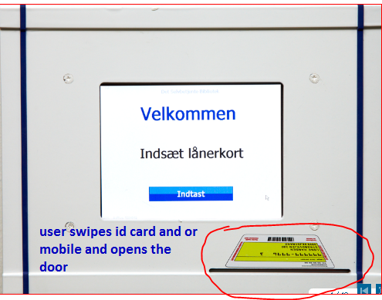
Custom designed entrance computer identifies and registers the users upon arrival at the library.
The users swipe can swipe id card or use the computer’s touch-screen or Mobile
http://cordura.dk/en/software/products/open-library/

Slide 5
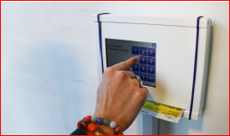

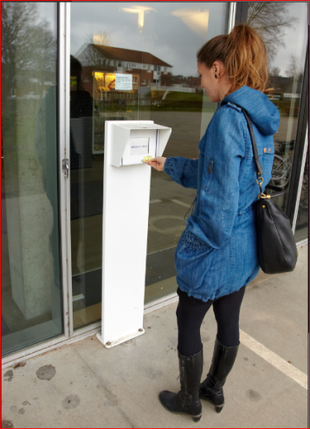
Library Metrics
Staff have the opportunity to redefine their own work tasks during the staffed opening hours.
Additional time to plan professional development
Family friendly and more time to share and plan leave
Stressless and putting the “Libraryness” back into Libraries

Slide 6
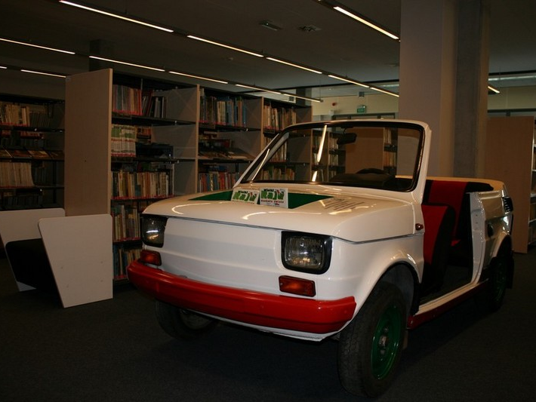
Totally Topless!!!!!!!!!

