Slide 1
The Power of 3: CUA pools academic research

Slide 2
Connacht Ulster Alliance
Letterkenny Institute of Technology
Galway – Mayo Institute of Technology
Institute of Technology, Sligo

Slide 3
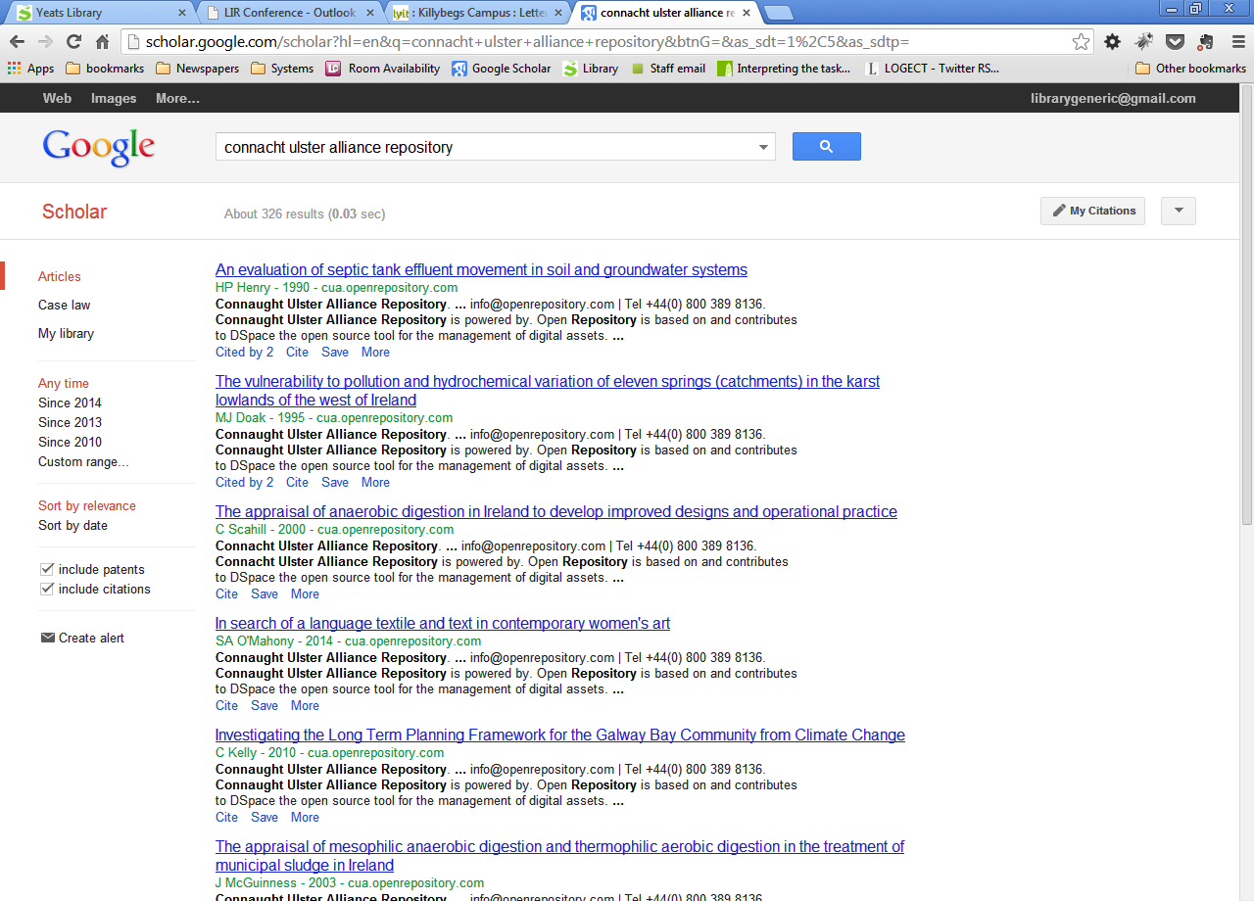
Research Repository
Functions
Showcase CUA Research
Facilitate CUA Presence on RIAN
Access to CUA Research within region
Visible to Search Engines – Wider visibility and impact

Slide 4
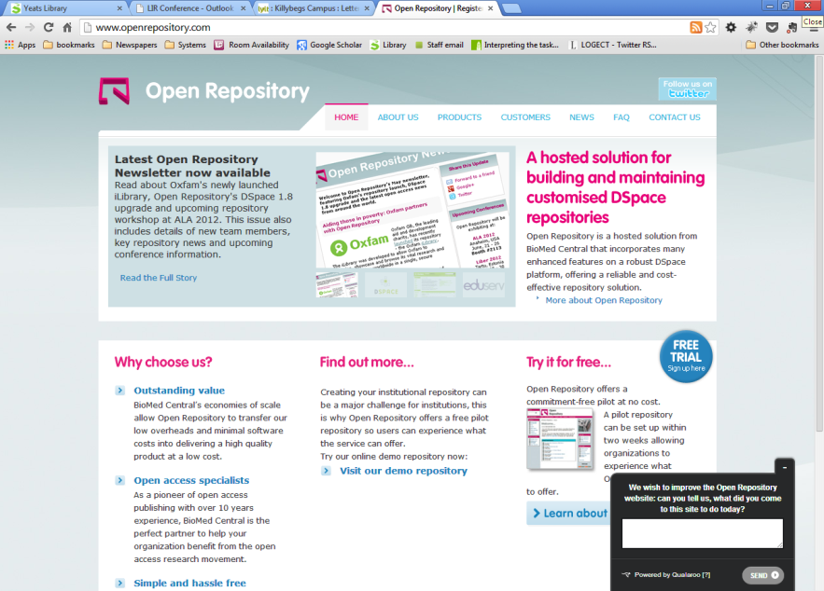
Tender
Specification (LYIT)
RFT (GMIT)
Librarians of GMIT, ITS and Systems Librarian of LYIT analysed tenders
Biomed Central – Open Repository

Slide 5
CUA Repository Steering Committee
Policy
Agreed policy document for repository
Metadata
Agreed Dublin Core Schemas for Theses, Articles, Conference Papers etc.
Technical
Worked with Open Repository on Design of Interface

Slide 6
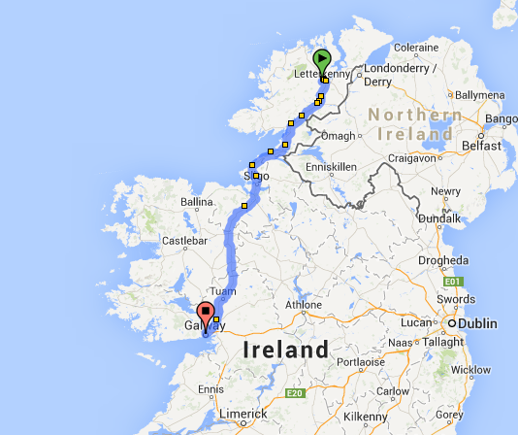
Communication
Microsoft Skydrive
Moodle
Site meetings
Conference Calls
Distances
L’kenny – Sligo c 112km
Sligo – Galway c 131km
L’kenny – Galway c 243km
(3.5 hours one way)

Slide 7
Content
Proposed Content
PhD and Master Theses
Research Papers
Journal Articles (Post Print with permission of publishers)
Technical Reports
Working Papers
Conference Papers
Books/Book Chapters
Book Reviews

Slide 8
Structure
LYIT
(Community)
ITS
(Community)
GMIT (Community)
Schools/Research Centres
(Sub-community)
School/Research Centres
(Sub-community)
Schools/Research Centres
(Sub-community)
Theses
(Collection)
Articles etc
(Collection)
Theses
(Collection)
Articles etc
(Collection)
Theses
(Collection)
Articles etc
(Collection

Slide 9
Licencing
Creative Commons
Attribution-NonCommercial-NoDerivs CC BY-NC-ND
Journal Policies (Sherpa Romeo)

Slide 10
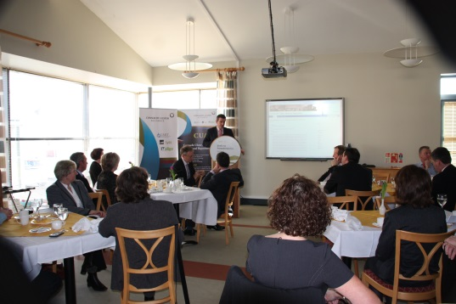
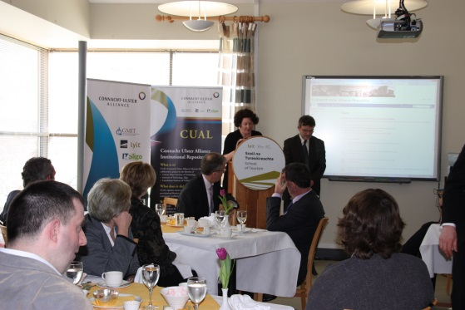
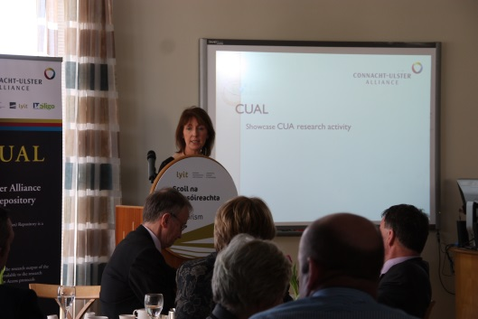
Launch
Launch Workgroup
Meeting of CUA Presidents and Registrars
LYIT Killybegs Campus
Publicity sent to local papers

Slide 11
Future
Self Archiving

Slide 12
Part II – Post-implementation Reflecting on the process

Slide 13
Starting Point
Working from a secure foundation
MIS project – understanding
Millennium Users List Forum
IOT Librarians - Consortia

Slide 14
Library ethos in IOTs
Sharing information
Working in teams
Raising the profile
Relevance – constant flux – reduced means
Development/research

Slide 15
Collaboration
Non commercial
Re-distribution of effort
Mutual benefit
Equal contribution

Slide 16
Build a Plan
Seminars and Conferences
Literature Review
Pooling together research – I.R. tripled in size
Positives & Risks
Presidents, Registrars and Heads of Development

Slide 17
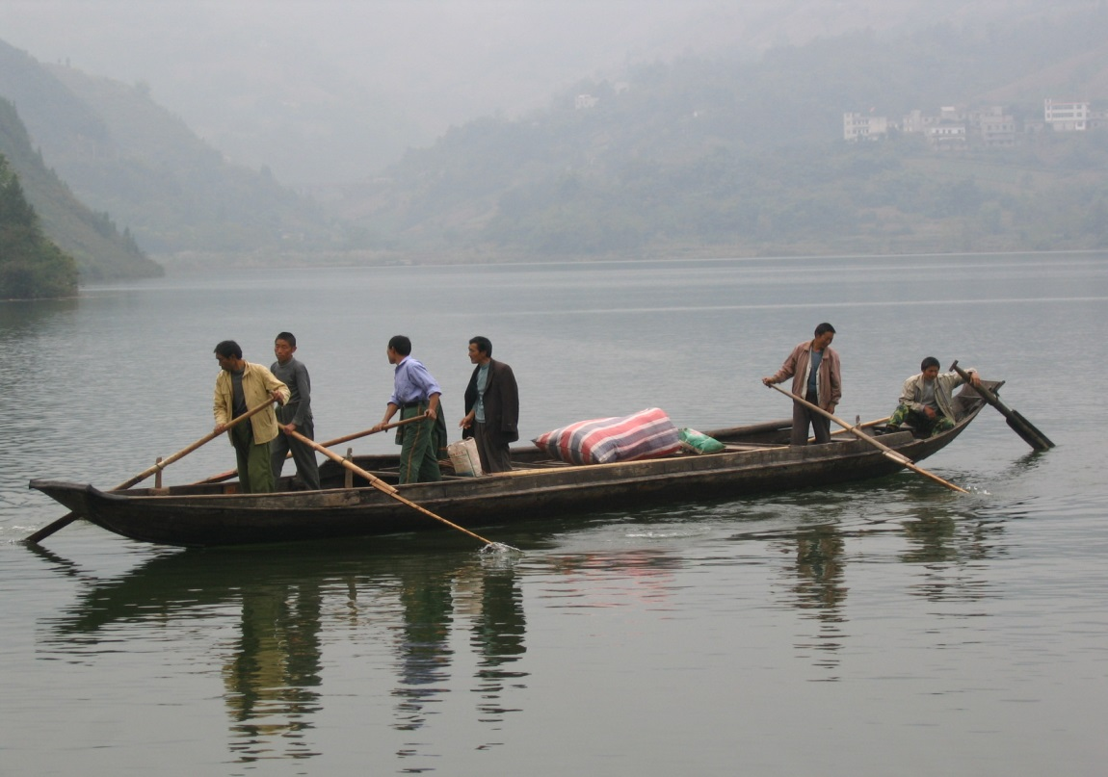
Benefits of Working in a Cluster
Additionality
Group decision better than the individual
Shared expertise invaluable – metadata, technical, procurement, policy and copyright.
Creativity

Slide 18
Benefits
Onsite visits
Adopting best practice
Renewing old peer-to-peer networks
New peer-to-peer networks
Raising profile
Library without walls

Slide 19
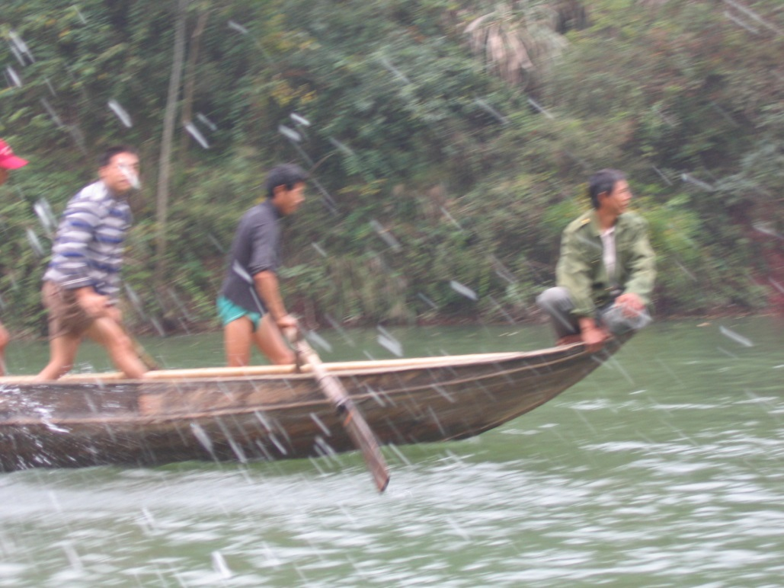
Quick Win
Parallel project– cost neutral
Reciprocal borrowing
Forming teams
Promotion
Extend to eResources

Slide 20
Working in a Group Challenges
Collective Decision making slower
Constraints on time - different windows different Institutions
Partial summer implementation – holidays
Better decisions
Minimum of three person committee

Slide 21
Unanticipated Challenges
Staff redeployment
Staff illness
Staff shortages

Slide 22
Launch School of Tourism, LYIT, Killybegs.

Slide 23
Team Voice Pox
“Developing a joint Connacht Ulster Alliance repository has had two major deliverables:
A functioning repository for the research output of the three Institutes
A functioning, cross-institutional team of library staff ready to undertake future projects.”
Jim Foran, Institute Librarian, ITSligo
“Working closely with the other Institutes in the CUA and has given me an insight into best practice with the group.
This sharing of information and methods will benefit all stakeholders and will continue to be of mutual benefit to all concerned going forward.”
Janice Margey, Senior Library Assistant, LYIT

Slide 24
“Joining forces on the repository gives us the power to promote access to the research output of the CUA institutes”
Kathryn Briggs, Systems Librarian, GMIT
“Purchasing a repository collaboratively generated a substantial monetary saving for each library whilst leveraging the expertise of our colleagues in each campus”
Margaret Waldron, Institute Librarian, GMIT

Slide 25
What next?

