Slide 1
The Development and Use of a RLO
Ellen Breen, Library, Dublin City University
Michael Ladisch, University College Dublin
LIR Annual Seminar, March 2013

Slide 2
Presentation Overview
About MyRI
MyRI Use
Recent Updates

Slide 3
Project Aim/Overview
National Digital Learning Resources - Project Funding Call May 2010
Develop materials that support a blended approach to training and education in the area of bibliometrics
Share knowledge, expertise, skills and resources
Deliver quality re-usable learning resources
10k awarded (matched by staff time)
Timeline: July 2010 - March 2011

Slide 4
Why This Project?
How do I calculate
my h-index?
What is the top journal in my field?
Why are my conference papers not appearing in WoS?
Why do I get higher citation counts when I use Google Scholar rather than WoS?
What’s the average citation rate for papers in physics?
How many times has my book been cited?

Slide 5
Project Team – 4 Libraries, Staff from 2 academic departments

Slide 6
The Toolkit
Workshop and presentation materials
Worksheets, datasheets, posters, booklet, videos Most can be edited to suit local needs
Online Tutorial
Materials for workshops & presentations
Bibliometrics Toolkit
Online tutorial
Overview Journal Ranking Personal bibliometrics Articulate used to create this tutorial Link to it, or download, customise and host locally
Lesson plans
Suggestions on how to pick materials and present them for different time periods and topics.
Includes powerpoint slides
Lesson Plans

Slide 7
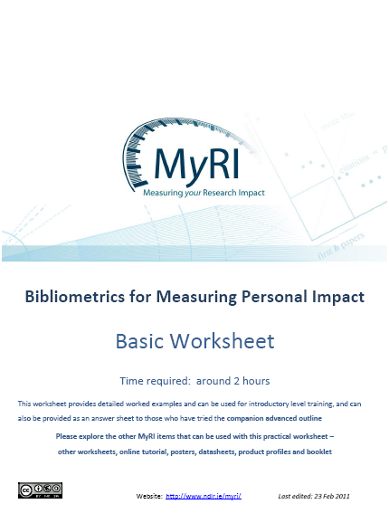
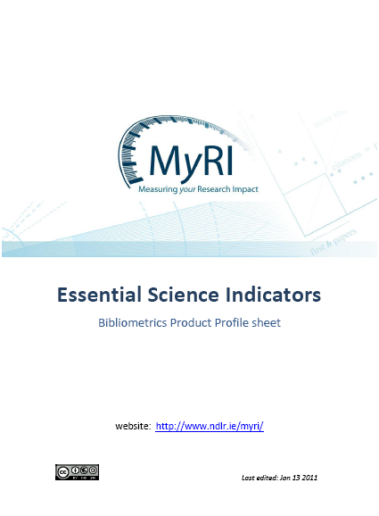
PowerPoint Slides; Product Profiles; Worksheets

Slide 8
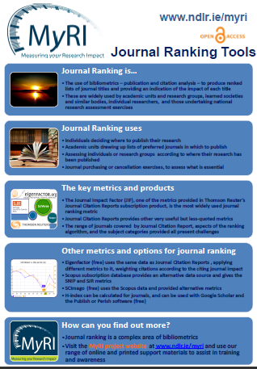
Exhibition posters
Notes:
8

Slide 9
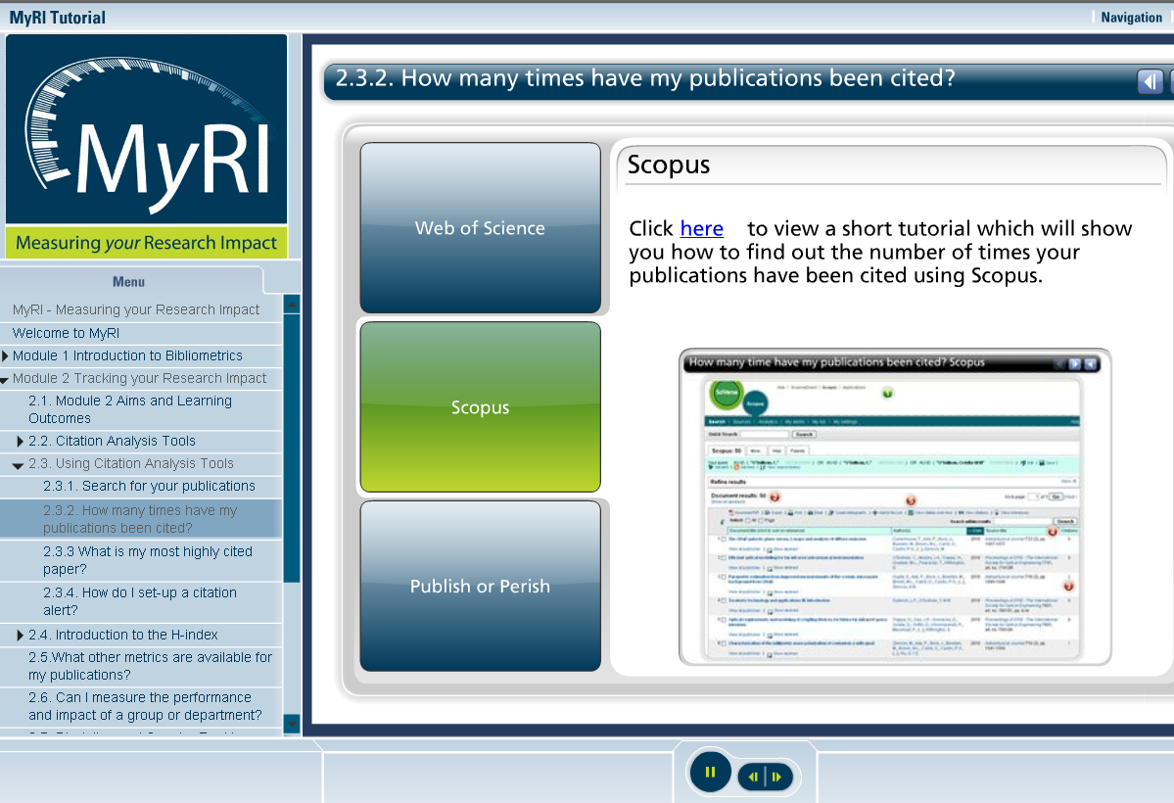
The Tutorial

Slide 10
Main Access Route: www.ndlr.ie/myri

Slide 11
The Tutorial
Module 1: Provides an overview of bibliometrics
Module 2: Focuses on the main bibliometric tools available to track and assess research performance at individual, departmental, institutional and country level
Module 3: Looks in detail at the ‘Journal Impact Factor’ (JIF) , how it is calculated as well as highlighting additional journal metrics and emerging journal ranking tools

Slide 12
Customisation
All printed materials can be downloaded for editing using MS PowerPoint or MS Word
To customise/edit the online tutorial you will need:
Software (MS PowerPoint, Articulate Software (Presenter & Engage), Captivate, Camtasia)
Instructions for downloading/editing online tutorial available on website

Slide 13
Using MyRI – Locally
Workshops
Measuring your Research Impact: Bibliometrics for your CV
MyRI Summary Datasheet and database worksheets
Journal Impact & Analysis
MyRI Summary Datasheet
JCR Worksheets
Individual support
Notes:
Michael

Slide 14
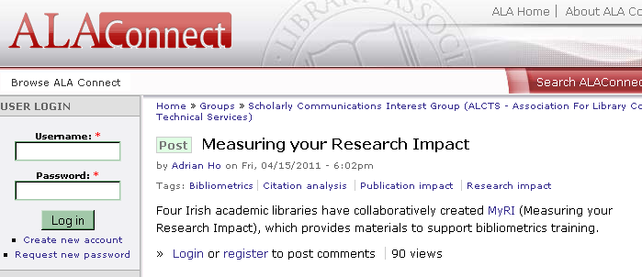
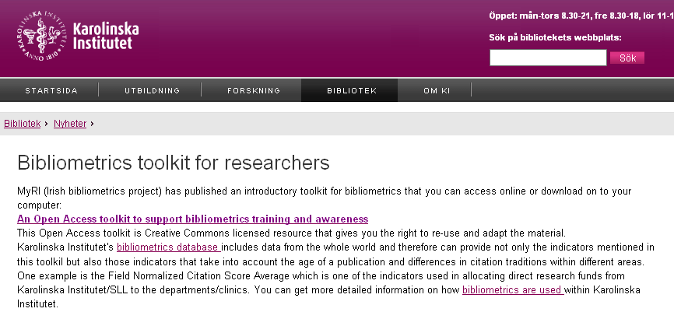
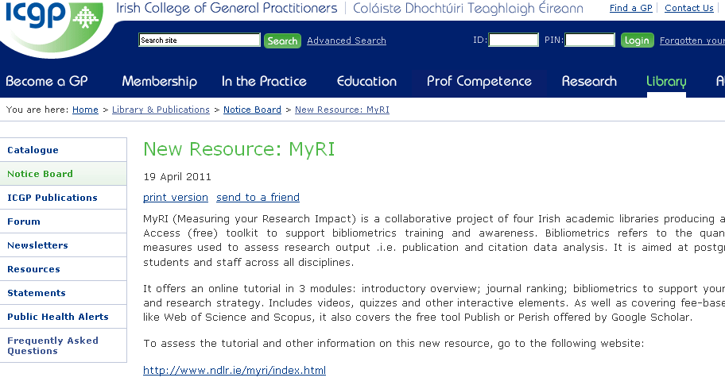
Marketing/Advocacy – Library Blogs

Slide 15
Marketing/Advocacy – Testimonials

Slide 16
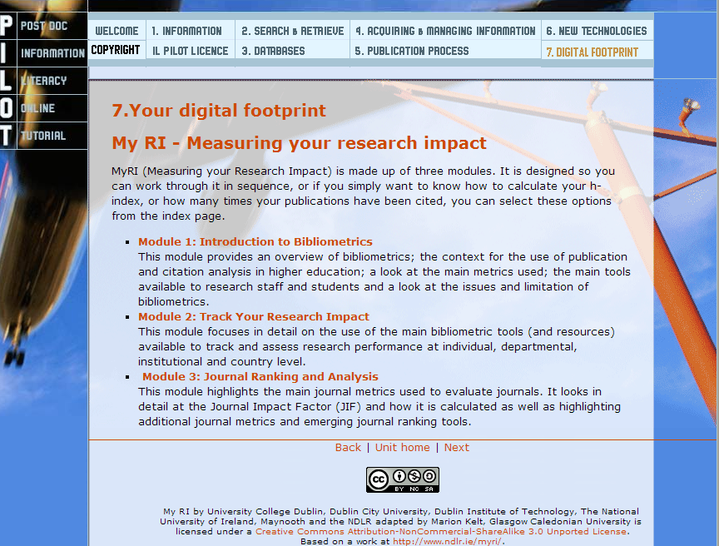
Customisation
Queen Margaret University Edinburgh
Glasgow Caledonian University

Slide 17
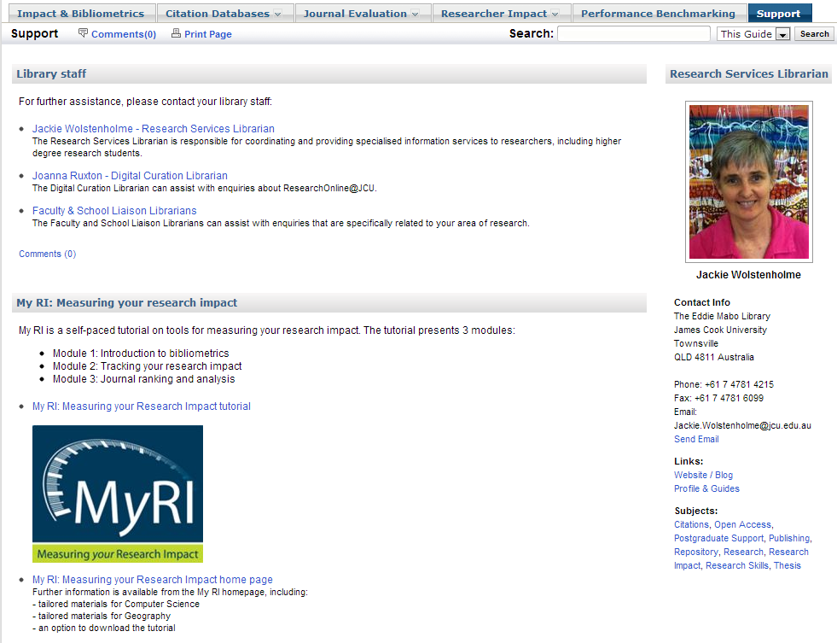
Use
James Cook University, Australia
HLWIKI, University British Columbia

Slide 18
Use

Slide 19
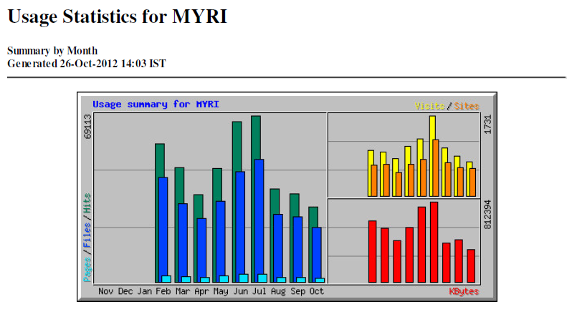
Use

Slide 20
Online Tutorial – Recent Updates
MyRI Ongoing Maintenance Group
Module Two
Google Scholar Citations
Added MS Academic Search to the list of tools with a link to a product profile
Update on Article-Level Metrics
Re-arranged content and added a new heading
‘Benchmarking Research Performance – Tools and Tips’
Module Three
Google Scholar Metrics
Notes:
Ellen

Slide 24
Contact – http://www.ndlr.ie/myri

