Slide 1
Internet Librarian International 2012 Re-imagine, Renew and Reboot: Innovating for Success
Marie G. Cullen
Assistant Librarian
National University of Ireland Maynooth
marie.g.cullen@nuim.ie
@cullenmarieg

Slide 2
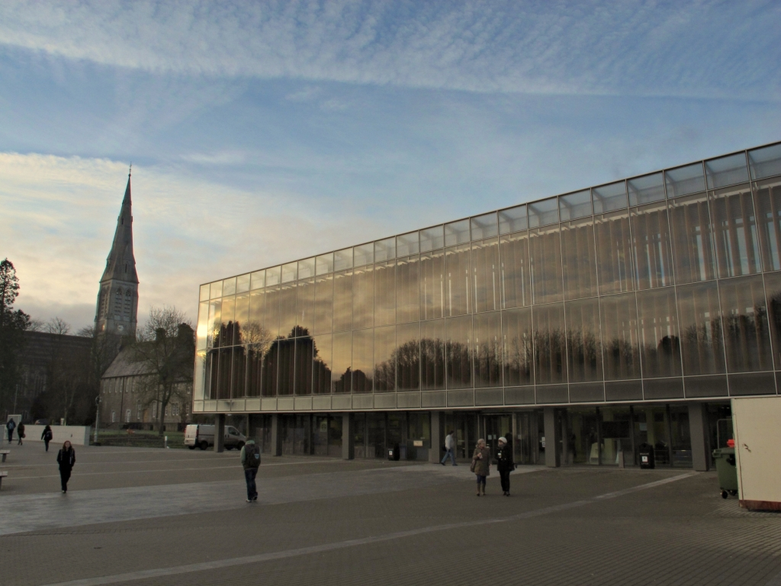
Thank You LIRHEAnet and the Library, NUI Maynooth
Photo Credit: Alan Monahan

Slide 3
THE INNOVATION AND TECHNOLOGY CONFERENCE FOR INFORMATION PROFESSIONALS
Workshops 29 October 2012
Conference and sponsor showcase
30 and 31 October 2012
Olympia Conference Centre, London
Notes:
Sister conference of Internet Librarian held annually in the USA

Slide 4
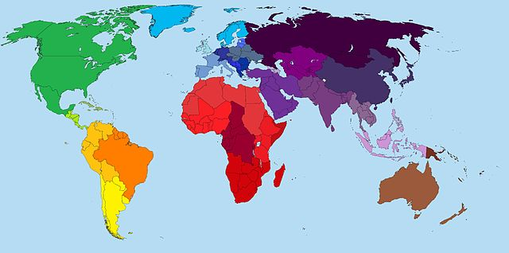
Attendees
Europe
Ireland
United Kingdom
North America
Australia
Map source:
http://commons.wikimedia.org/wiki/File:World_Map.jpg#filelinks
This file is licensed under the Creative Commons Attribution 3.0 Unported

Slide 5
France
UK x 6
Canada
Netherlands x 2
Sweden
USA
Norway
South Africa
Notes:
Advisory Board

Slide 6
Re-imagine, Renew, Reboot: Innovating for Success
Notes:
Theme

Slide 7
Context
Innovative Services
Fast changing technology landscape
Budgets under pressure
Notes:
Context
explores how innovative services and products are being
developed and implemented by librarians for ever more demanding
customers in a fast-changing technology landscape. Library patrons,
users and customers now expect access to information wherever
they are, on a variety of devices. Budgets remain under pressure.
Access to information, data and knowledge is becoming more open
and transparent, with partnerships and new social media contexts
expanding knowledge sharing in new and surprising ways.

Slide 8
Context
Expectations of customers/users/patrons
Access to information everywhere on a variety of devices
Notes:
Context
explores how innovative services and products are being
developed and implemented by librarians for ever more demanding
customers in a fast-changing technology landscape. Library patrons,
users and customers now expect access to information wherever
they are, on a variety of devices. Budgets remain under pressure.
Access to information, data and knowledge is becoming more open
and transparent, with partnerships and new social media contexts
expanding knowledge sharing in new and surprising ways.

Slide 9
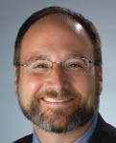
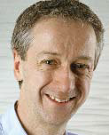
Keynote speakers
R. David Lankes
Syracuse University School of Information Studies. Director, Information Institute of Syracuse, New York, USA
“Stop lending and start sharing”
Roly Keating
Chief Executive, British Library
“The journey to digital at the British Library”
Notes:
Stop lending and start
sharing
R. David Lankes, Syracuse University School
of Information Studies Director, Information
Institute of Syracuse.
R. David Lankes is a passionate advocate
for libraries, librarians and their essential
role in today’s society. He is also interested in how information
approaches and technologies can be used to transform
organisations. His book The Atlas of New Librarianship won
the 2012 ABCCLIO/Greenwood Award for the Best Book in
Library Literature.
In his keynote, Professor Lankes will argue that the future of
libraries is not in our collections or a building, but in our
relationship with those we serve. Libraries are knowledge
hubs that bring together the wisdom of the community, and
share it with the world. This is more than just a rhetorical shift;
it has real implications for how libraries organise themselves
and how they use technology.
The journey to digital at
the British Library
Roly Keating
Roly Keating is Chief Executive at the
British Library. Prior to this he was the
BBC’s first ever Director of Archive
Content and a former Controller of BBC
Two. He developed and implemented the BBC’s digital
strategy for its programme library.
The digital revolution is opening up enormous opportunities to
the British Library. It is enabling large parts of the national
collection to be widely shared both within the UK and globally,
for the digital unification of ancient manuscripts separated
across continents, and for increased collaboration between
researchers.
Expectations of what can be achieved are understandably
high, and the challenges in meeting these considerable.
Protecting copyright, ensuring material that is ‘born-digital’ is
preserved, and dealing with the huge scale of the digitisation
task are just some of the issues the British Library is tackling
on its journey to digital.

Slide 10
Parallel Sessions “Tracks”
Short (30 mins)
2 presentations per track
Theme “Rethinking”
Notes:
Three Tracks – A, B, and C. 2 presentations per track morning and afternoon

Slide 11
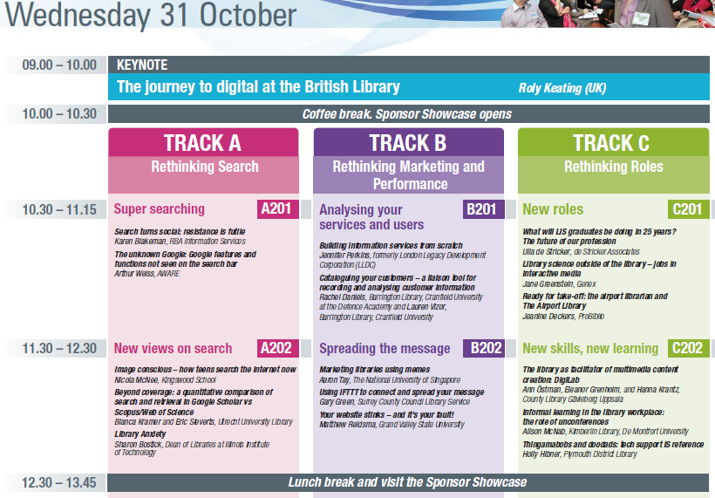
Notes:
Track A:
Rethinking Search
Track A:
Rethinking Discovery
Track B:
Rethinking Marketing and Performance
Track C:
Rethinking Roles
Track C:
Rethinking Teaching and Learning
Track A:
Rethinking Search
Track A:
Rethinking Discovery
Track B:
Rethinking Marketing and Performance
Track C:
Rethinking Roles
Track C:
Rethinking Teaching and Learning

Slide 12
Experimentation
Mobile
Supporting research
Web architecture , open access to library data and services
The “Cloud”
Digital Services, seeing into the future

Slide 13
User experience/User centric
Search/discovery
CPD, learning
Reaching new users, engagement
Dissemination/Marketing

Slide 14
Finally
Twitter
Conference hashtag
#ili2012
Notes:
Twitter
Really came in to its own.
Badges had peoples twitter handle.
Following online and retweeting finding it useful
Meet people and might know them by their twitter handle

Slide 15
Thank you

