Slide 1
Exploring use of LibGuides as an additional online environment to facilitate UCD Library online services and information to users
Ros Pan
Project Lead
Notes:
UCD Library is currently piloting LibGuides.

Slide 2
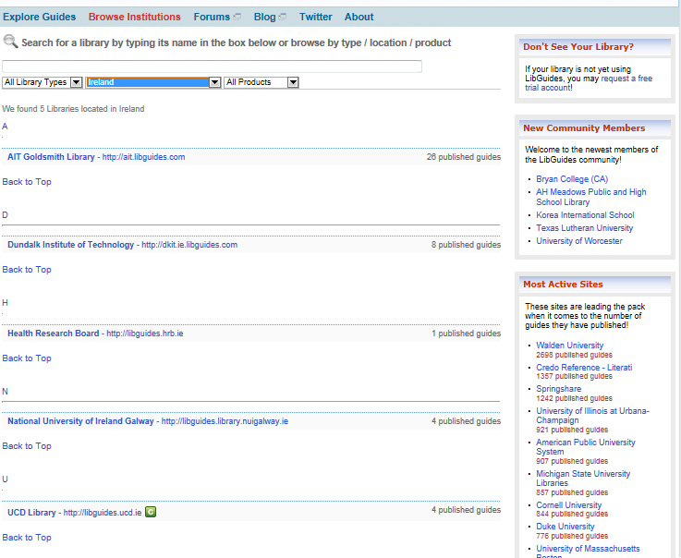
In Ireland…

Slide 3
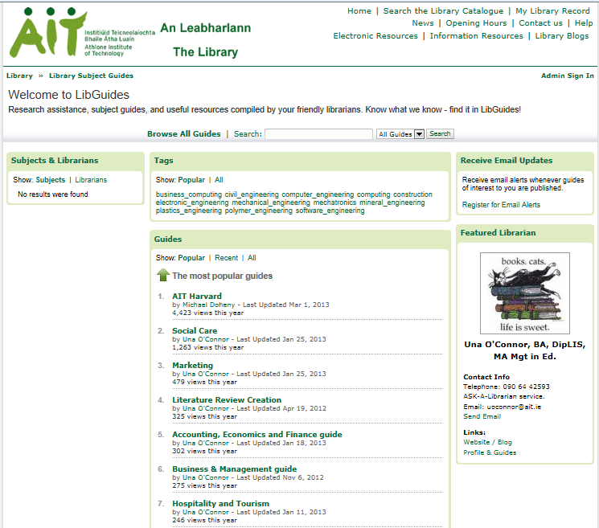

Slide 4
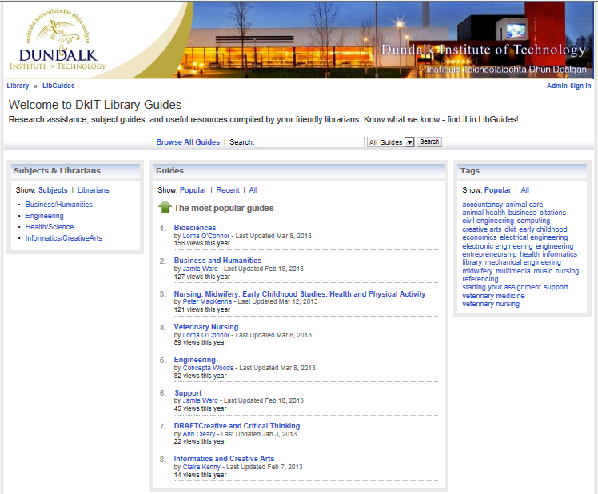

Slide 5
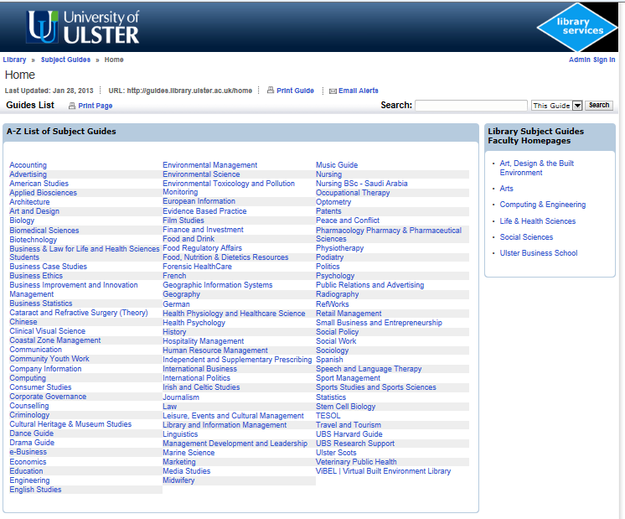

Slide 6
Re-use others work!
“Search and explore 329,898 guides by 54,863 librarians at 3911 libraries worldwide!”
Can re-use their guides and pages of guides (with permission)
Need to explore how that works further, to get them into our look and feel

Slide 7
Project details
Are adopting a project approach, work packages, deliverables, success factors etc etc
http://libguides.ucd.ie – all project details are there in our published “guides”
Pilot team: Julia Barrett, Joshua Clark, Lorna Dodd, Michael Ladisch, Jane Nolan = 3 authors plus managers and outreach staff
Set it up with custom domain so that the URL looks like it is us which is desirable – breadcrumb trail take you back in the end to the library website

Slide 8
Context
UCD Library has a number of online environments for users. Most of these are primarily for resource discovery (catalogue, Find it, Repository, digital library).
We also make use of social media channels, mainly for short communications and PR items to our users.
Regarding online environments to provide in-depth information and e-learning to users there is really currently just the Library website, which was professionally re-designed and re-organised and pruned in 2011 at significant cost and contains some sections that are essentially online tutorials, and use of pdf guides for detailed supports of various kinds.
The CMS-based website is edited primarily by the Outreach unit but that is broadening to include other members of the Planning and Administration support team: one question is why can’t people use the CMS?

Slide 9
How to justify LibGuides?
LibGuides (http://springshare.com/libguides/) is a good way to provide more information skills materials, eLearning material and in-depth research guides fully online
LibGuides is a good way to achieve a wider distribution of content-creation and maintenance across the library staff, with significant advantages compared to broadening use of the CMS
LibGuides can be fitted into the overall management of our online environments, maintaining an acceptable level of quality and uniformity in the content alongside a wider content editing group of staff

Slide 10
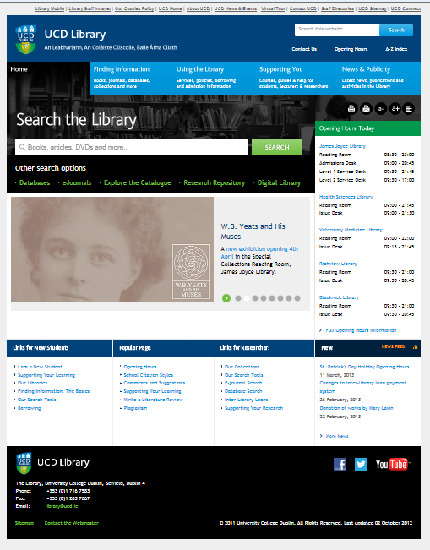
The website and LibGuides…

Slide 11
What we subscribe to
We have purchased the more expensive version, used to be called Campus guides, now called LibGuides CMS, do pay nearly 1k more a year for that. €3.5k
Main advantages to us:
Can have essentially separate instances of LibGuides. In other words each Group has its own home page and this is good if you want to use the product for a diverse range of things
Each could have own header and footer, own colour scheme (not doing these) each gets own top page and if show subject headings and tag clouds to users only see the ones used in your group
Can present one group as guides, one group as online subject rooms, the others as portals if you wish.
Other advantages too: can store docs and images etc on the remote server with this version.

Slide 12
The pilot areas
In the pilot we are indeed using it in a diverse way, 4 trial areas:
Bibliometrics Michael Ladisch
Maps and GIS Jane Nolan
Subject Guides Lorna Dodd
General Library guides Michael Ladisch

Slide 13
Milestones
2013
17 Jan commence project with kick-off meeting
8 Feb 12 month subscription starts
Mar 11 and 13 main in-house training
31 May 4 sets of pages ready to go live, library staff update held
3 Jun 4 sets of pages go live
30 Nov live use for semester completed, statistics analysed, qualitative user feedback obtained
21 Dec report and recommendations tabled
2014
31 Jan decision reached on continuing recurrent expenditure for year 2 to complete full year of pilot, and future beyond that

Slide 14
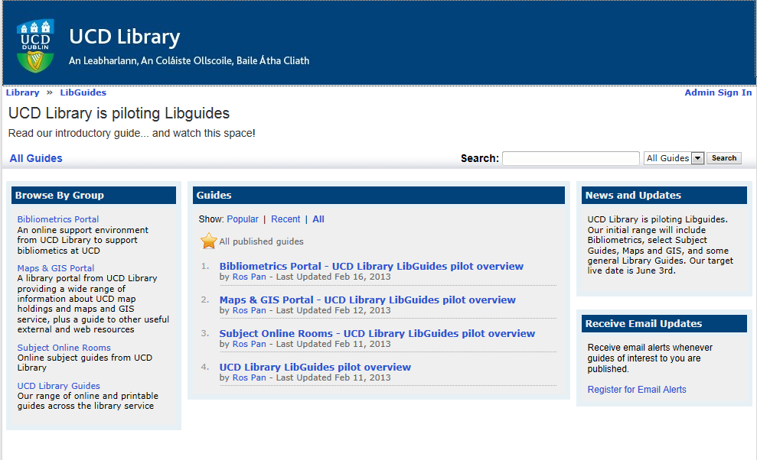
Online

Slide 15
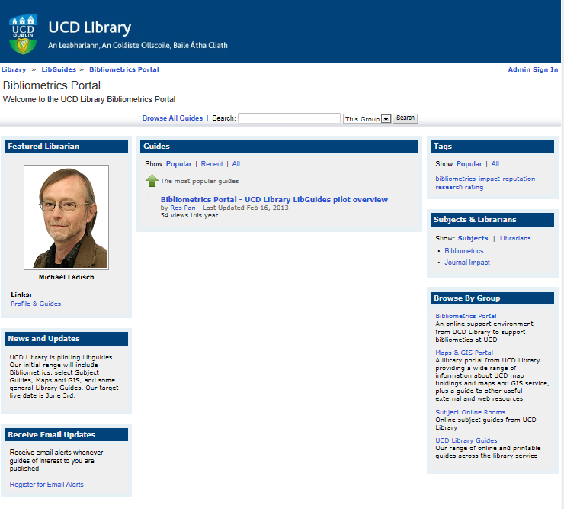
Online

Slide 16
Where are we?
Had a good look round other users
Good that get mobile version automatically, printable version quite good too
Got training done and unpublished guide where we have tried out all the main box types – the system is based on boxes on pages
Unearthed quite a lot of managerial issues:
Mirroring of commonly used content
Subject headings to use
Tags to use
Relation of group/subject category/tags
Keeping standard font and colour scheme
Keeping administrative record on hidden page of when created, reviewed, what images and docs are uploaded and used in that guide etc

Slide 17
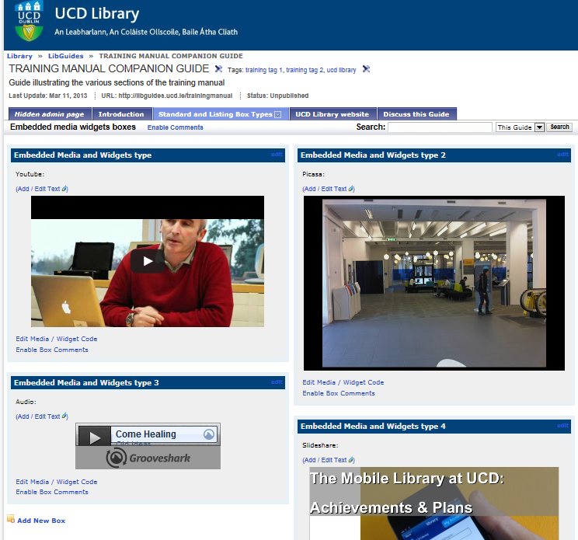
Training guide – all box types tried

Slide 18
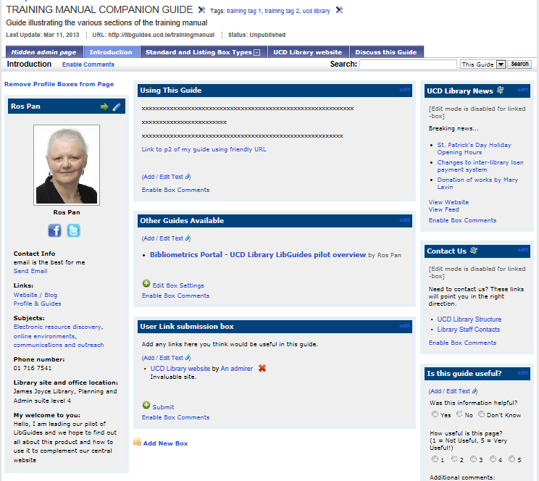
Training guide – all box types tried

Slide 19
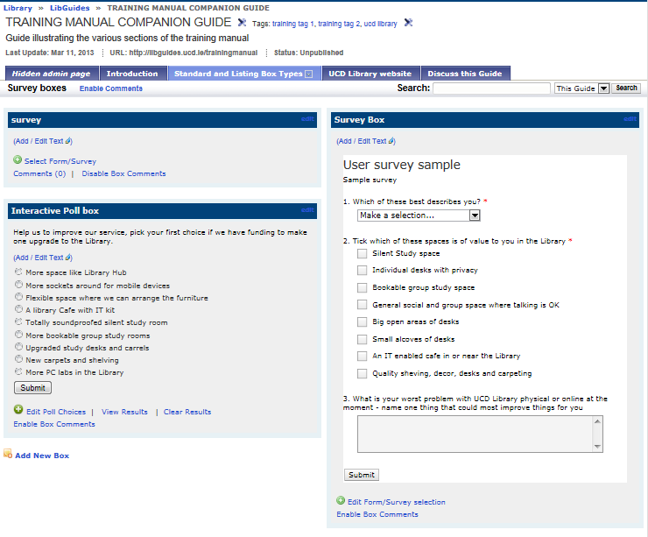
Training guide – all box types tried

Slide 20
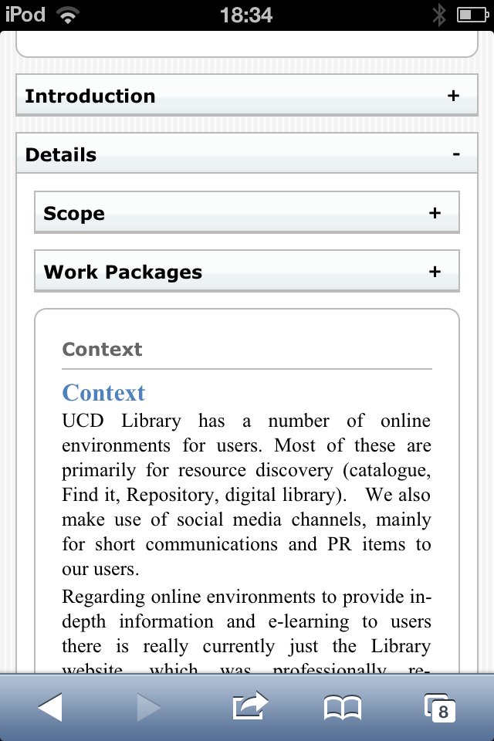
Mobile version
You can shorten the mobile version by suppressing non-essential boxes as you create the guide

Slide 21
So far..
Very promising, it works alright!, very easy to use
Have to get to grips with the groups/guides/pages of guides and boxes on pages
Also groups/subjects/tags: what are all for?
Boxes of content is a different way to present info
Got to get to grips with mirroring commonly used content not duplicating it
Are a lot of admin issues to consider up front and things to do with new guides e.g. friendly URL for every guide, every page of every guide, every subject category you create etc.
The 4 areas will all have very different challenges to them

Slide 22
Success Factors
Statistics and qualitative feedback during the period of live testing of the pilot pages shows a significant usage of the pilot content by our users. This is the key success factor: many pages e.g. numerous maps by theme web pages, were taken off the website due to minimal usage bar the three remaining; subject pages were removed from the website due to minimal usage levels bar 4 or 5 of them - evidence has to be there that a different platform generates usage or there is no return of library staff time invested
It is agreed that LibGuides can be adapted to an acceptable look and feel for UCD Library
It is agreed that there are significant advantages to using LibGuides rather than the CMS for these pages
A managerial system is in place and agreed to ensure quality and look and feel of the LibGuides content is maintained, that can be extended to a mainstream use of the product
The performance of the hosted solution and company support if found to be satisfactory

Slide 23
If successful and we subscribe
This project is exploring the concept that the CMS-based website should be restricted to:
acting as a portal to our various resource discovery tools
providing terse practical information regarding visiting the library, borrowing, training and our collections
offering general news and publicity about the Library
providing detailed collection level descriptions of Special Collections until such time as a different approach goes live. These make up a third of the current web pages.
LibGuides would provide the platform for:
eLearning materials
user guides and support services alongside them

Slide 24
Finally….
http://springshare.com/libguides/
http://Libguides.com have a good look round all of their customers
Thanks for listening

