Slide 1
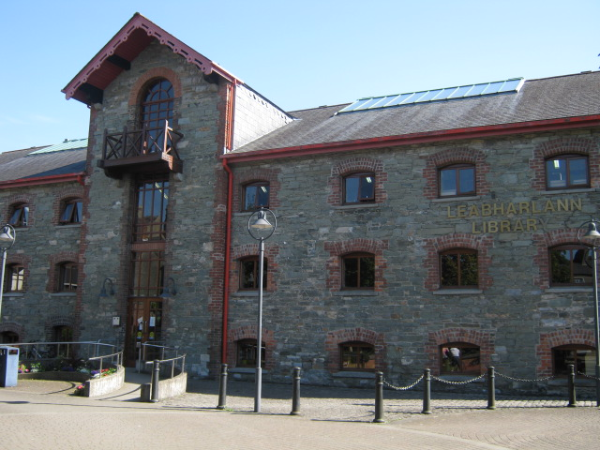
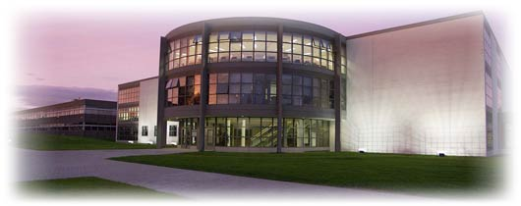
1 card 6 Libraries
Jamie Ward Systems Librarian DkIT
Amanda Branigan Senior Executive Librarian, Louth County Libraries

Slide 2
What is it?
Joint partnership initiative between Dundalk Institute of Technology and Louth County Libraries
Collaboration:
to support the learning, knowledge and cultural needs of people in County Louth
learn from each others practice -training and development of staff
Provide reciprocal borrowing for members

Slide 3
What it isn’t? Not an integration of stock management system
Patron
Database
Bibliographic
Records
Patron
Database
Patron
Database
Bibliographic
Records
Patron
Database
1card6 Libraries shared patrons records

Slide 4
Reasons
First proposed 2007
Social remit / community engagement / promotional
Benefits to each library
Staff practices shared
Events in County Library e.g. Literacy Promotion
Writer in Residence
Value added for both sets of patrons
Collections
Facilities (5 branches and mobile library for students around Co. Louth)

Slide 5
Unique Challenges
Fear of unknown
Data protection (permissions and secure transfer)
Different patron data input
(Large Banner registration files vs. single membership)
Large part of DkIT collection are e-resources
Vendor Access (Contracts for walk-in access)
Different membership regulations
Different loan rules (loan terms and fines etc.)
Technical issues
Different LMS

Slide 6
Overcoming Issues
Scoping exercise
Project team - regular meetings
Timeframe for implementation
Terms of reference drawn up for:
Changes in work practices
Technical confluence of 2 LMS
Horizon and Millennium transfer fields
May
July
Aug
Sept/Oct
Initial Meeting
Data testing
First transfer
Launch

Slide 7
Technical Stuff
New p-type and loan rules setup
Card barcode tested(1 Card 6 Libraries)
Data protection
Permission procedure and encryption software (MEO)
Used existing Bannerload fields for Exporting and importing patron data
Worked with Millennium and Horizon (Interleaf)
Agree minimum data fields to be exported and imported
Header codes agreed

Slide 8
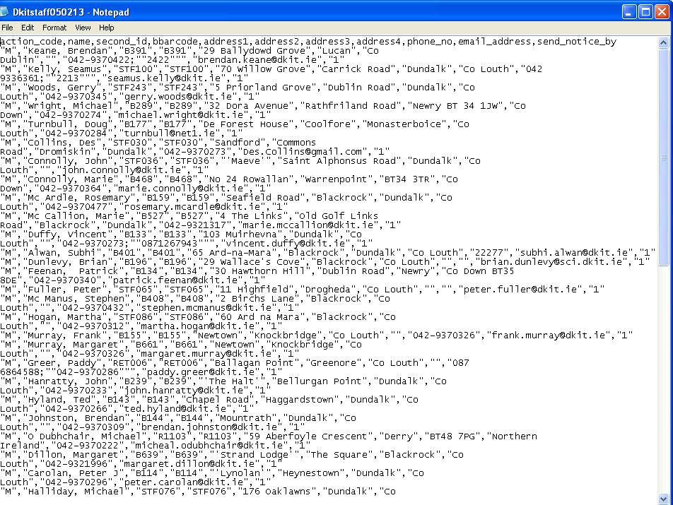
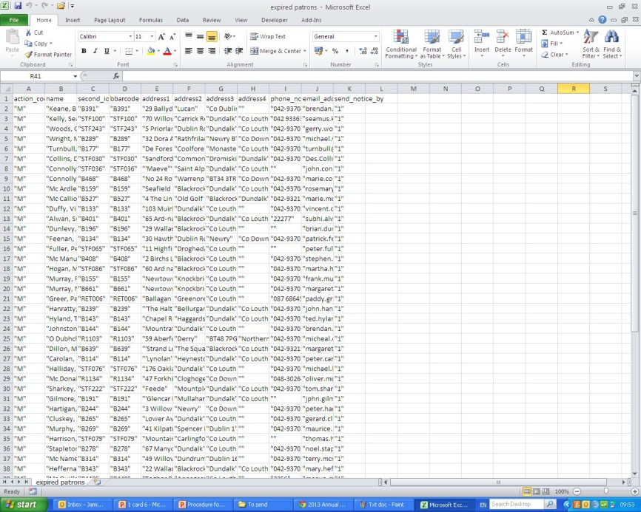
Exporting Data from Millennium
Create patron list
Export certain fields
Use Excel macros
Encryption
Export in .txt
Millennium
Text (.txt)
Master Excel
(Run Macros)
Text (.txt)
Purchased automated "patron profile” from III Millennium
Not implemented yet!

Slide 9
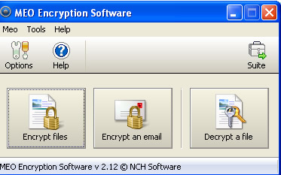
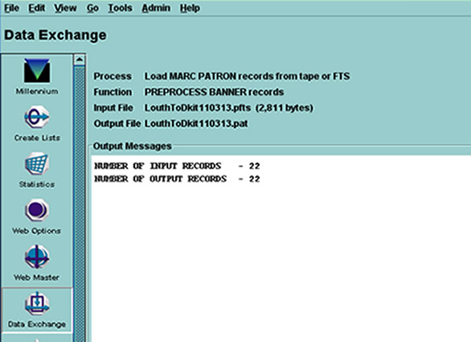
Importing Data to Millennium
Decrypt file
Data Exchange (Load records)
Pre-process (Banner)
Load records
Rapid Update expiry date
Test

Slide 10
Experience so far
Very positive from patrons
Increase of patron numbers (1,200+)
New staff practices
Regular meetings & communications to address issues
Opportunities for expansion (ILL, Acquisitions, Events etc.)
Re-emphasise community role of Academic library

Slide 11
1 card 6 Libraries
Amanda Branigan Senior Executive Librarian, Louth County Libraries

Slide 12
Background
5 branches + Mobile Library Service.
2011/12 offered free membership to DkIT students;& opportunity to avail of our free WiFi in branches & Market Square.
Collaborative Initiative – share staff expertise & knowledge
Focus on ease of access to unique collections, e.g. database access in DkIT; valuable & historic reference collection in Dundalk Reference Library
Co-operative agreement drawn up outlining terms of reference

Slide 13
Challenges
2 Library services with different remits, collection & lending policies (public vs academic)
Users must adhere to lending library’s rules & regulations
Data protection issues – borrowers must ‘opt-in’ to initiative
Opportunity to ‘clean up’ registration records
Patron load exported on a weekly basis to DkIT
Data purged after expiry date, usually one year

Slide 14
Technical
Horizon LMS/Interleaf
Recalibrated scanners (DkIT unique identifiers)
Mapped Horizon fields to Millennium
Export
‘Opt-in’ field added to Horizon registration page
Borrower export programme set up, following Millennium format – encrypted files
Weekly patron export is manual not automatic, to allow checking
Import
Borrower import utility set up for DkIT
Less frequent imports from DkIT, 3-4 files to date

Slide 15
Access to Services
Louth Co Libraries
DkIT
300,000+ stock
5 Branch network + mobile service
50,000+stock
eBooks & eAudio downloadable books
Databases/ eJournals / eBooks
Reference Collection
400 study spaces
Study & Internet facilities
115 PCs / bookable study rooms
Children’s Services
Printing
Study & Internet facilities
Wi-Fi
1card6
Libraries

Slide 16
Success to date
Service indicators – increase in membership (624 DkIT staff & 4,787 DkIT students added to our database to date)
Interest from non-DkIT students living in Dundalk
Promoting lifelong learning through awareness of academic courses, e.g. evening classes, further education
Our branch library network very advantageous for DkIT students from across the county.
Ease of access to our joint services and collections
WiFi, e-audio downloadable books, eBooks etc.
Win-Win for all!

Slide 17
Thank You

