Slide 1
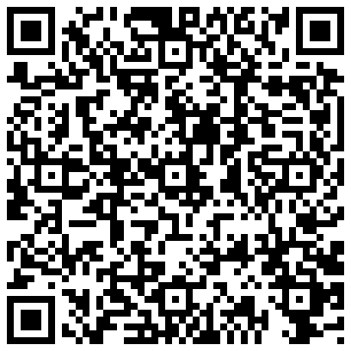
QR Codes: engaging library users at NUI Maynooth Elaine Bean

Slide 2
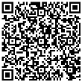
Why
Use
Them
How
To
Create
Them
Where
Are we
Using
Them

Slide 3
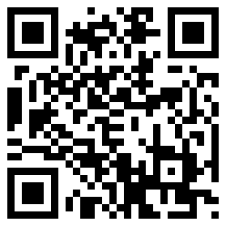
What are QR codes?
QR (Quick Response) Code is a type of barcode. When you scan or read a QR code with your iPhone, Android or other camera-enabled Smartphone, you can link to web pages, receive information contained in the code as text format to name but a few functions. You need to download and install a QR Code reader application on your mobile phone and this will enable you to scan the barcode, which will then link you to the information.

Slide 4
Why we are using QR codes in maynooth

Slide 5
Available at point of need so information is appropriate
Engages users by offering information in different ways
Mobile – don’t have to remember URLs/text

Slide 6
What do you need to make/use them?

Slide 7
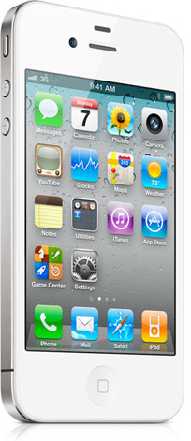
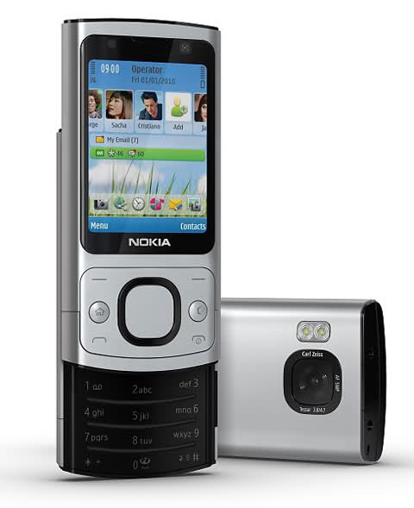

Slide 8
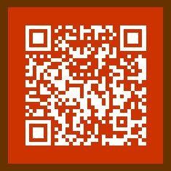
Match your corporate colours
Use B/W image

Slide 9
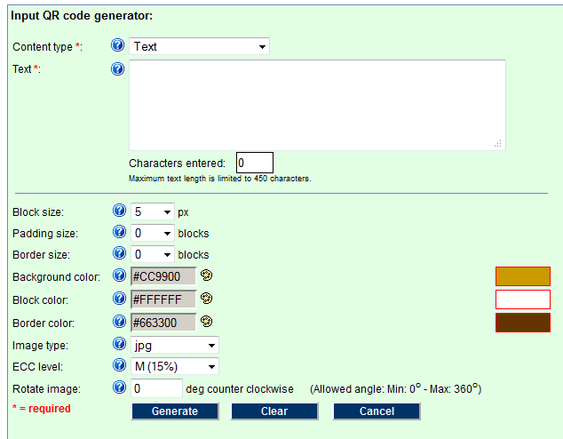
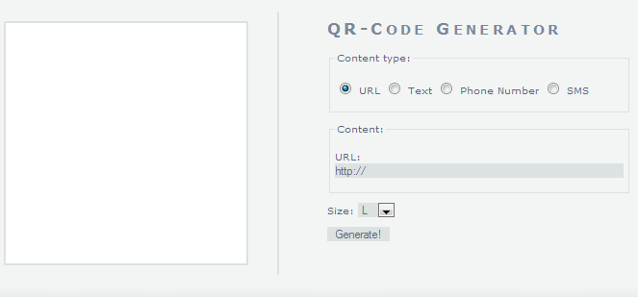

Slide 10
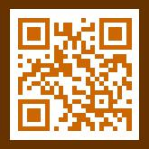

Slide 11
How are we using them in Maynooth?

Slide 12
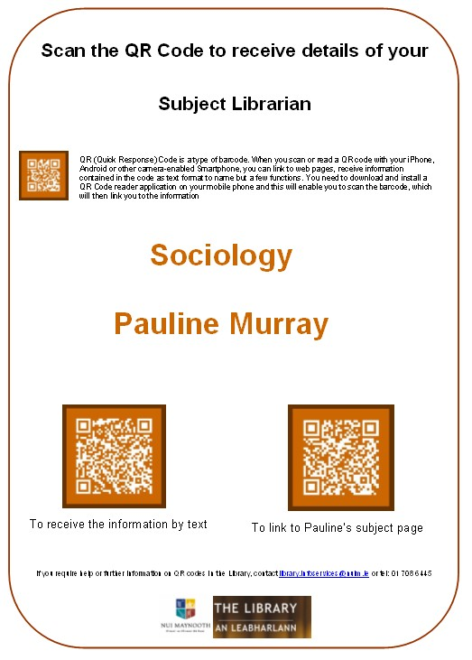
SHELF ENDS

Slide 13
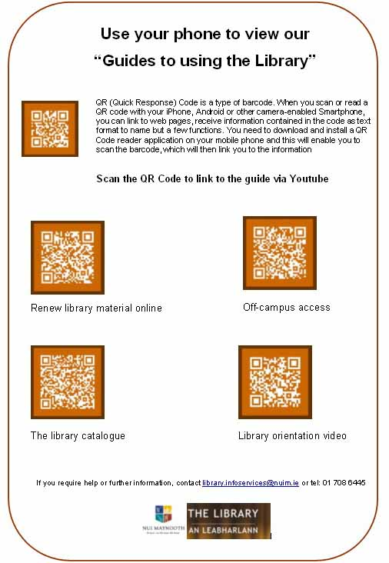
GUIDES

Slide 14
EXHIBITIONS

Slide 15
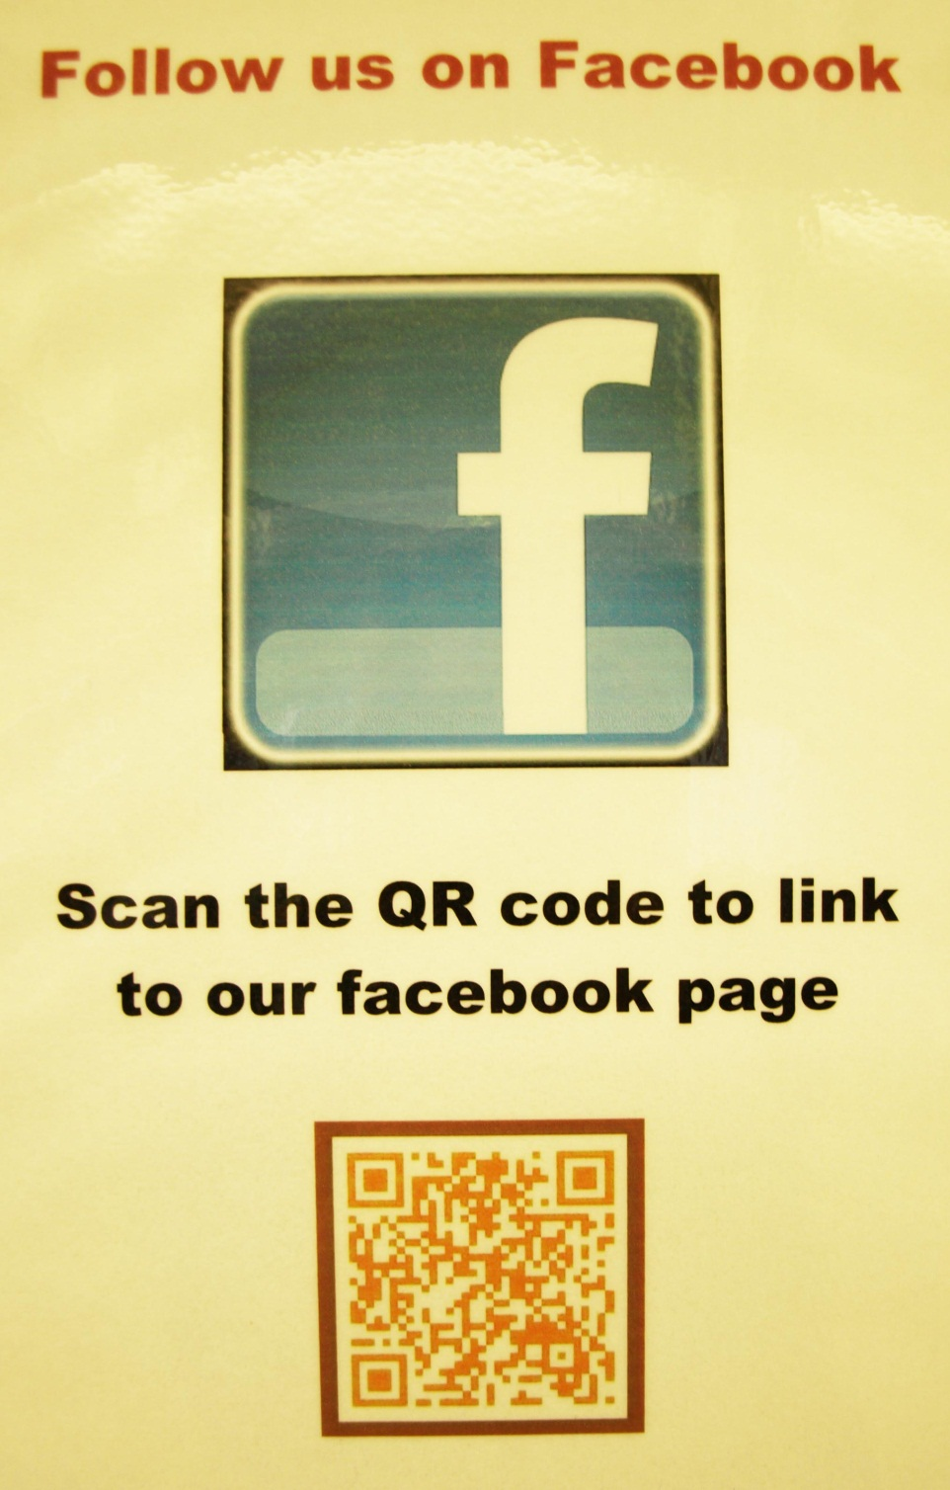
FACEBOOK

Slide 16
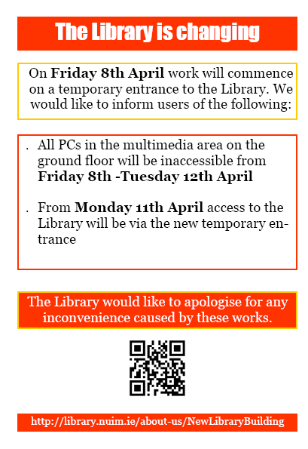
Building update

Slide 17
eBOOKS

Slide 18
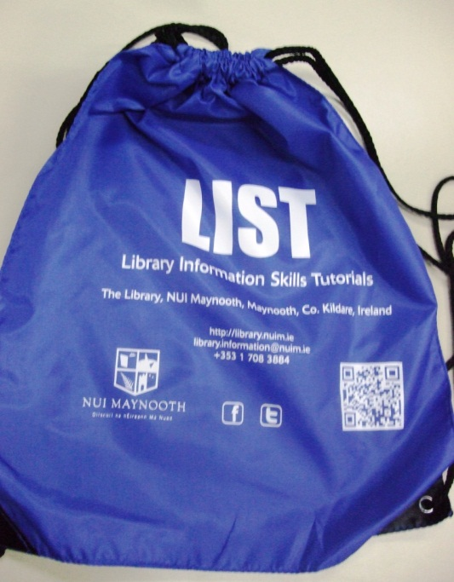
Promotional material

Slide 19
Other uses
Ejournals Quiz - yes/no Guides for using equipment
Floor plans

Slide 20
Points to remember
Off-campus access/URLs
Mobile friendly sites
Position them where they can be scanned
Lighting – size of code - relevance
Advertise
Help to get started
Library made a guide – available on our website
http://library.nuim.ie/about-us/publications/guides-using-library

Slide 21
You are welcome to contact me!
Elaine Bean
Information Services
The Library, NUI Maynooth
elaine.bean@nuim.ie
Tel: 01 708 6445

