Slide 1
Inside the work of the IReL Monitoring Group
Rose Buttimer, IReL Monitoring Group Chair
Aaron Binchy, IReL Officer
5 December 2018

Slide 2
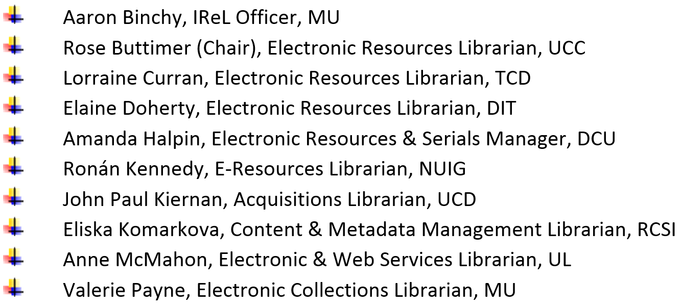
Monitoring Group Current Membership

Slide 3
Terms of Reference (2005)

Slide 4
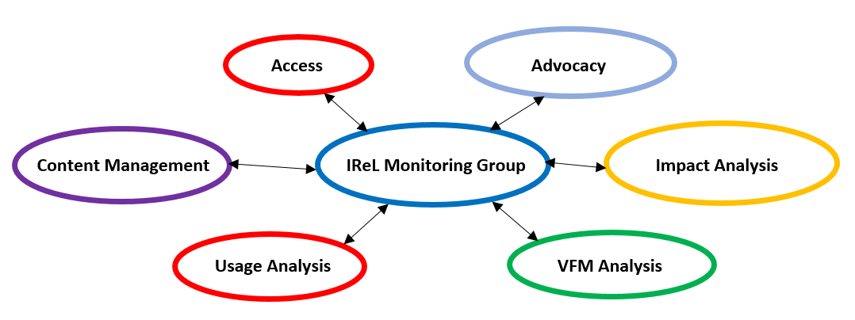
Monitoring Group Work

Slide 5
Audience - Funders
Higher Education Authority
Irish University Association
The Department of Business, Enterprise and Innovation
Notes:
Thank you Rose. I would like to speak a little on the Report on the Usage of IReL resources which has been produced annually since 2005 by the Monitoring Group. It contains approximately 50 pages, which review the usage of IReL resources for the past year and compares performance to previous years. It focuses on usage and cost of resources and contains numerous tables and charts to analyse usage and breaking it down by funding stream, resource type and subject area.
The report contains confidential and commercially sensitive information and therefore has a restricted audience. It’s primary audience are: IReL Funders: HEA, IUA - Irish University Association and The Department of Business, Enterprise and Innovation.

Slide 6
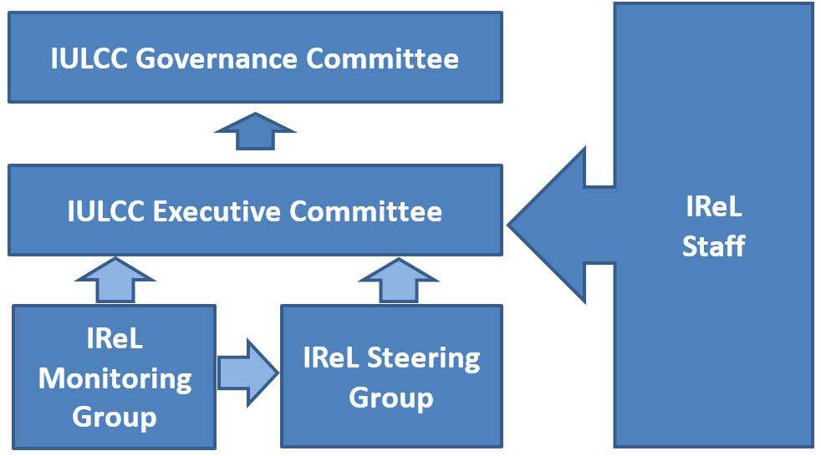
Information flow of report audience
Notes:
The monitoring Group start compiling the report at start of the year collection data from the previous year. Once it is complete it is circulated to the to the Steering Group and the IULCC Executive and Governance committee. It is scrutinised by all readers to to evaluate the value for money provided by IReL resources. The report is extensively used by the IReL office and by member libraries.

Slide 7
Process - Barriers to Harvesting Data
Notes:
Harvesting Data is the first step in creating the report. It is the fundamental step and possibly the most time consuming. Harvesting data often requires overcoming a variety of obstacles, before obtain it, be confident in it or work with it.
Initiatives such as COUNTER compliant reports and SUSHI Protocol (Standardized Usage Statistics Harvesting Initiative) have improved the process, but It is still a very manual and time consuming operation.
Barriers to collection can often start with at login and ensuing Password problems (these can include out of date passwords, broken links, change of publisher platform). While these are relatively minor and for the most part easy to rectify, it does hinder the process and slow progress.
Once login has been successful - there is always the challenge of finding where reports are located on the publisher platform. Platform architecture is differs from vendor to vendor. User stats are very seldom one click away from the login page.
Not all usage reports provided by vendors are COUNTER compliant, this raises questions of their validity and also creates additional work in preparing data as it is not in a standardised format
Amazingly there are still vendors who cannot provide online access to usage reports and these must be requested directly from the vendor, which again slows the process.
Once data has been collected - it must be accessed ensuring there are no anomalies, or spikes that require investigation or vendor assistance. In other words we need to ensure that the data is clean, reliable and ready to work with.

Slide 8
Configuring data “Standardised Usage Statistics”
“Counting and reporting usage data is far from a simple process, since the ultimate data can vary significantly depending on what exactly is counted (HTML, PDF or both), how it is counted (loads, versus reloads, internal links, etc.), and what “counts” (bots, automated usage, clicks to abstracts, or landing pages or the full text).”
Todd A Carpenter
Scholarly Kitchen 30 Jan 2017
https://scholarlykitchen.sspnet.org/2017/01/30/counter-prepares-release-5-code-practice/
Notes:
“Standardized Usage Statistics” - may be an oxymoron. Once data is harvested, it must be configured into a standardised format and layout so that relevant information can be extracted and ingested into the IReL database
It involves
Preparing data for many sources, consolidating and configuring it into a workable dataset.
Usage is collected by resource down to title level
Usage is filtered against title lists to ensure we are only collecting data for the correct resources.
The data must then be structured into a report friendly format

Slide 9
What we collect
Notes:
Primarily the reports examine Usage and Costs of IReL resources and titles. These are broken down by funding streams, resource types and subject areas.

Slide 10
Cost per use (CPU)
“Quote for Slide: Cost per use (CPU), an extremely valuable metric in evaluating big deals in particular, is often used as a primary evaluation tool within consortia…….when considering and attempting to compare differing types of use across varied resource formats and subject areas. Understanding the need for more in-depth and holistic approaches to consortial resource evaluation is one thing, implementing it another.”
Determining Value: The Development of Evaluation Metrics for Shared Content
Genya O’Gara and Anne Osterman
http://www.ala.org/acrl/sites/ala.org.acrl/files/content/conferences/confsandpreconfs/2017/DeterminingValue.pdf
Notes:
Apologies for using such a long quote. But O’Gara and Osterman gets to the essence of the value of CPU as a metric and the problems it presents. CPU may be seen as blunt instrument which fails to provide qualitative analysis (who is using resources or how they are being used, what it is being used for etc.). Nor does it probe the long tail - for example perhaps only the 5 most popular titles from a publisher are downloaded, receiving 80% of the usage and the other 100 plus titles sit metaphorically be gathering dust with little or no usage

Slide 11
CPU – Euro to Dollar
Graph courtesy of Statista: https://www.statista.com/statistics/412794/euro-to-u-s-dollar-annual-average-exchange-rate/
Notes:
CPU has proved to be and essential metric for IReL when tough decisions have to be made quickly.
It provides a very clear metric on usage and value for money and is an essential tool in our armoury for contract negotiations, or to justify cancelling a resource which are not widely used and can be source by more effectively through different acquisition methods (e.g. inter library loans).
Two examples of where CPU was used by extensively by IReL in the past were the financial crash in 2009 and when the exchange rate of euro fell drastically against the Dollar and Sterling in 2015 and 2016. These events, were outside of our control and like so many others we were presented with enormous challenges. This meant that tough decisions had to be made, agreements renegotiated and some resources cancelled. CPU was a primary metric in making these decisions. It enabled decision makers to quickly make informed decisions on which resources were providing value for money.

Slide 12
CPU – Red Flag
“Understanding the need for more in-depth and holistic approaches to consortial resource evaluation is one thing, implementing it another.” O’Gara and Osterman
Notes:
CPU is perhaps most useful as As a Red Flag - It alerts us to declining usage and rising costs, providing an effective early warning system. High CPU notifies us that certain resources require investigation (this may bring to light light issues with their licence, the need to investigate turnaways or check if there are any technical issues which were not resolved). When monitoring a resource over a number of years the trend will show if the CPU rise is a temporary blip or a steady decline. This information and additional investigation allows us to make necessary decisions on the future of the resource.
O’Gara and Osterman captures perhaps why for the time being we are still tied to working with CPU, and I will leave you with a question before I hand you back to rose to wrap up
Have we found a better metric to replace CPU?

Slide 13
Future considerations
Altmetrics
COUNTER Code of Practice release 5
COUNTER Code of Practice for Research Data Usage Metrics release 1
LIBER’s Open Access: Five Principles for Negotiations with Publishers
Outcome of IReL Review and expanding membership

Slide 14
Relationship Management

Slide 15
Contact Details
Aaron Binchy
Email: Aaron.Binchy@mu.ie
Tel.: +353 (0)1 474 7112
Web: www.irelibrary.ie
Rose Buttimer
Email: r.buttimer@ucc.ie
Tel.: +353 (0)21 490 2085
Web: https://libguides.ucc.ie/eresources/home

