Slide 1
Client Requirements Process
Service Change Management
How HEAnet handles it
How to request service change
Requirements
Timelines
Future

Slide 2
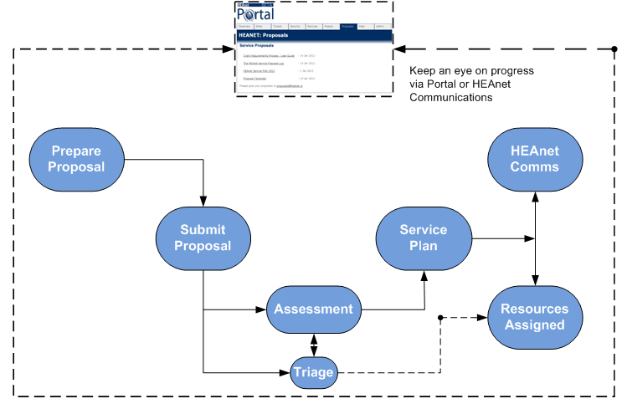
Client Requirements Process

Slide 3
Client Requirements Process
Information Services
First point of contact
Formulate proposal/request
Assemble supporting material
Contact HEAnet / Submit proposal

Slide 4
Client Requirements Process
HEAnet assessment
Triage / regular procedure
Strategic service?
Already available?
HEAnet MT -> SSG
Management team
Services Steering Group

Slide 5
Client Requirements Process
Timelines: New Service
Requirement analysis
1 month: client(s) + HEAnet
Service Proposal
1 month: HEAnet + client(s)
Procurement
Prepare Tender
6 months : PIN/RFT/Award
2 Months : Legal discussion … contracts signed

Slide 6
Client Requirements Process
Timelines (contd)
Service Proposal -> New Service
10 months
Can be shortened (simple, cheap)
Typical example: 18 months

Slide 7
Client Requirements Process
New role
Client Collaboration & Delivery Manager
Responsible for:
Dedicated requirements gathering
Pushing changes within HEAnet
Coordinating client interest groups
Supporting funding initiatives

Slide 8
Todays Presentations
9:45-10:00 | HEAnet Introduction | Brian Boyle
10:00-10:15 | Contracts Management / Procurement | Garvan McFeeley
10:15-10:25 | Edugate | Glenn Wearen
10:25-10:30 | Edustorage | Orla McGann
10:30-10:40 | Security scanning/auditing & Certificates | Glenn Wearen
10:50-10:55 | IdP-hosting | Glenn Wearen
10:55-11:05 | Datacenter hosting | Orla McGann
11:05-11:20 | Web-hosting & Moodle hosting | Robert Gallagher
11:20-11:40 | Multimedia | Justin Hourigan
11:40-11:50 | Ciera (cloud platform) | Robert Hackett
11:50-12:05 | eduroam | Louis Twomey
12:05-12:15 | Listserv, DNS registration, FileSender | Brian Boyle
12:15-12:30 | Service Development Process / Proposals | Brian Boyle
12:30 | Q&A / Close | All

Slide 9
Questions?

